Slide 1
Collocation criteria
in
Salinity Pi-MEP

Slide 2
Introduction
The Salinity Pilot Mission Exploitation Platform (Pi-MEP) systematically co-localizes all Level-2, Level-3 and Level-4 satellite SSS products from the various L-band satellite sensors (and associated data centers) with numerous pre-processed Quality-controlled in-situ datasets.
The resulting match-up (MDB) files are generated for each available pair of satellite SSS product and in-situ data for the duration of each satellite product.
The discrepancy (e.g., RMSD) between a satellite SSS product and the matched-up in-situ data is not only related to the inaccuracies of the satellite SSS product itself, but also to the sampling differences between satellite and in-situ SSS (at horizontal, vertical and temporal scales) as discussed in [Vinogradova et al., 2014], [Bingham et al., 2019; 2021], [Thouvenin-Masson et al., 2022], [Fournier et al., 2023], [Westbrook et al., 2023].

Slide 3
Collocation criteria
Different strategies can be adopted to collocate satellite and in-situ data. Within Pi-MEP, different criteria are used depending on the processing level of the specific satellite SSS product:
Level 2
Level 2-Averaged
Level 3 & Level 4
These criteria are discussed in detail in the following slides

Slide 4
Level 2
If R_{sat} is the spatial resolution* of the satellite swath SSS product, for each in-situ data sample collected in the Pi-MEP database, the algorithm searches for all satellite SSS data found at grid nodes located within a radius of R_{sat}/2 from the in-situ data location and acquired with a time-lag from the in-situ measurement timestamp that is less or equal than ±12 hours.
If several satellite SSS samples are found to meet these criteria, the final satellite SSS match-up point is selected to be the closest in time to the in-situ data measurement timestamp.
The final spatial distance and temporal lags between the in-situ and satellite data are stored in the Match-up file.
* R_{sat} = (x + y) / 2 where x and y are the satellite footprint major and minor axis

Slide 5
Level 2-averaged
Following the approach proposed in [Schanze et al., 2020], the algorithm searches and averages all SSS L2 swath pixels falling in a spatio-temporal window defined by R_{sat}=50km and D=3.5 days around the in-situ location.
Currently, this criterion is used only to match-up satellite Level 2 SSS (SMOS, Aquarius and SMAP) products with Argo profilers.

Slide 6
Level 3 and Level 4 satellite products
If R_{sat} is the grid resolution of the composite satellite SSS product and D the period over which the composite product was built (e.g., periods of 1, 7, 8, 9, 10, 18 days, 1 month, etc.) with central time t₀, then for each in-situ data sample in the Pi-MEP database within the time interval [t₀ − D/2, t₀ + D/2], the algorithm searches for all satellite SSS data of the composite product found at grid nodes located within a radius of R_{sat}/2 from the in-situ data location.
If several satellite SSS product samples are found to meet these criterion, the final satellite SSS match-up point is chosen to be the SSS with central time which is the closest in time to the in-situ data measurement date.
The final spatial distance and temporal lags between the in-situ and satellite data are stored in the Match-up files.

Slide 7
Match-up workflow for L2, L3 & L4
INPUTS
MDB generator code design
1) Read a satellite SSS file
Store temporal/spatial resolution (Res) and grid of the satellite products for subsequent collocation (cfr. 3))
2) Select quality-controlled In-situ data falling in the time window
±12h for L2,
±D/2 for L3/L4
3) Find nearest L2-L4 pixel within a distance R=[0,Res/2] for each in-situ data
4) Store actual Δt & Δdistance between satellite product pixel and in-situ data
5) Generate NetCDF4 files
SMOS, SMAP,
Aquarius
L2 to L4
Match-up
generator
In situ
+ Auxiliary parameters
(rain, wind, SST, MLD, etc.)
OUTPUTS
pimep-mdb_satelliteID_insituID_Time_V01.nc

Slide 8
Match-up workflow for L2-Averaged
INPUTS
MDB generator code design
1) Read a satellite SSS file
Store temporal/spatial resolution (Res) and grid of the satellite products for subsequent collocation (cfr. 3))
2) Select quality-controlled In-situ data falling in the time window
±3.5 days
3) Average all L2 pixels within a distance R=±50 km around the in-situ location
4) Store average value of Δt & Δdistance between satellite product pixels and each in-situ location
5) Generate a single NetCDF4 file with all the match-up
SMOS, SMAP,
Aquarius
L2
SMOS, SMAP,
Aquarius
L2 to L4
Match-up
generator
In situ
Argo
+ Auxiliary parameters
(rain, wind, SST, MLD, etc.)
OUTPUTS
pimep-mdb-merged_satelliteID_argo_Time_V01.nc

Slide 9
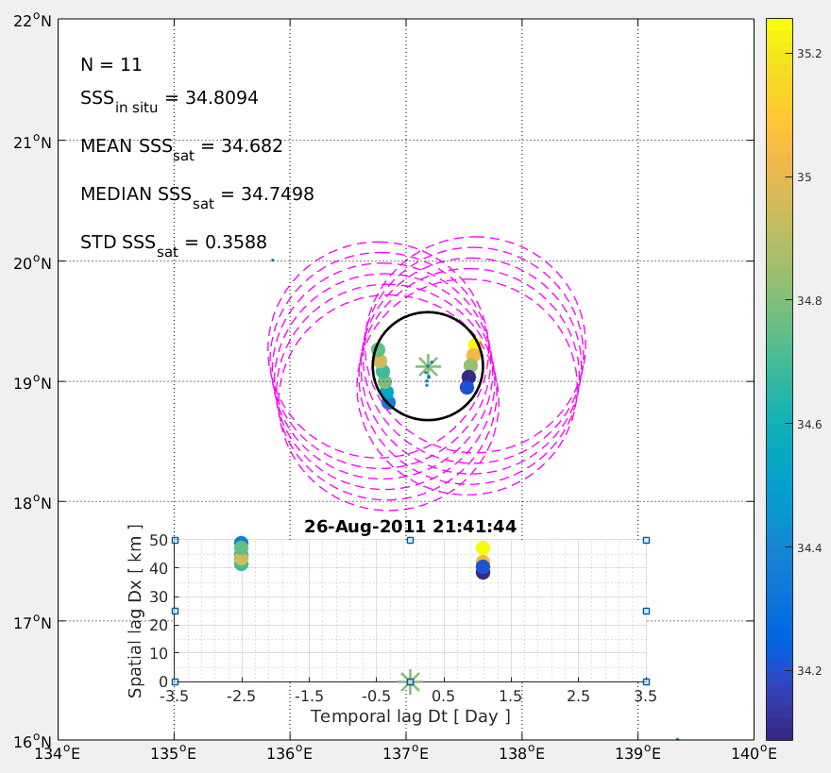
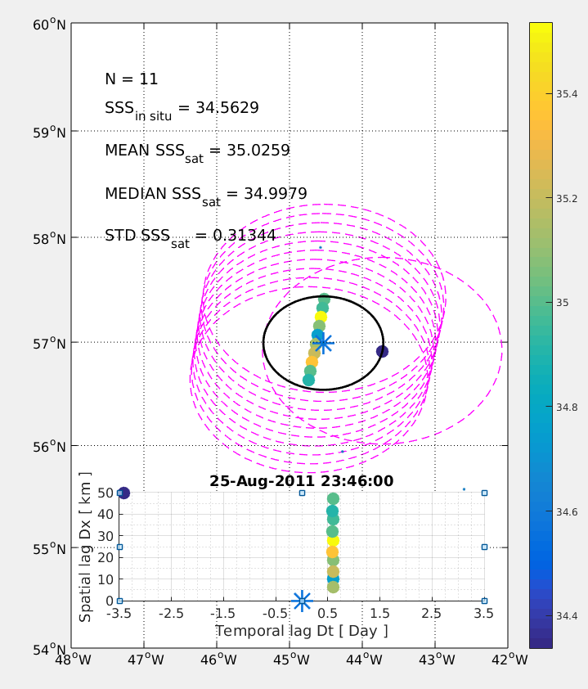
L2-averaged examples using L2 Aquarius at different latitudes
19°N
Argo
57°N
Latitude
R
Satellite
Satellite
Footprint
R=50 km
7 Days
Longitude
Argo

Slide 10
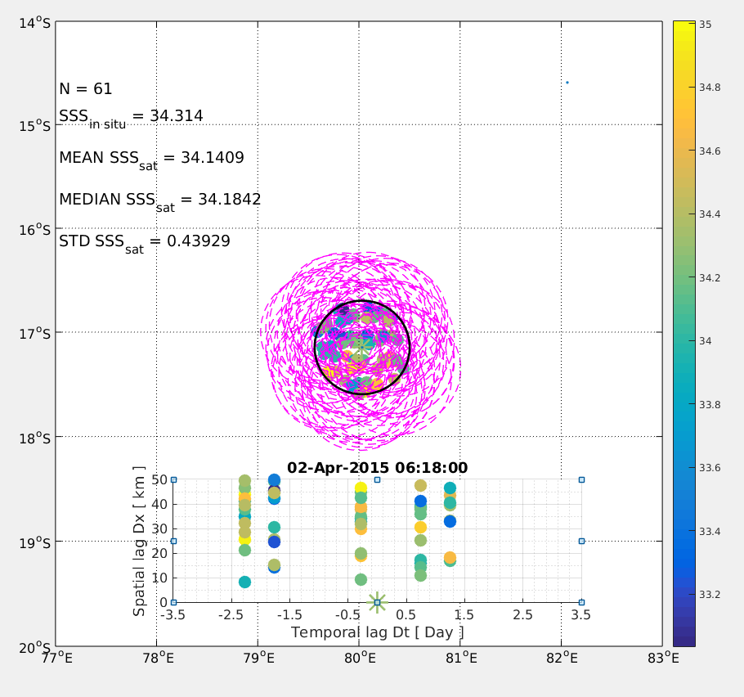
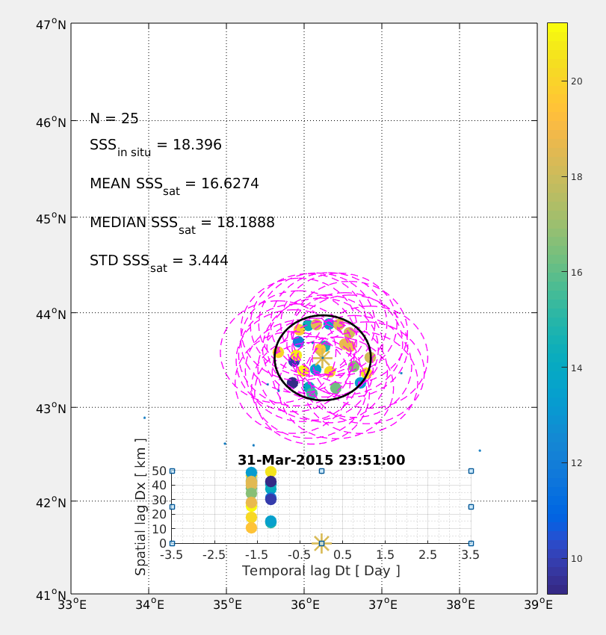
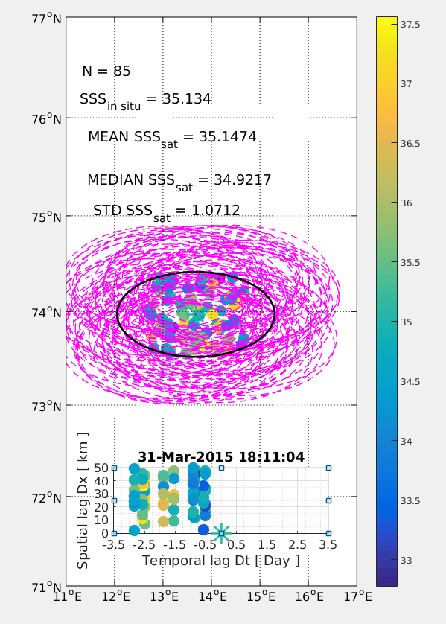
L2-averaged examples using L2 SMAP (JPL)
74°N
17°S
43°N
Latitude
Longitude

Slide 11
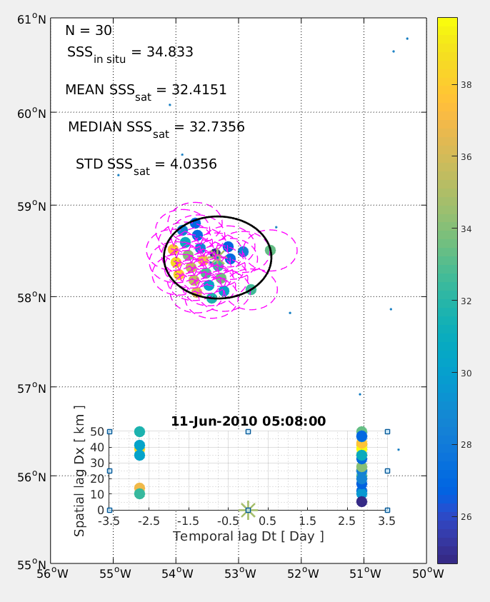
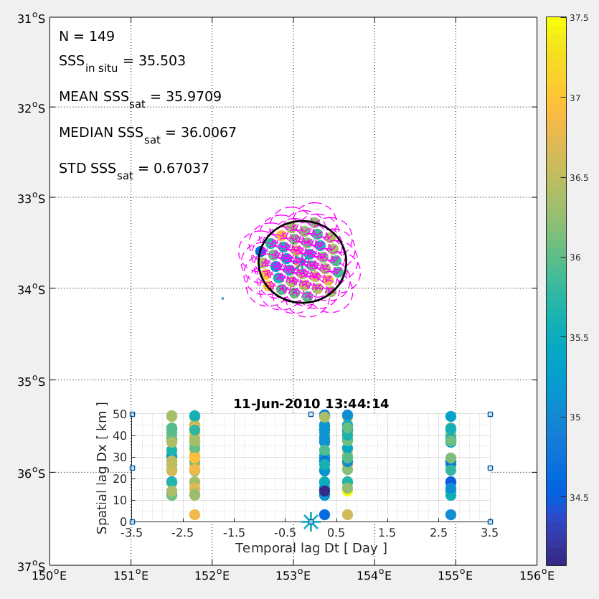
L2-averaged examples using L2 SMOS
58°N
33°S

Slide 12
References
Vinogradova, N. T., Ponte, R. M., Fukumori, I., and Wang, O., Estimating satellite salinity errors for assimilation of Aquarius and SMOS data into climate models, J. Geophys. Res. Oceans, 2014, 119, 4732– 4744, doi:10.1002/2014JC009906.
Bingham, F.M. Subfootprint Variability of Sea Surface Salinity Observed during the SPURS-1 and SPURS-2 Field Campaigns. Remote Sens. 2019, 11, 2689. https://doi.org/10.3390/rs11222689
Julian J Schanze; David M Le Vine; Emmanuel P Dinnat; Hsun-Ying Kao, Comparing Satellite Salinity Retrievals with In Situ Measurements: A Recommendation for Aquarius and SMAP, 2020. 10.5281/zenodo.4769713
Bingham FM, Fournier S, Brodnitz S, Ulfsax K, Zhang H. Matchup Characteristics of Sea Surface Salinity Using a High-Resolution Ocean Model. Remote Sensing. 2021; 13(15):2995. https://doi.org/10.3390/rs13152995
Thouvenin-Masson Clovis, Boutin Jacqueline, Vergely Jean-Luc, Reverdin Gilles, Martin Adrien C.H., Guimbard Sebastien, Reul Nicolas, Sabia Roberto, Catany Rafael, Hembise Fanton-D’andon Odile (2022). Satellite and In Situ Sampling Mismatches: Consequences for the Estimation of Satellite Sea Surface Salinity Uncertainties . Remote Sensing , 14(8), 1878 (21p.) . https://doi.org/10.3390/rs14081878
Fournier, S.; Bingham, F.M.; González-Haro, C.; Hayashi, A.; Ulfsax Carlin, K.M.; Brodnitz, S.K.; González-Gambau, V.; Kuusela, M. Quantification of Aquarius, SMAP, SMOS and Argo-Based Gridded Sea Surface Salinity Product Sampling Errors. Remote Sens. 2023, 15, 422. https://doi.org/10.3390/rs15020422
Westbrook, E.E.;Bingham, F.M.; Fournier, S.;Hayashi, A. Matchup Strategies for Satellite Sea Surface Salinity Validation. Remote Sens. 2023, 15, 1242. https://doi.org/10.3390/rs15051242
https://salinity.oceansciences.org/docs/Kao_matchup_method_2020.pdf

