Slide 1
Sea Surface Salinity (SSS) comparisons
Moorings vs Satellite
Sébastien Guimbard, OceanScope
we present some comparisons of mooring SSS time series with CCI-L4-ESA-MERGED-OI-v1.8-7dr satellite product
In Pi-MEP , we identify some « suspicious » mooring signals shown in the following slides and we decide to filter them
Only mooring data with Flag <=3 are shown.
ftp://ftp.pmel.noaa.gov/cdf/fields/TAO_TRITON/s_xyzt_dy.cdf
ftp://ftp.pmel.noaa.gov/cdf/fields/PIRATA/s_xyzt_dy.cdf
ftp://ftp.pmel.noaa.gov/cdf/fields/RAMA/s_xyzt_dy.cdf
Notes:
Quality indices and sensor drift
Instrumentation recovered in working condition is returned to PMEL for post-deployment calibration before being reused on future deployments. After post-deployment calibrations are made, the resultant coefficients are compared to the pre-deployment coefficients. A set of output values are computed by application of the calibration equation using pre-deployment coefficients to a set of input values. Input values are chosen so that the output values would range over normal environmental conditions. A second set of output values are generated by application of the calibration equation using post-deployment coefficients to the same set of input values. Sensor drift is calculated by subtracting the first set of output values from the second set of output values. The sensors are then assigned quality indices based on drift using the following criteria:
0 - Datum Missing.
1 - Highest Quality. Pre/post-deployment calibrations agree to within sensor specifications. In most cases, only pre-deployment calibrations have been applied.
2 - Default Quality. Default value for sensors presently deployed and for sensors which were either not recovered, not calibratable when recovered, or for which pre-deployment calibrations have been determined to be invalid. In most cases, only pre-deployment calibrations have been applied.
3 - Adjusted Data. Pre/post calibrations differ, or original data do not agree with other data sources (e.g., other in situ data or climatology), or original data are noisy. Data have been adjusted in an attempt to reduce the error.
4 - Lower Quality. Pre/post calibrations differ, or data do not agree with other data sources (e.g., other in situ data or climatology), or data are noisy. Data could not be confidently adjusted to correct for error.
5 - Sensor or Tube Failed.
When a recovered sensor meets the criteria for nominal drift, the quality index is changed from the default value of "2" to "1" for highest quality data.. When it does not meet the criteria for sensor drift, the index becomes "4". If an adjustment based on post-deployment calibrations or other information is later made, the index may then be set to "3" or "1". When damage or loss of an instrument due to vandalism, harsh environmental conditions, electronics failures, or loss of a mooring prevents post-deployment calibration, a default quality of "2" is assigned to the data.

Slide 2
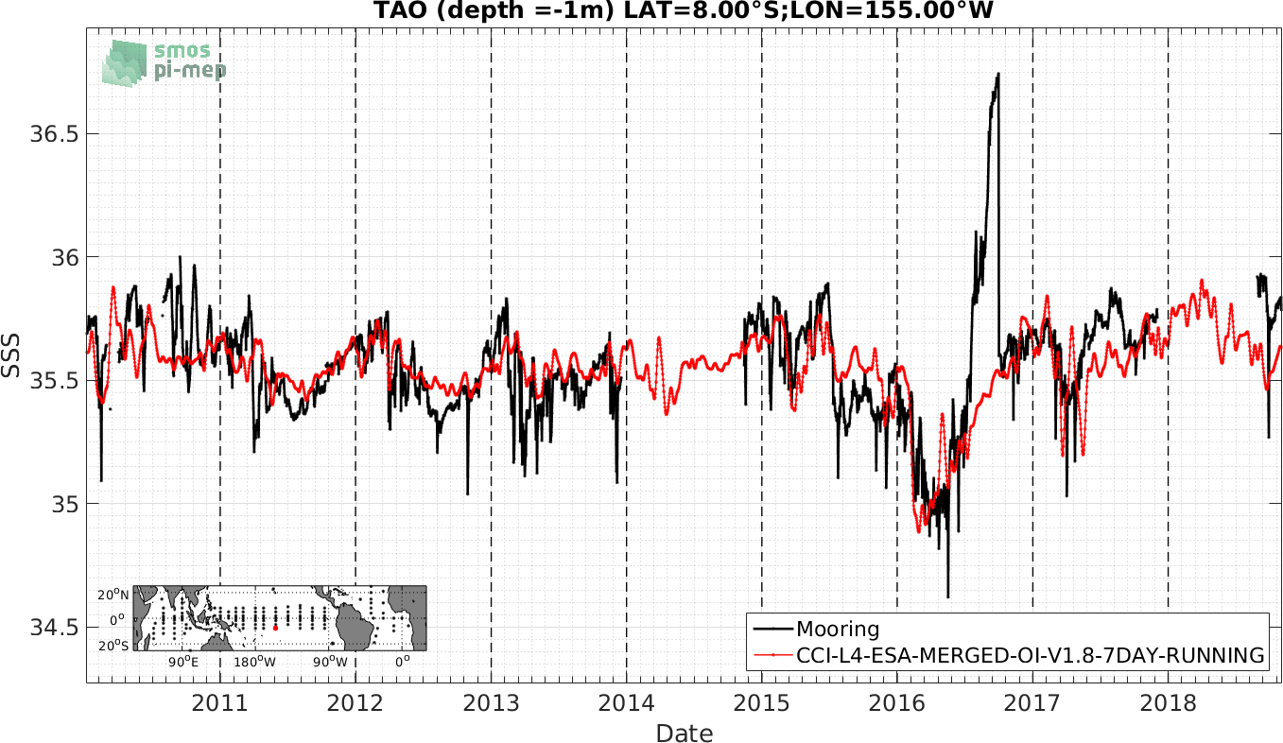
HIGH SALTY SIGNAL : IS IT REAL ? SIMILAR SIGNAL AT 180W-2S, 180W-0N, 180W-5N, not seen in all satellite products

Slide 3
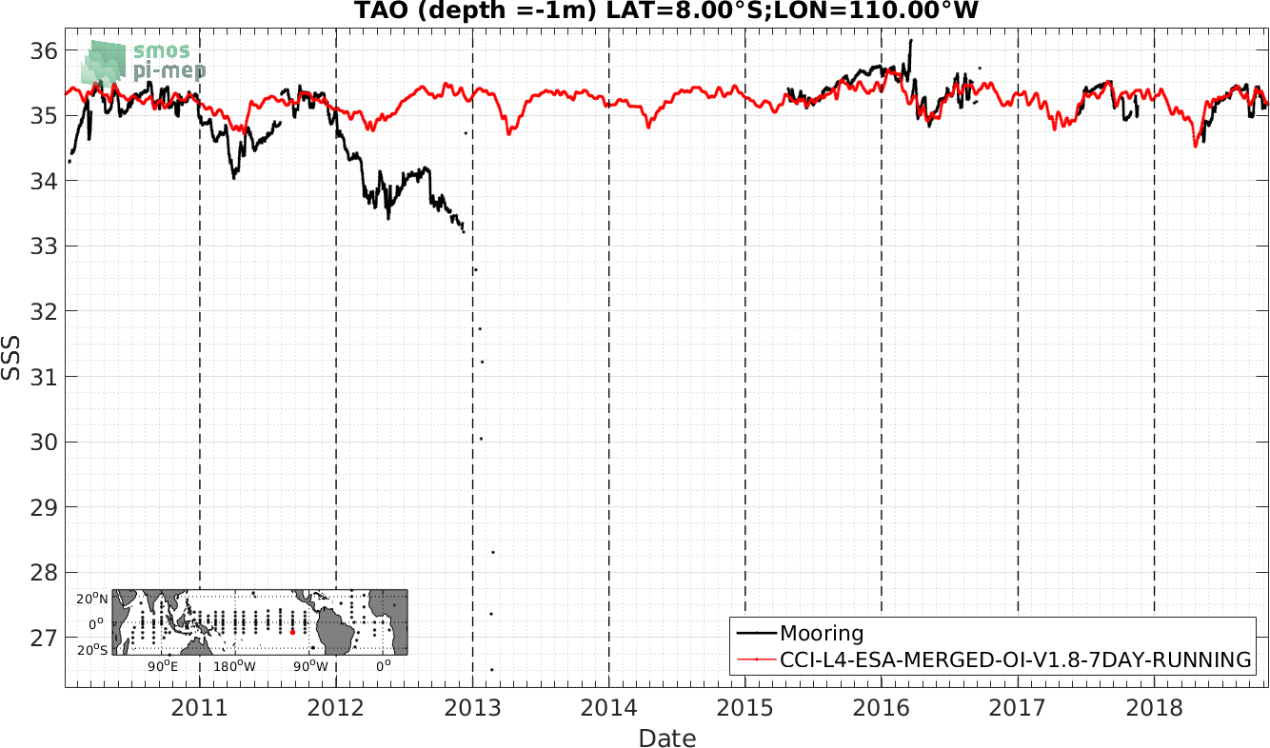
DRIFT

Slide 4
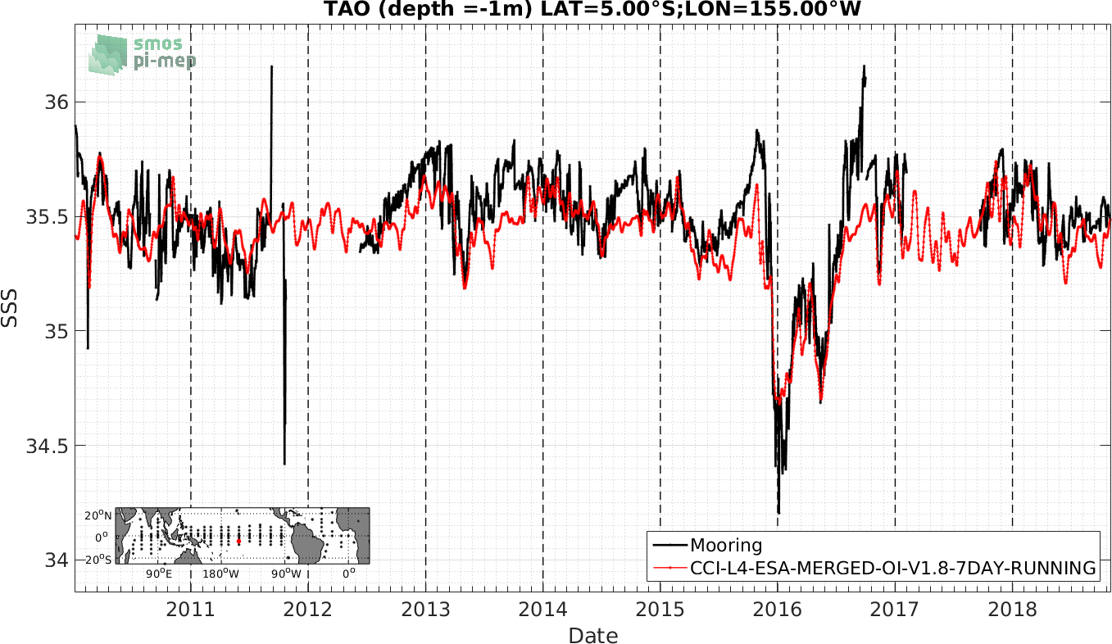
HIGH SALTY SIGNALS

Slide 5
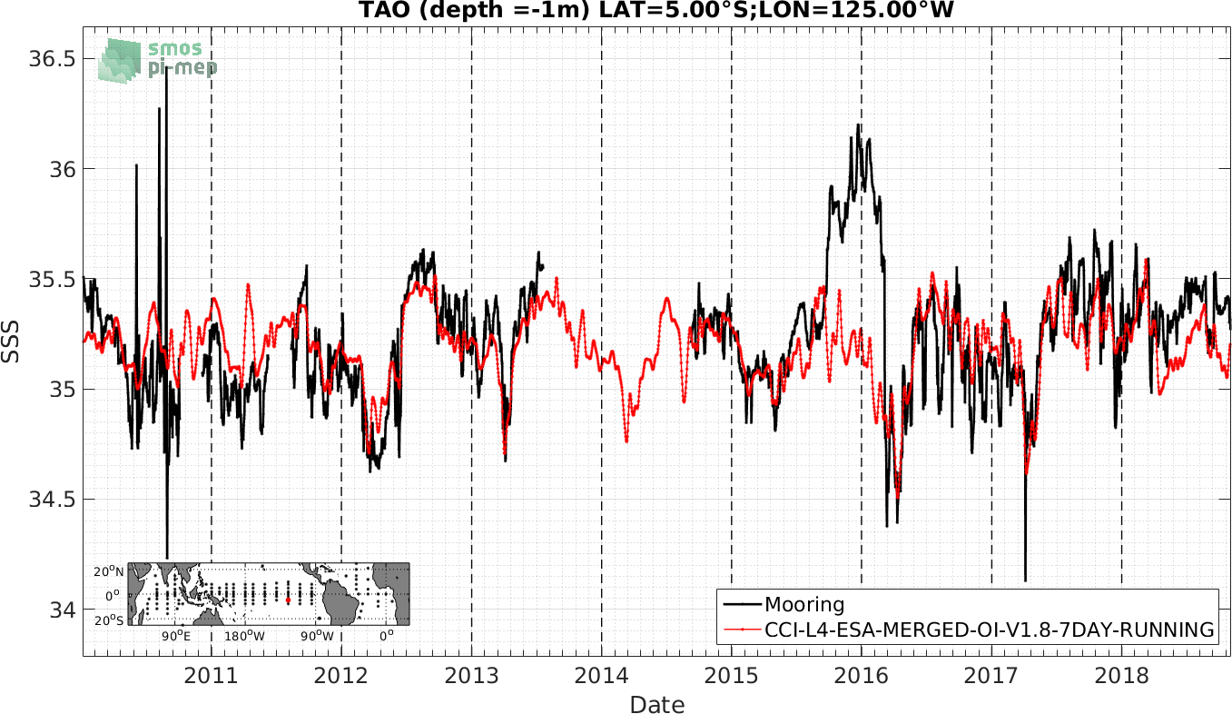
HIGH SALTY SIGNALS

Slide 6
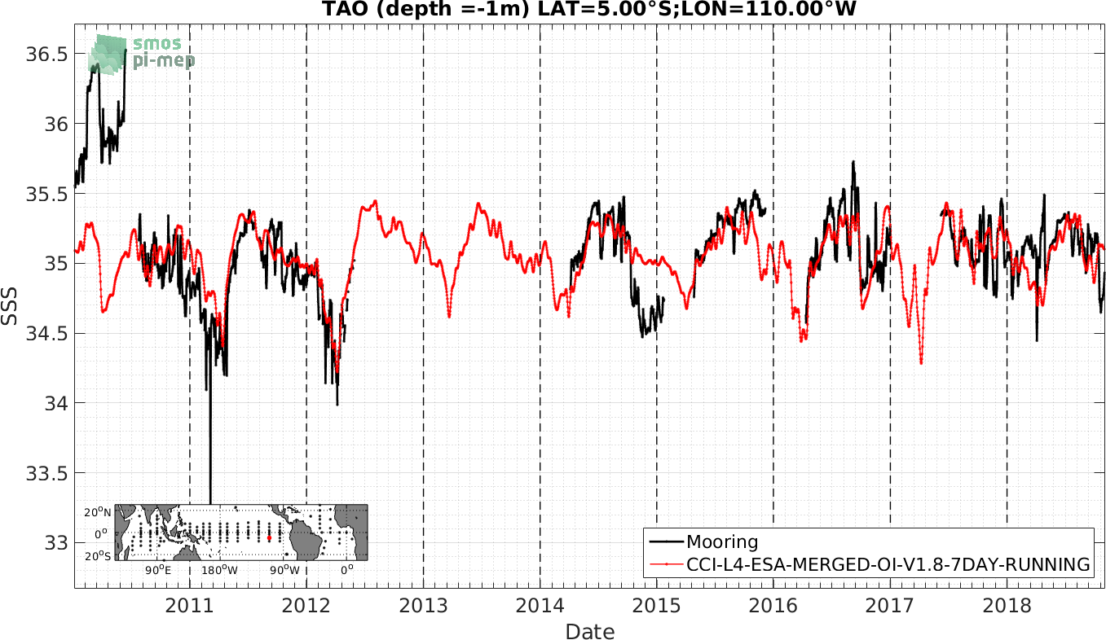
DRIFT

Slide 7
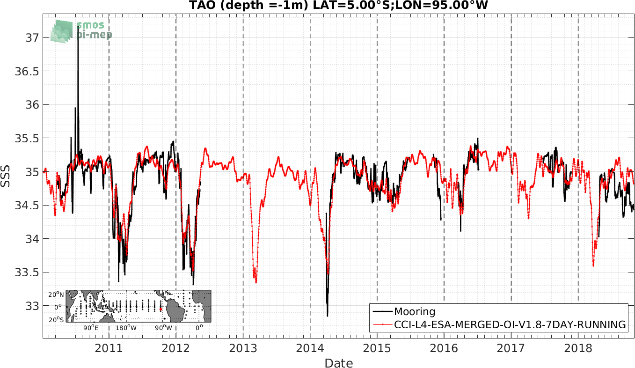
HIGH SALTY SIGNAL

Slide 8
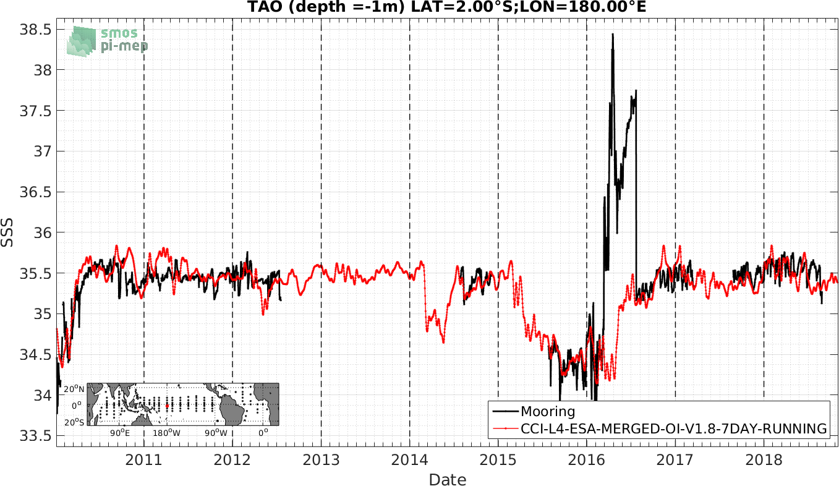
VERY HIGH SALTY SIGNALS

Slide 9
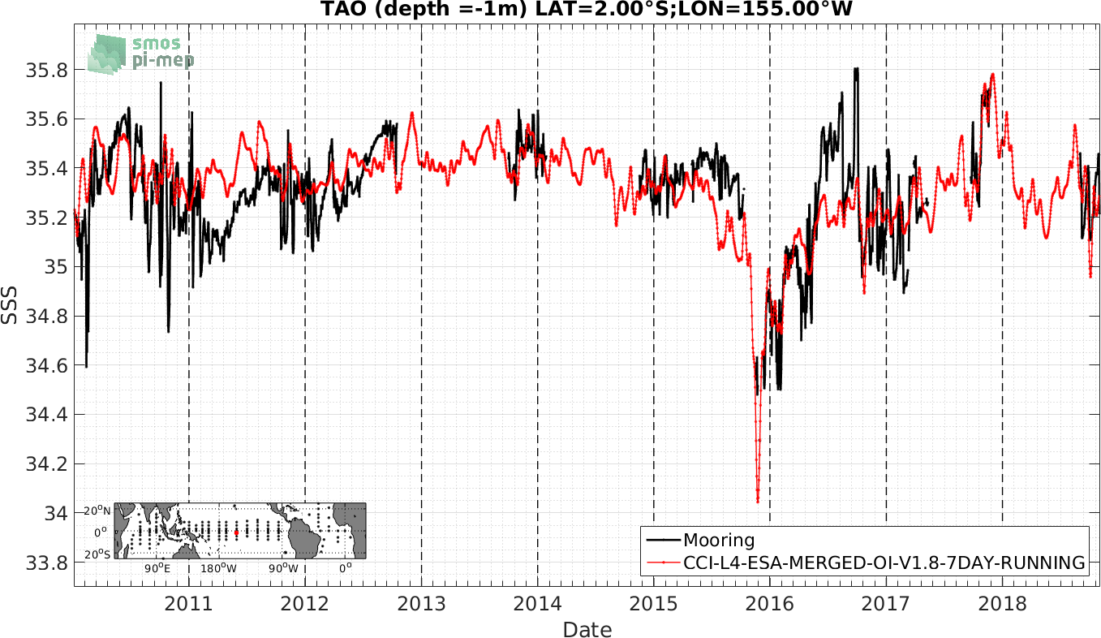
HIGH SALTY SIGNALS

Slide 10
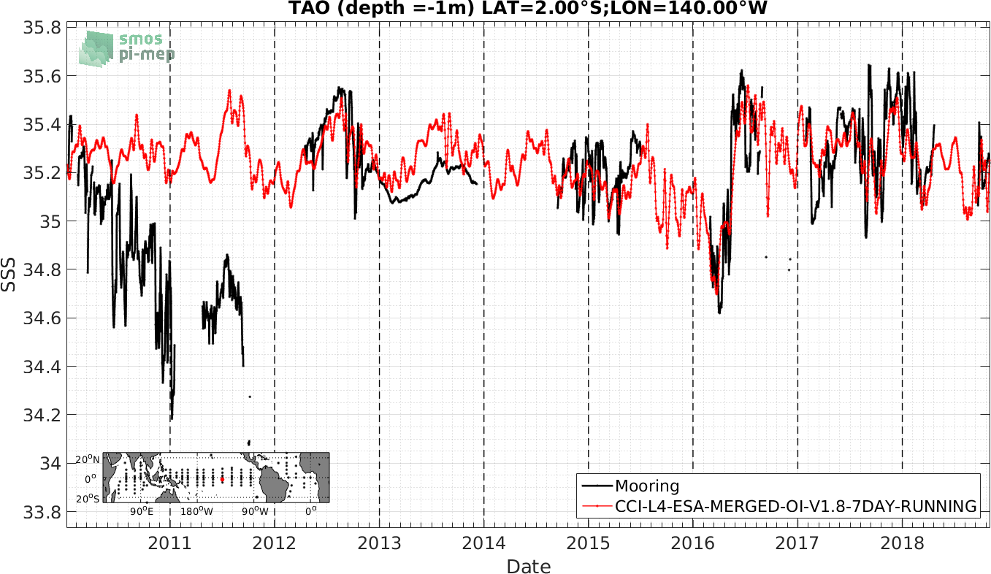
DRIFT

Slide 11
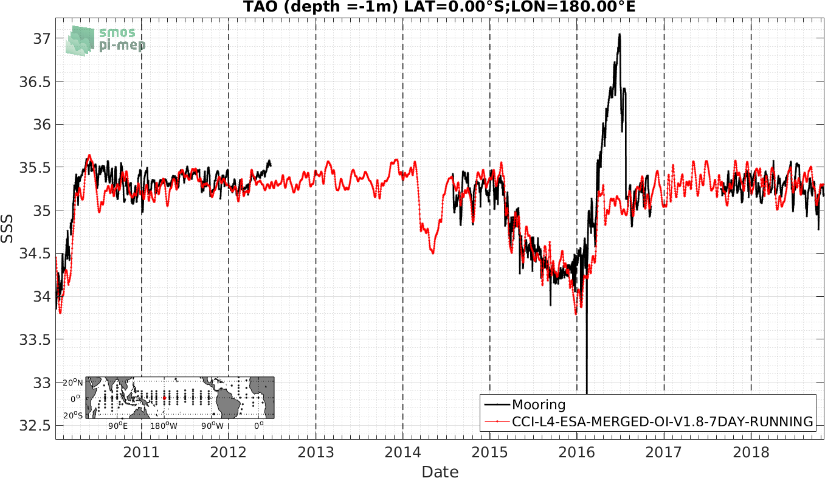
VERY HIGH SALTY SIGNALS

Slide 12
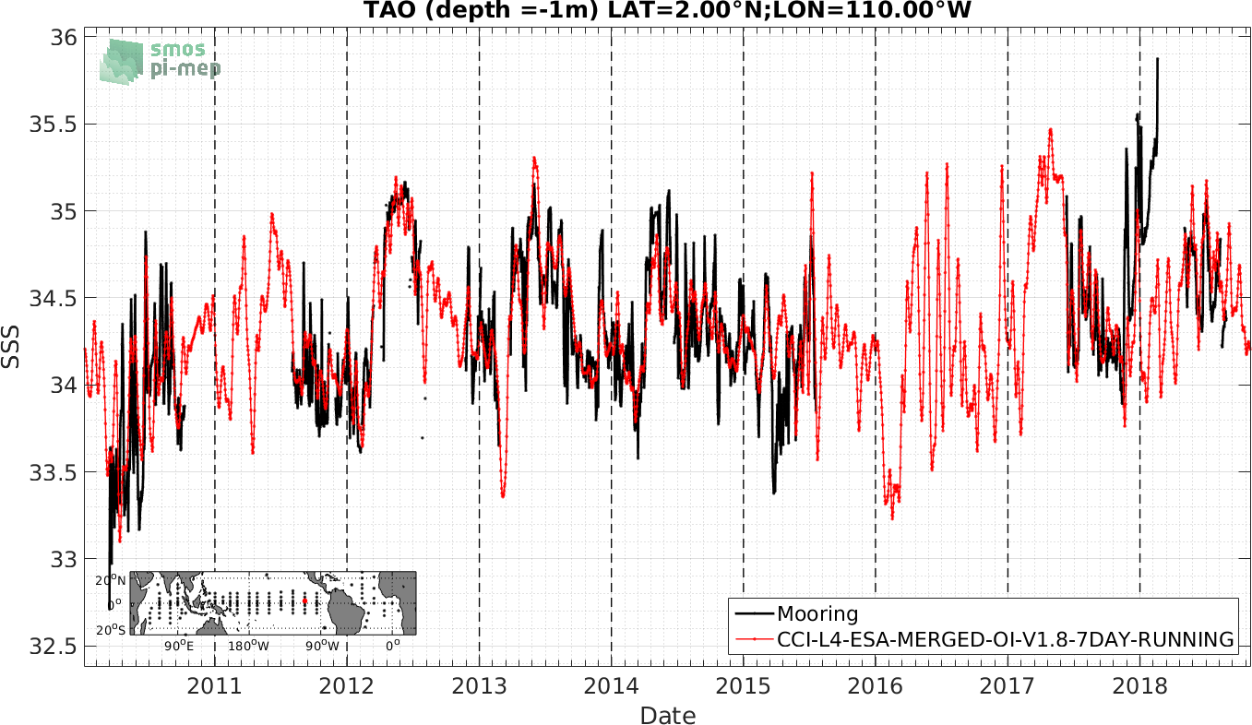
DRIFT

Slide 13
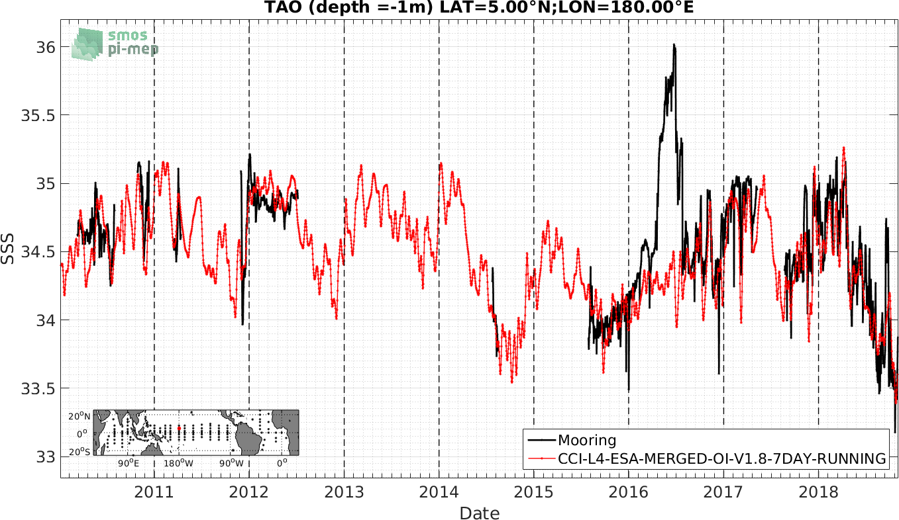
VERY HIGH SALTY SIGNALS

Slide 14
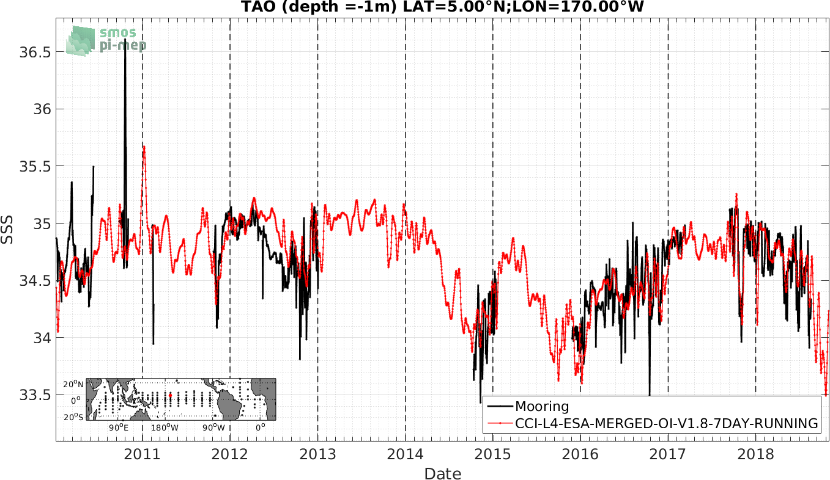
VERY HIGH SALTY SIGNALS

Slide 15
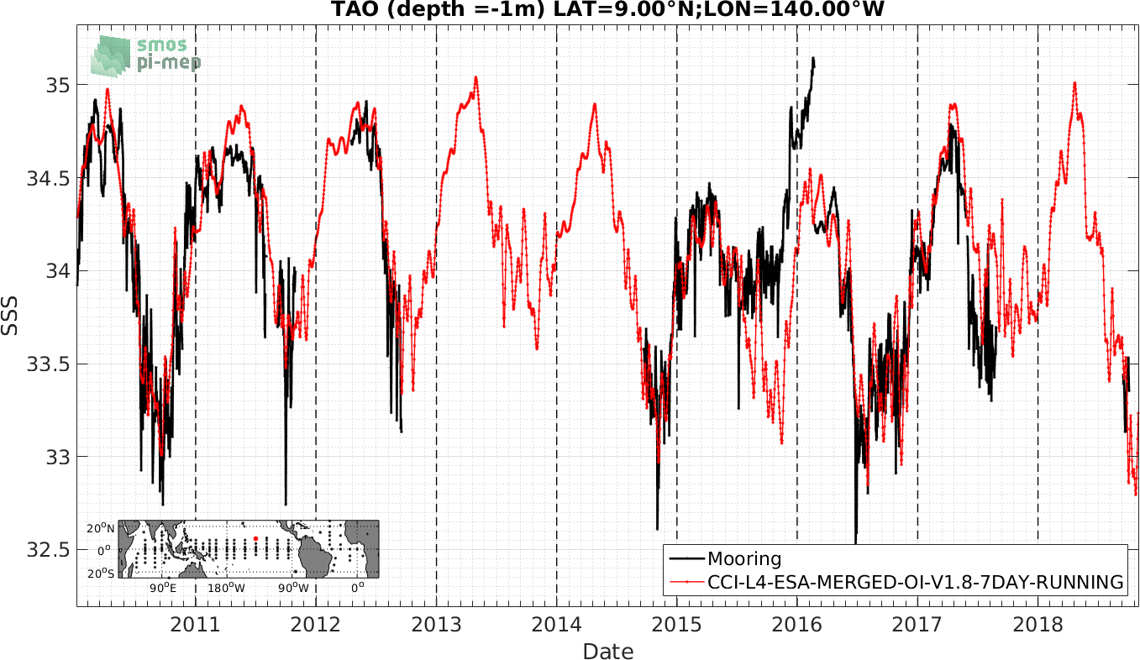
DRIFT

Slide 16
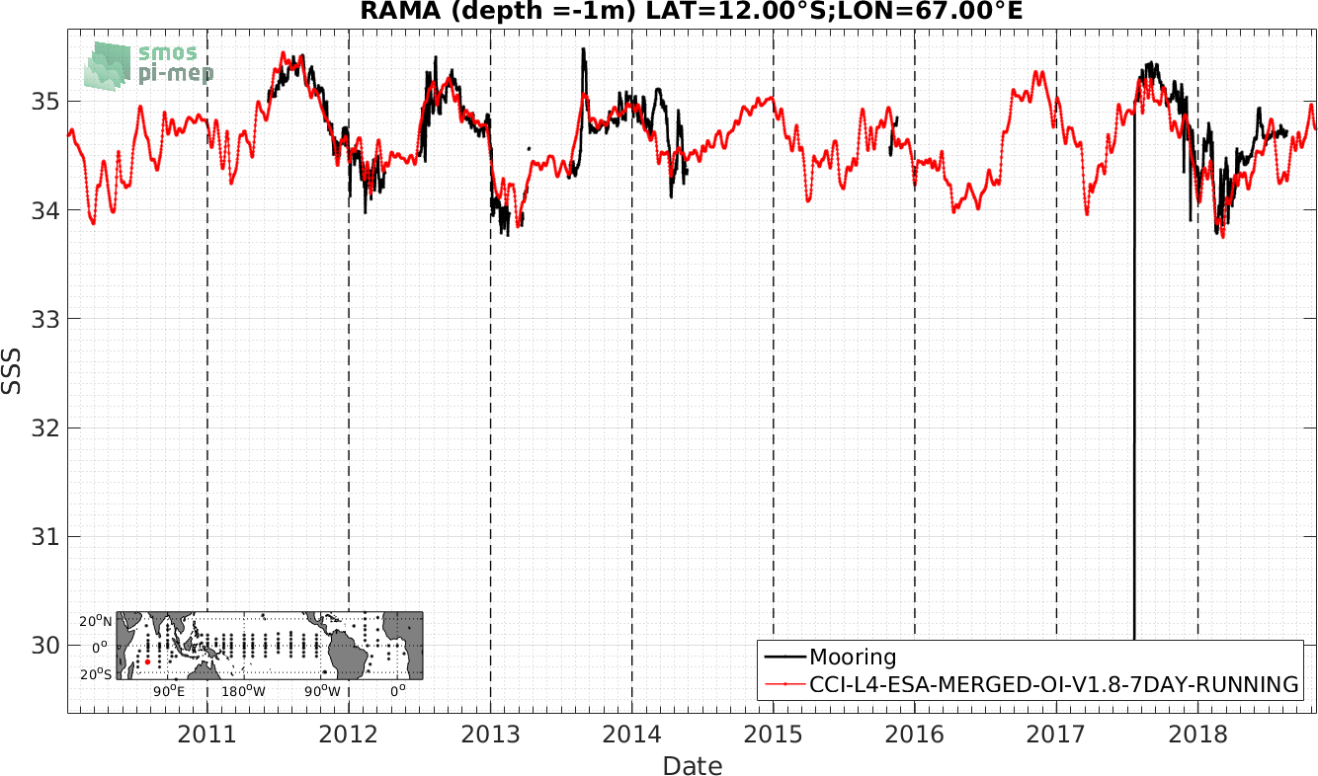
Fresh point not presents in the Hi-res (1hour) data

Slide 17
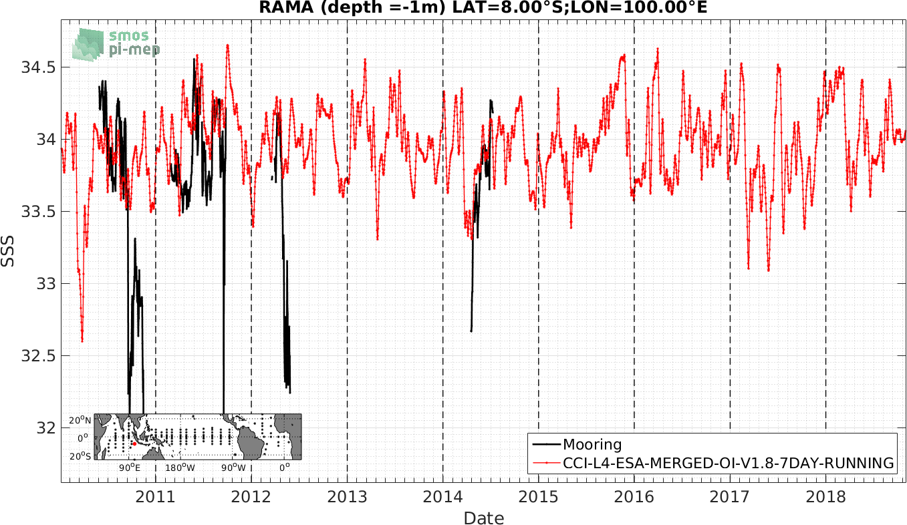
DRIFT

Slide 18
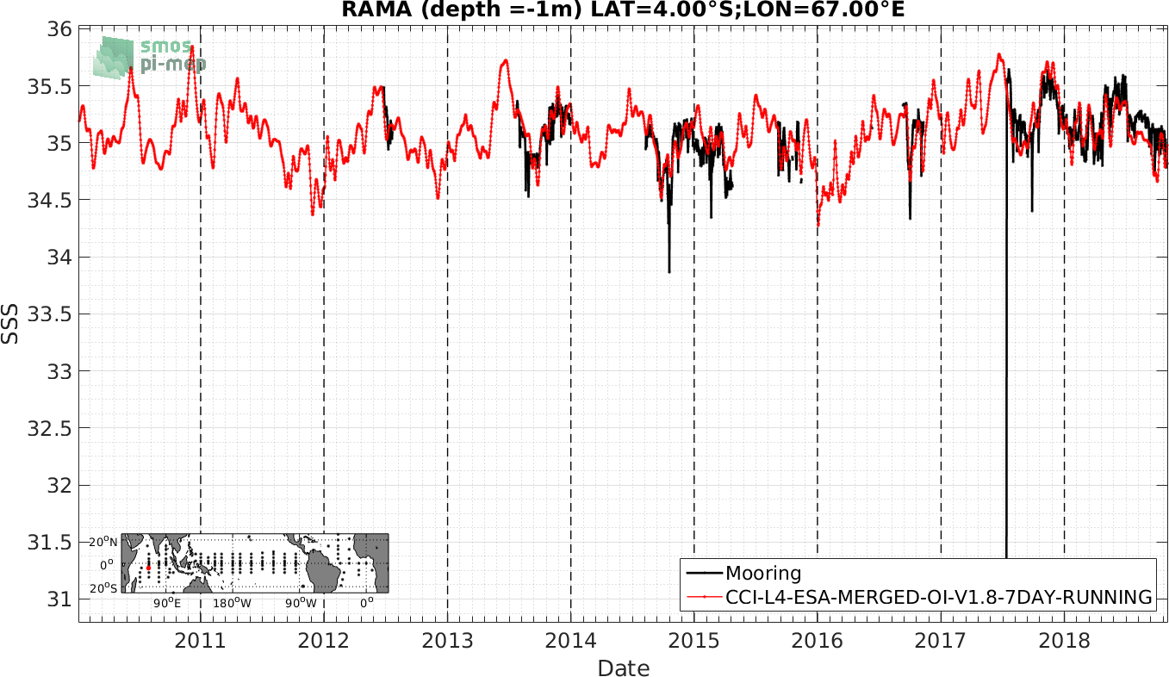
Fresh point not present in the Hi-res (1hour) data

Slide 19
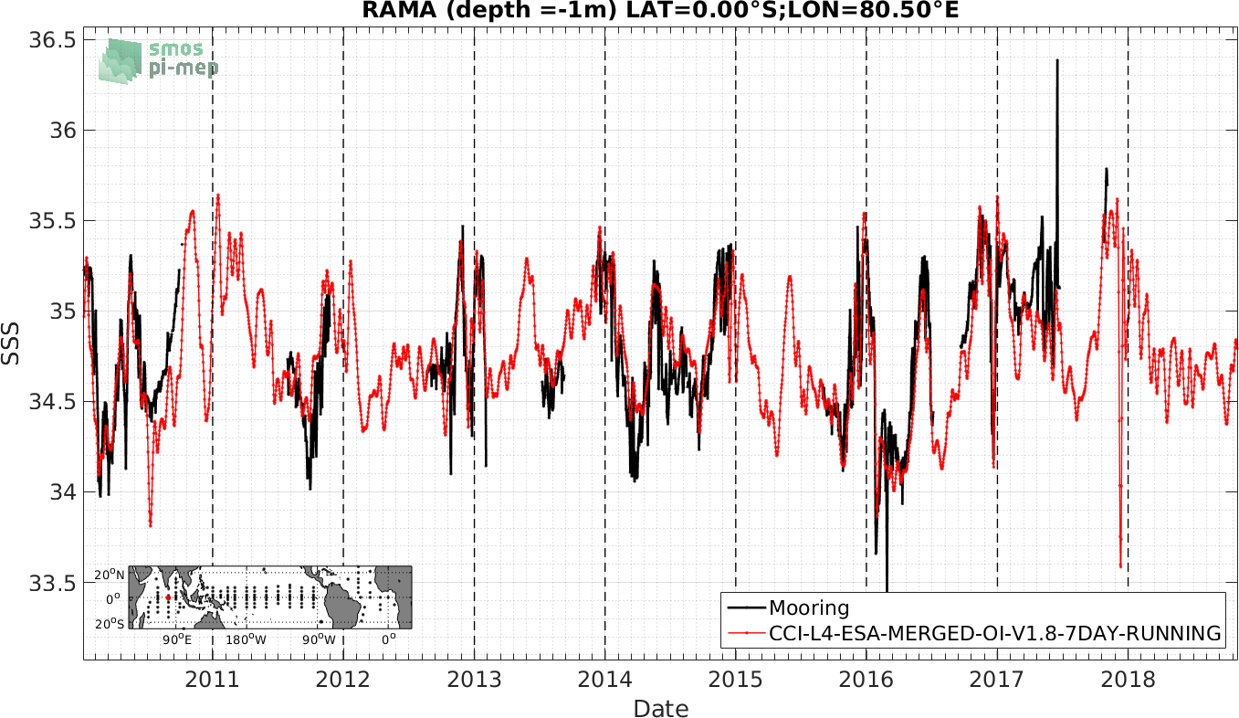
DRIFT

Slide 20
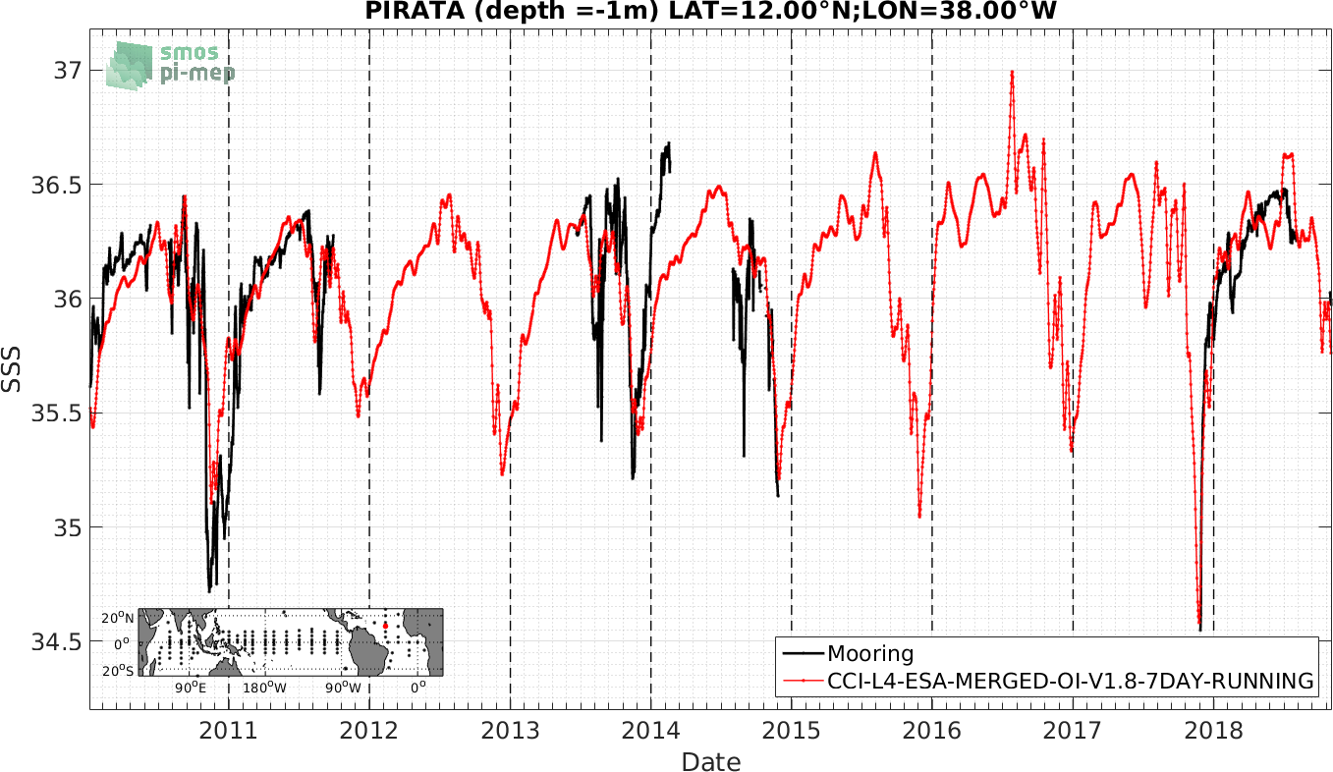
DRIFT

Slide 21
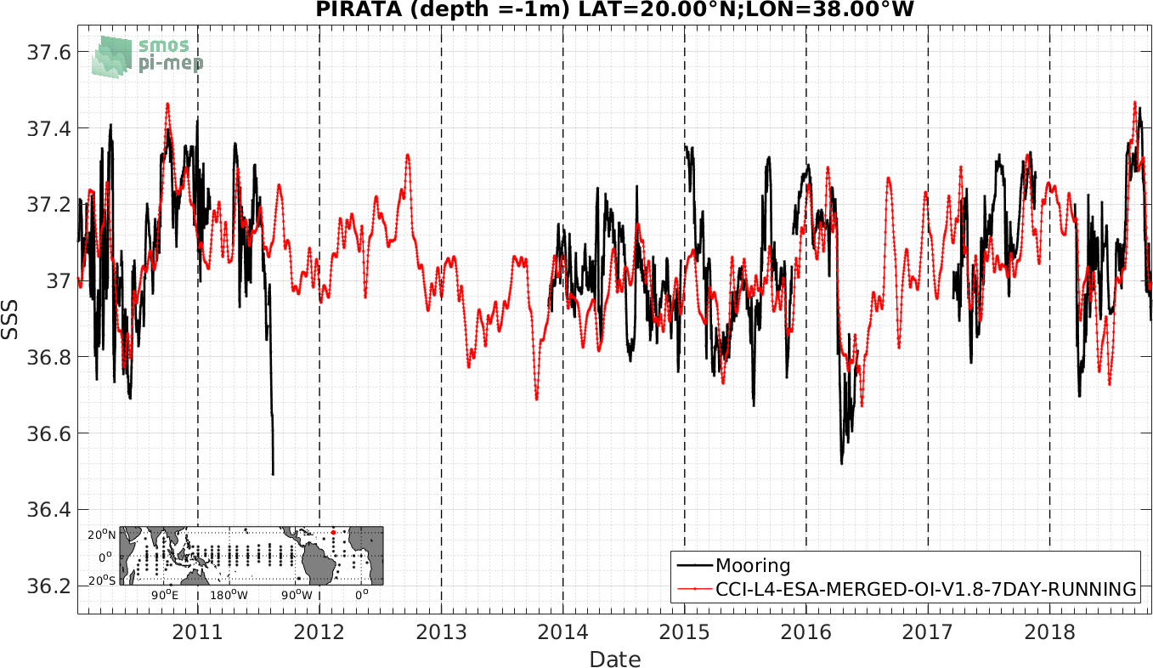
DRIFT

