Slide 1


Roadmap for the
« SMOS Pilot-Mission Exploitation Platform (Pi-MEP) »
Nicolas Reul
SMOS SAG CM2-24 May 2018

Slide 2
Towards the Pre-Operational Platform
Two phases
Test Platform
  Collect and read data
  Produce match-ups and validation metrics
  Provide user-friendly visualization
Pre-operational platform
  Provide enhanced validation metrics
  On-demand plots
  On-demand extractions
  On-demand custom process

Slide 3
Next steps: Enhanced Validation Metrics & Analyses
Systematic processings (next steps) :
Comparative Validation Reports
Systematic comparisons between products
=> plots, files & reports
Temporal Spectra :
Systematic temporal Spectra for all products at moorings
Plots and files
Spatial Spectra
Systematic spatial spectra in some locations
Plots and files
Case Studies:
Deepened analyses :
Hovmueller, etc..
Specific analyses for each case study

Slide 4
Next steps: Enhanced Validation Metrics: Comparisons
The primary objective of these satellite SSS intercomparisons is to be able to rank which product is the “best” regarding different statistical metrics (mean of the difference between satellite SSS and in-situ SSS (MEAN), the standard deviation (STD) of the difference, the root mean square (RMS) of the difference and the interquartile range (IQR) of the difference).
The platform will provide summary tables with all the results of the MDB analyses for each of the SMOS Pi-MEP regions and some summary plots (Mean, STD, RMS, IQR) regrouping a selection of 3 or more of the best ranked satellite products:
as a function of time,
as a function of latitude,
as a function of geophysical conditions (low, moderate and high wind speed, low and high rain rate, cold and moderate sea surface temperature)
as a function of the distance to the coast
In addition, using as input the temporal and spatial spectral analysis NetCDF files determined for each core satellite SSS product, temporal and spatial power spectrum plots will be generated to enhance the spectral content differences between the different satellite SSS products.

Slide 5
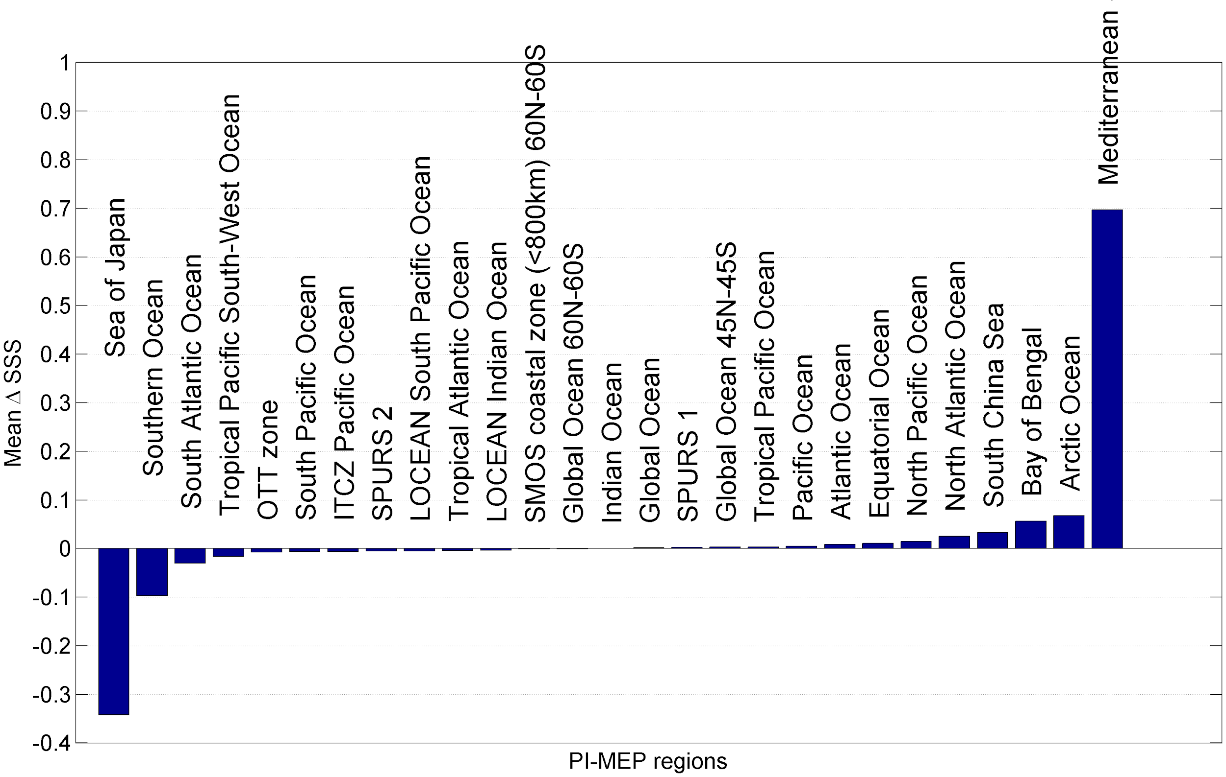
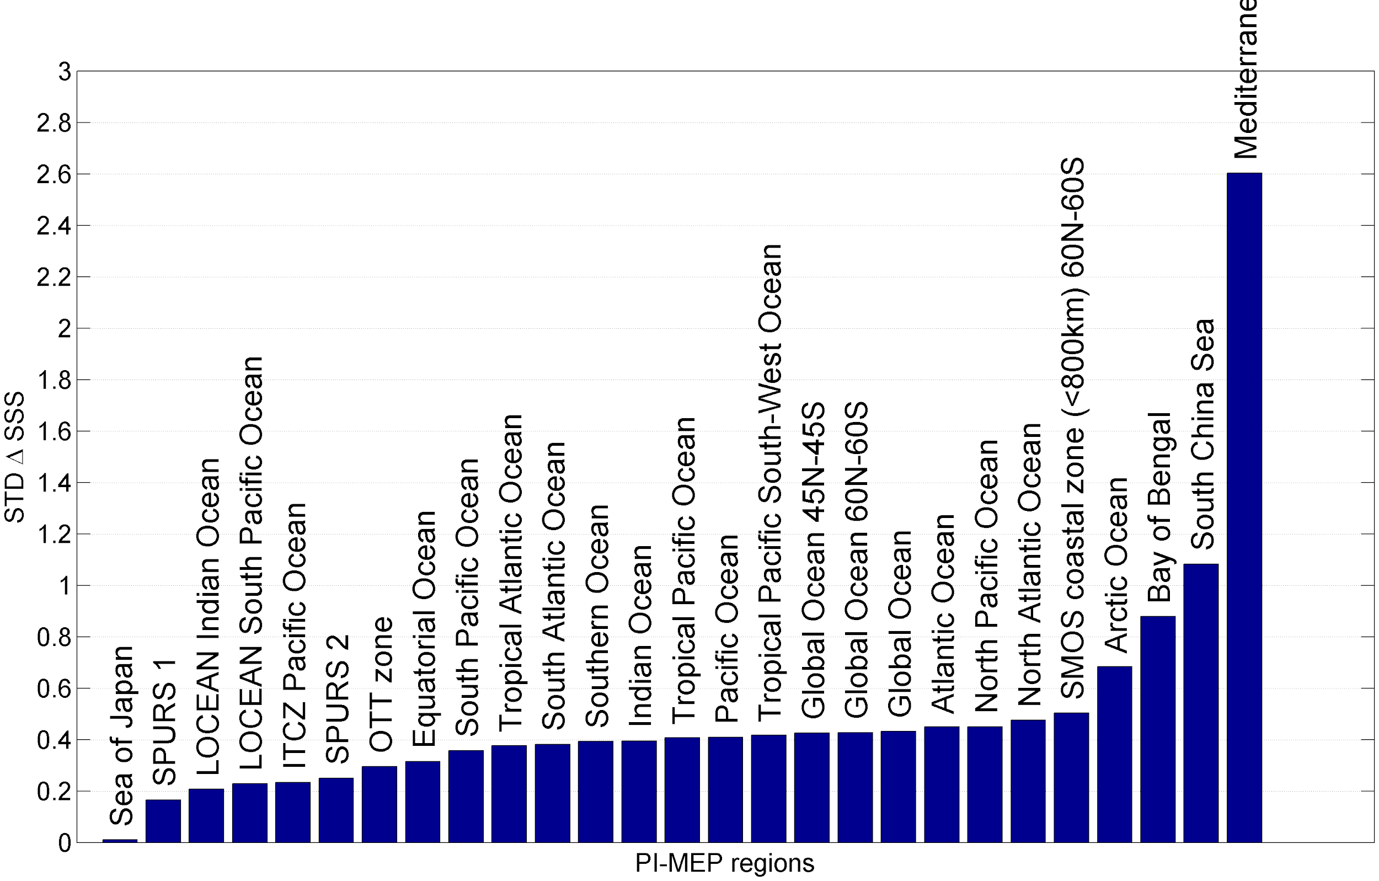
Next steps: Enhanced Validation Metrics: Comparisons
Examples of the statistics summary for the ∆SSS between SMOS L4 SSS CEC weekly 0.5° x0.5° resolution and ARGO per Pi-MEP region. Std deviation (top) and mean (bottom) ∆SSS (SMOS-ARGO) values are sorted by region from lowest std or mean to highest values.

Slide 6
Next steps: Enhanced Validation Metrics: Comparisons
Evaluation of cross-correlation between satellite SSS product and other EO datasets
To investigate the coherency between Satellite SSS and other datasets, the platform will
evaluate 2D and/or temporal cross-correlation coefficients between the satellite SSS
products and potentially:
SST
Sea level anomalies from altimetry
Wind and wave parameters
Precipitation/Evaporation
Ocean Color properties (chlorophyll-A, CDOM)
For each Pi-MEP validation region, the platform will provide, when it is physically relevant, correlation maps showing the correlation coefficient using simple linear regression between the two variables over time within each grid cell.
Plots of cross-correlation over time will also be generated after spatially averaging the two variables in each region.

Slide 7
Next steps: Spectral Analyses
Two types of spectral analyses:
Temporal spectral analyses
Spatial spectral analyses

Slide 8
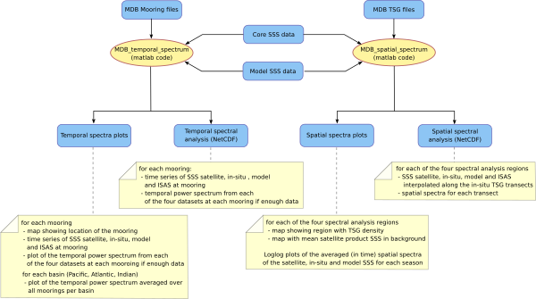
Next steps: Spectral Analyses
Sketch of the architecture of the spectral analyses processing

Slide 9
Next steps: Temporal Spectral Analyses at moorings
TAO/PIRATA/RAMA mooring array (black dots):
115 moorings within the array

Slide 10
Next steps: Temporal Spectral Analyses at moorings

Slide 11
Next steps: Temporal Spectral Analyses at moorings
Using the mooring MDB time series as input, the code will generate for each mooring:
A plot of a map showing the location of the mooring considered (indicated by a green dot and included in the title as lon/lat coordinates),
A time series plot of the co-localized satellite SSS data, mooring SSS, model SSS and ISAS field interpolated at the mooring location
if the mooring time series is long enough (some moorings have little valid data), the platform will generate a temporal power spectrum of the mooring SSS, Satellite SSS model SSS (hycom, CMEMS) and ISAS time series
An average of the power spectra over all moorings from the same basin (TAO, Pirata, Rama)

Slide 12
Next steps: Spatial Spectral Analyses in Each PiMep Regions
The first outputs of spatial spectrum analysis will be for each Pi-MEP validation region :
-A plot of the PSD of the satellite SSS product together with the PSD from ISAS and from an ocean model (MERCATOR or HYCOM), for each direction (zonal and meridional)
-A NetCDF file of the PSD for each of the core satellite SSS products together with the PSD from ISAS data and from an ocean model, for each direction (zonal and meridional)

Slide 13
Next steps: Spatial Spectral Analyses: sat SSS versus TSG

Slide 14
Next steps: Spatial Spectral Analyses: sat SSS versus TSG

Slide 15
Next steps: Spatial Spectral Analyses: sat SSS versus TSG

Slide 19
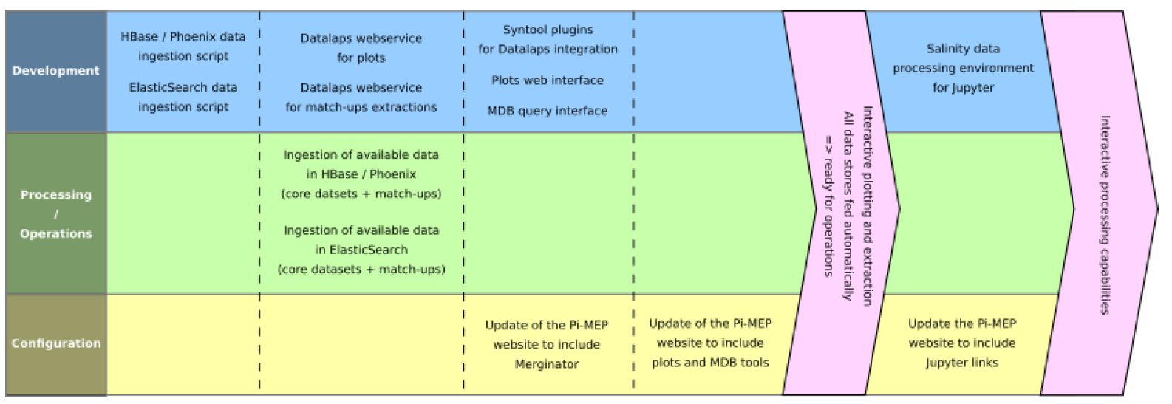
Next steps: web services

Slide 20
Next steps: Data visualization & extraction
Two tools: Datalaps and Merginator
Merginator :
Datasets displayed side-by-side
Easier to compare several global products
Datalaps
Time Series visualization
MDB extraction

Slide 21
Next steps: User Generated Results
Objectives
Comparing products using plots
Extracting results from the MDBs (Match-up DataBases)
Generating custom reports (areas, filters)
Processing data remotely

Slide 22
Next steps: User Generated Results
Comparing products using plots
One interface with 5 types
of plots :
Time series
Scatterplots
Histograms
Hovmöller diagrams
Maps

Slide 23
Next steps: User Generated Results
Extracting results from the MDBs (Match-up DataBases)
One interface to query MDB data and :
Extract match-ups (CSV, JSON or NetCDF)
Generate plots for match-up metrics
Produce custom PDF reports
Many controls to tune data filters

Slide 24
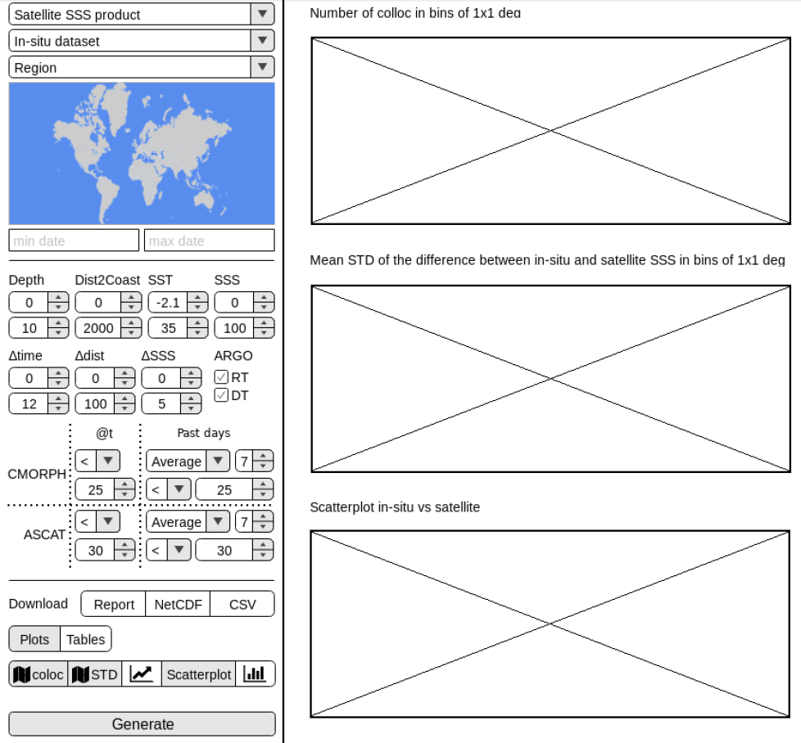
Next steps: User Generated Results
Extracting results from the MDBs (Match-up DataBases)

Slide 25
Next steps: User Generated Results
Custom Validation Algorithm
Jupyter notebook
Basically a Python console in a webpage:
Code executed on the platform (direct access to data)
Results displayed in the web browser
Python environment pre-installed
Authenticated/Trusted users only

Slide 26
