Slide 1


« SMOS Pilot-Mission Exploitation Platform (Pi-MEP) »
Oceanographic Case Study
Nicolas Reul
SMOS SAG CM2-24 May 2018

Slide 2
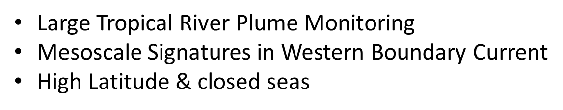
Pi-MEP’s Oceanographic Case studies status
Currently 3 main case study are monitored by the platform:
Literature Review & specific MDB files and reports
Demonstrator for Datalaps Time series
Case studies in the pre-operational platform

Slide 3
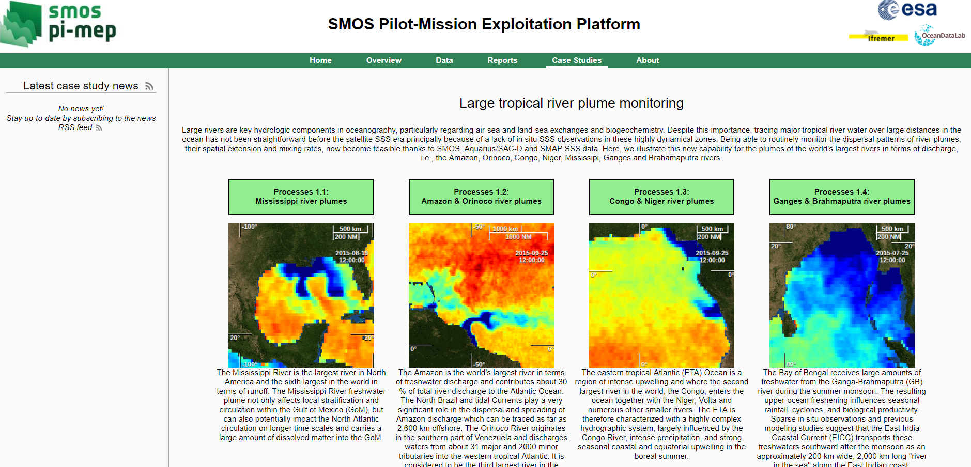
Ex: Large tropical river plume monitoring case study webpage

Slide 4
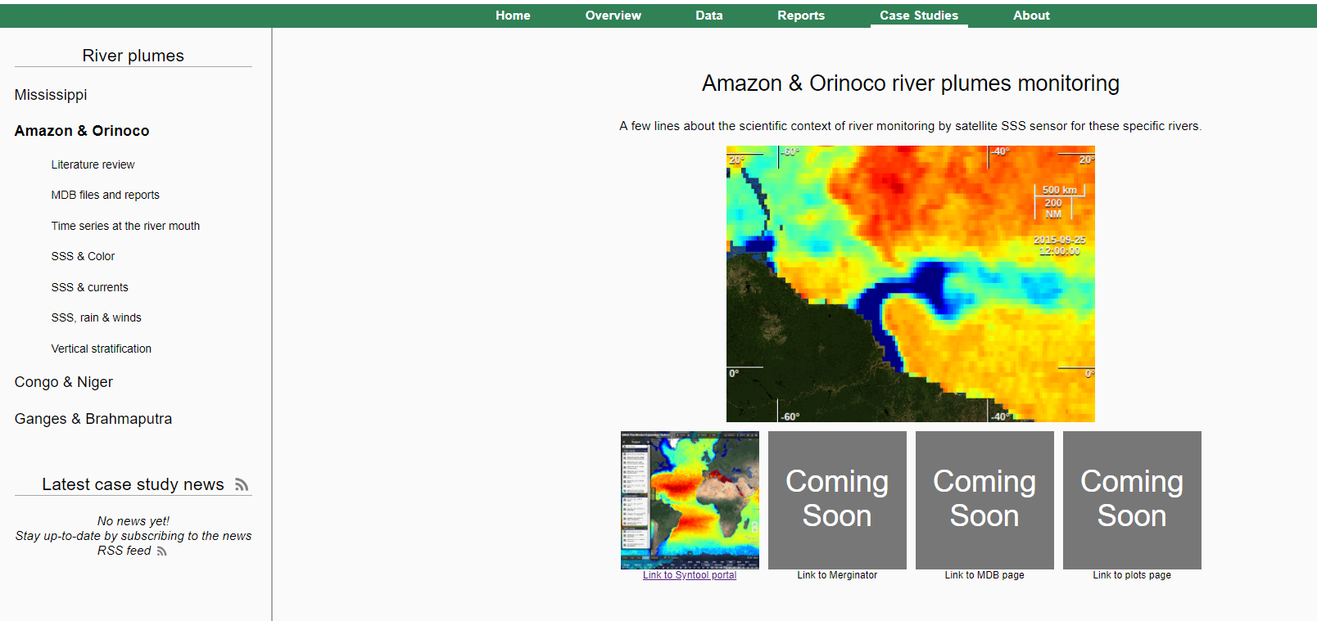

Slide 5
Literature Review
Content:
Overview
Thematic classification of papers & abstracts involving Satellite SSS
Year per Year classification of Publications related to the case study & involving Satellite SSS
Other publications
Status:
Done for
-all river plumes
-the meso-scale signature in western boundary currents
Not yet done for Southern ocean and Med sea

Slide 6
Specific MDB files and reports
Content:
MDB files extracted over the specific case study region
Validation reports for the specific case study region
Status:
Done for
-few sat products & few case studies

Slide 7
Large tropical river plume monitoring case study webpage
In addition, the next platform delivery will give access to the following sub-menus:
Time series at the river mouth
SSS & Color
SSS & Currents
Vertical stratification inferred from satellite SSS & in-situ S(z) & T(z)

Slide 8
Next steps
Demonstrator for Datalaps Time series
Case studies in the pre-operational platform

Slide 9
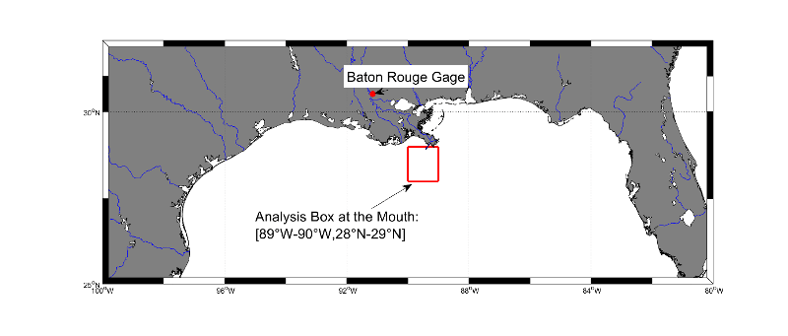
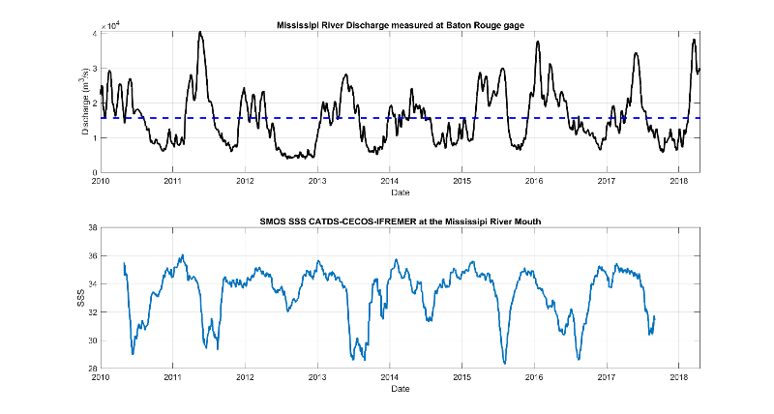
Time series at the River Mouths
+datalaps

Slide 10
SSS & color

Slide 11
SSS & currents

Slide 12
SSS & rain/wind

Slide 13
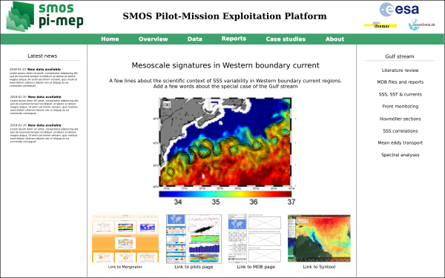

Slide 14
Meso-scale signature in the Gulf stream
On these pages, the user will find a web-page with a menu on the right giving access to :
● A literature review plus access to papers for the GS region,
● The SSS in-situ/satellite MDB files and reports generated over the GS region.
The best ranked (with respect to ARGO, TSG and drifters data) SMOS, Aquarius and SMAP L3 products will be selected for further case study illustration. Indicators on the SSS spatio-temporal variability in the region shall be provided in the reports.
In addition, the web page will give access to the following sub-menus:
SSS, SST & currents
Front monitoring
Hovmueller section
SSS correlation with SST & SLA
Mean Eddy Transport
Spectral Analyses

Slide 15
SSS, SST and Currents

Slide 16
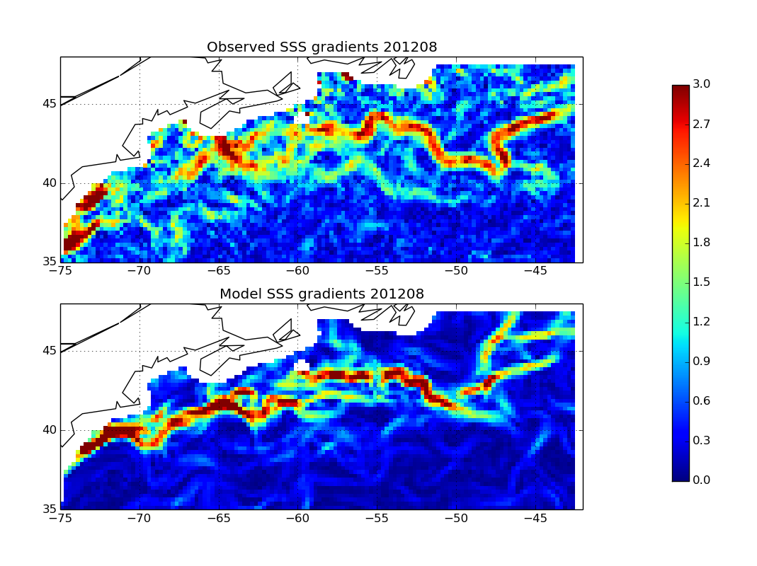
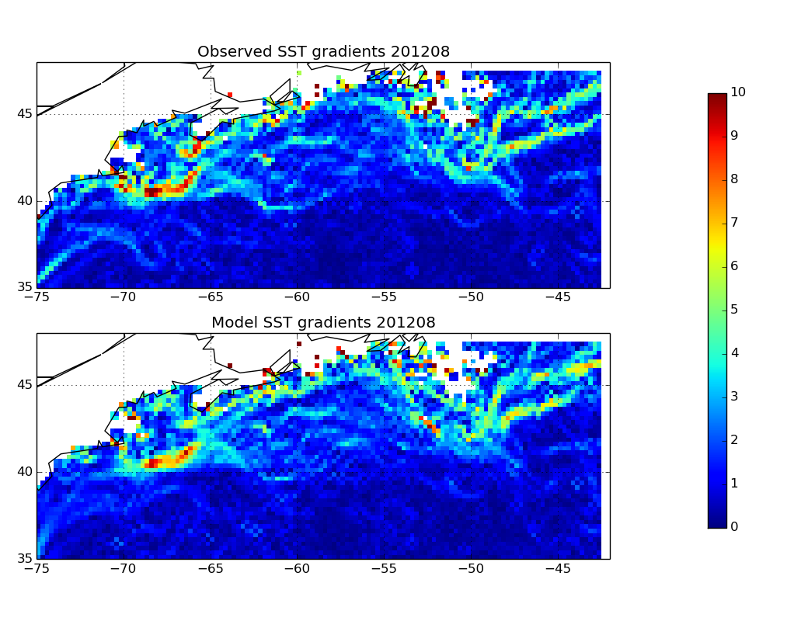
Front Monitoring
SSS horizontal gradients
SST horizontal gradients
SMOS
FOAM
Model
SSS & SST fronts will be evaluated & compared between model and satellite SSS observations

Slide 17
Hovmueller sections
65°W 50°W

Slide 18
SSS correlations

Slide 19
Mean Eddy Transport
F=SSS’*v ’
Meridional
Zonal

Slide 20
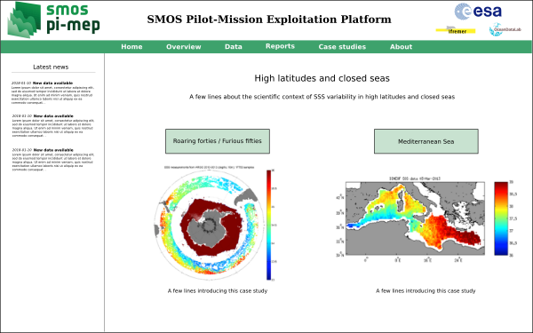

Slide 21
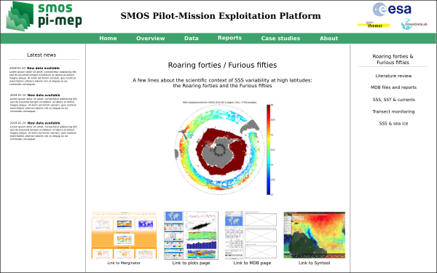

Slide 22
Roaring Forties/Furious fifties
On these pages, the user will find a web-page with a menu on the right giving access to :
● A literature review plus access to papers for the southern ocean region,
● The SSS in-situ/satellite MDB files and reports generated over the region.
The best ranked (with respect to ARGO, TSG and drifters data) SMOS, Aquarius and SMAP L3 products will be selected for further case study illustration. Indicators on the SSS spatio-temporal variability in the region shall be provided in the reports.
In addition, the web page will give access to the following sub-menus:
SSS & SST monitoring
Transect monitoring
SSS correlation with SST & SLA
Mean Eddy Transport
Spectral Analyses

Slide 26
