Slide 1


SMOS
Pilot-Mission Exploitation Platform
(Pi-MEP)
Match-up database
Sébastien Guimbard¹, Nicolas Reul², Sylvain Herlédan¹, Ziad El Khoury Hanna¹, Jean-Francois Piollé², Frédéric Paul², Roberto Sabia³
1. OceanDataLab, Plouzane, France
2. Ifremer, Laboratoire d’océanographie physique et spatiale, Plouzane, France
3. Telespazio-Vega UK Ltd for ESA, ESRIN, Frascati, Italy
SAG CM#2, ESA-ESRIN
May 24, 2018

Slide 2
Outline
Match-up database generation
MDB report content
Pre-operational platform evolution

Slide 3
Pi-MEP in situ SSS database pre-processing
ARGO
Sea mammals
TSG
Drifters
Select “valid” salinity profiles (salinity value for z < 10 m)
Spatial median filtering of SSS and SST values with different spatial window (25km, 50km, 100km)
Calculate of mixed layer depth, thermocline depth, barrier Layer thickness, buoyancy frequency N(z)…
Colocation with Auxiliary datasets
(Ascat, CMORPH, ISAS, WOA)
Colocation with Auxiliary datasets
(Ascat, CMORPH, ISAS, WOA)
Pi-MEP in situ database

Slide 4
MDB Generation
INPUTS
SMOS, SMAP,
Aquarius
L2 to L4
MDB generator code design
1)Read a SSS satellite file
Store temporal/spatial resolution (Res) and grid of the satellite products for further collocation (cf 3))
2) Select quality controlled In situ data falling in the time window (±6h for L2, ±D/2 for L3/L4)
3) Find nearest L2-L4 pixel within a distance R=[0,Res/2] for each in situ data
  4) Store actual Δt & Δdistance between product pixel & in situ data
5) Generate NetCDF4 files
In situ
MDB
generator
+ Auxiliary parameters
(rain, wind, sst, mld, …)
OUTPUTS
pimep-mdb_satelliteID_insituID_Time_V01.nc

Slide 5
MDB generation: some details
Search temporal radius for colocation:
  For running mean products (one file/day) : D=±12H
  SMOS-L3-LOCEAN-9D/18D (one file/4 days): D=±2days
Search spatial radius:
  Aquarius L2: 55km
  SMAP L2: 20 km(rss), 30 km(jpl) and 35 km (rss-70km)
  SMOS L2: 20km km
  For L3 products: grid resolution vs real product res.?
L2 flags: Aquarius v5

Slide 6
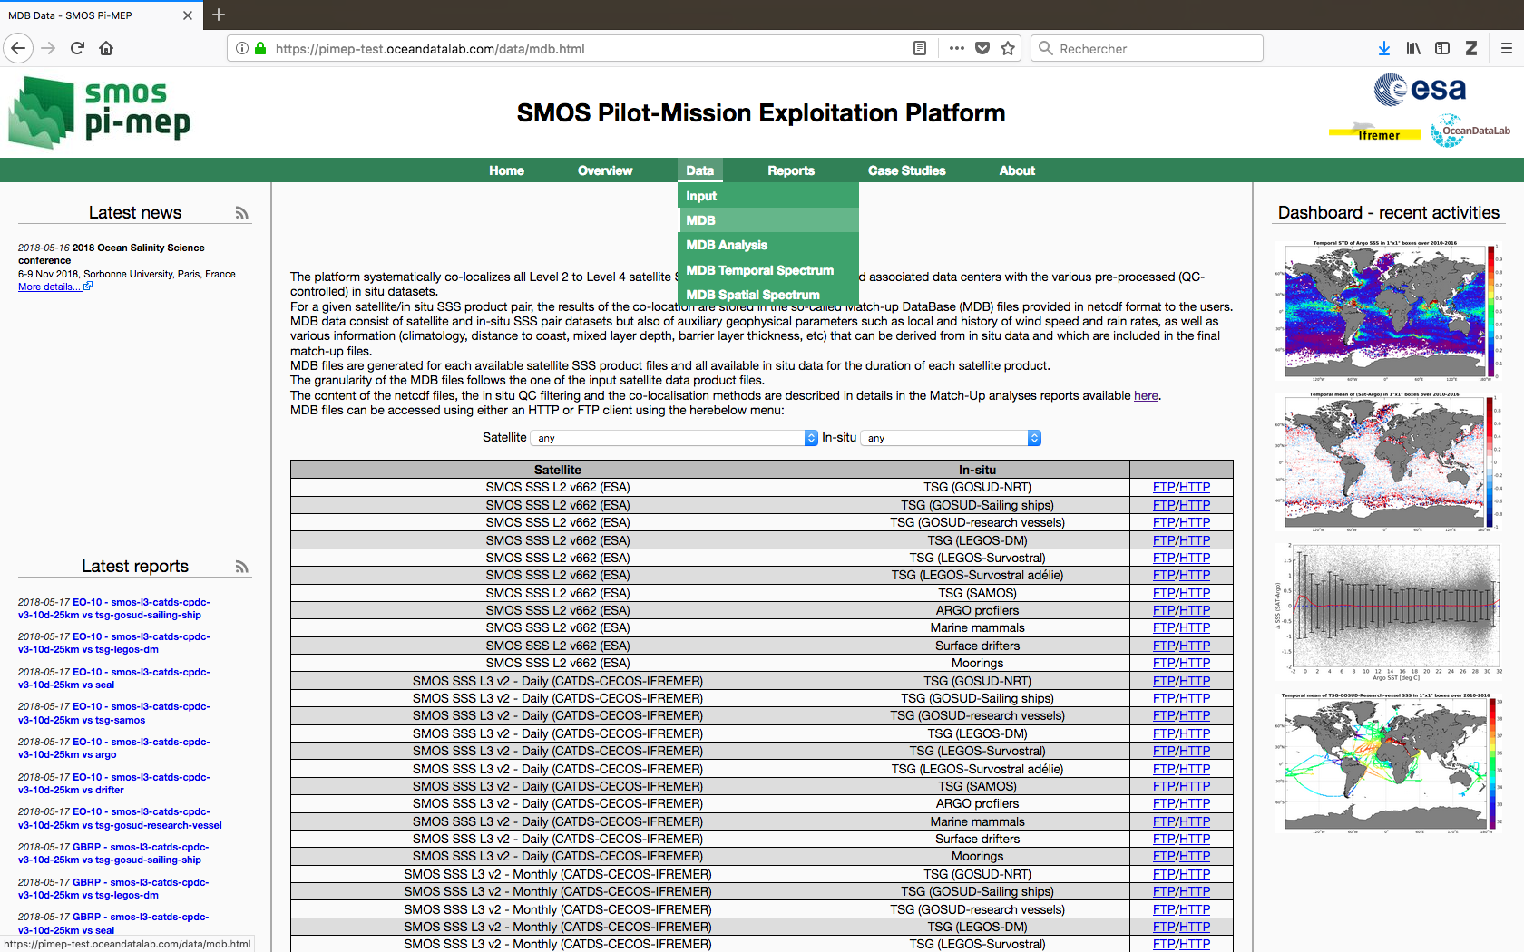
Match-up database

Slide 7
Match-up database
28 satellites products
10 in situ datasets
200 Gb ~ 500.000 files
Processing time < 3 days (if parallelized)
Reprocessing: once/year
Monthly update: only new pairs in situ/satellite are generated.

Slide 8
MDB database reports
PiMEP MDBs (ARGO, TSG, SEAL, Moorings, Drifters)
INPUTS
pimep-mdb_satelliteID_insituID_*_V01.nc
MDB analyzer code design
1)Read each MDB dataset file
2) Extraction of sub-dataset corresponding to the predefined Pi-MEP region
3) Systematically generate predefined plots, tables and statistics for each zone
4) Generate pdf reports
MDB
analyzer
OUTPUTS
STATISTICS, PLOTS, REPORTS, NetCDF files
pimep-mdb-report_regionID_satelliteID_insituID.pdf
pimep-mdb-figure_satelliteID_insituID.png
pimep-mdb-ncfile_satelliteID_insituID.nc
pimep-mdb-stat_satelliteID_insituID.csv

Slide 9
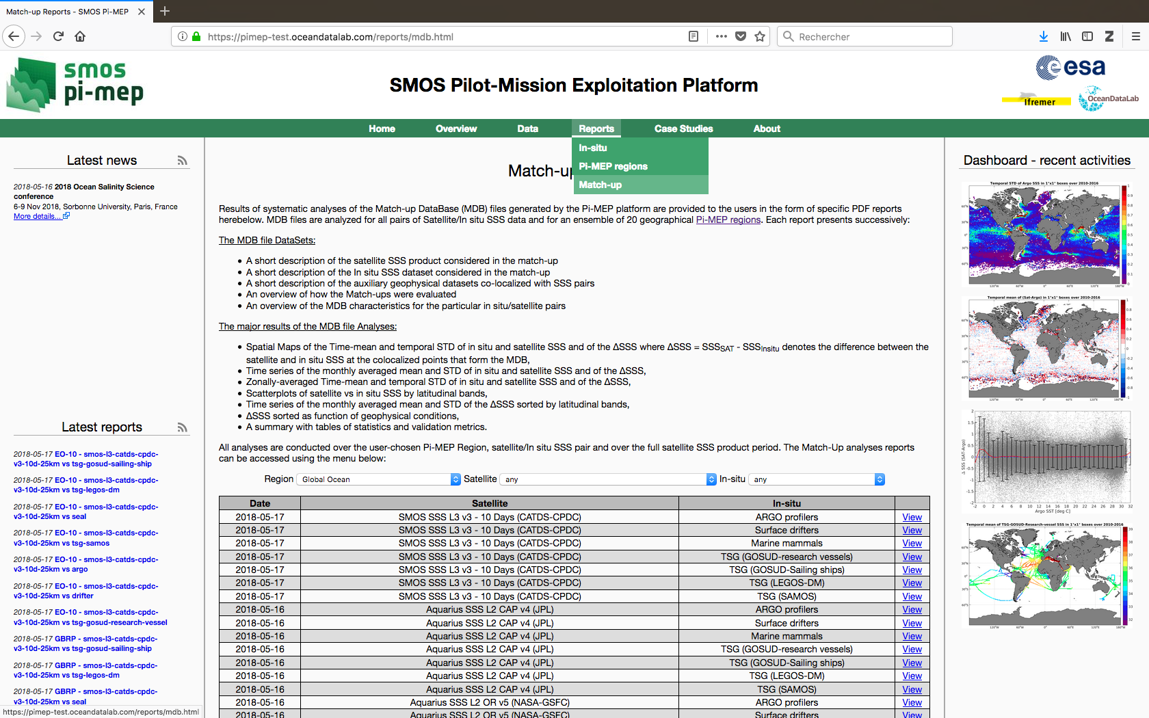
Match-up database reports

Slide 10
Pi-MEP systematic reporting
By satellite products (28)
By in situ database (10)
By Pi-MEP region (30)
~ 8000 reports
~40 plots/report
~320 000 figures

Slide 11
MDB report structure

Slide 12
MDB report content

Slide 13
MDB report content

Slide 14
MDB report content

Slide 15
MDB characteristics

Slide 16
MDB analyses

Slide 17
MDB report summary

Slide 18
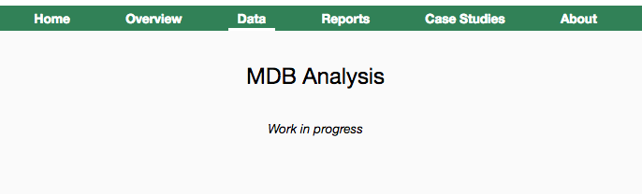
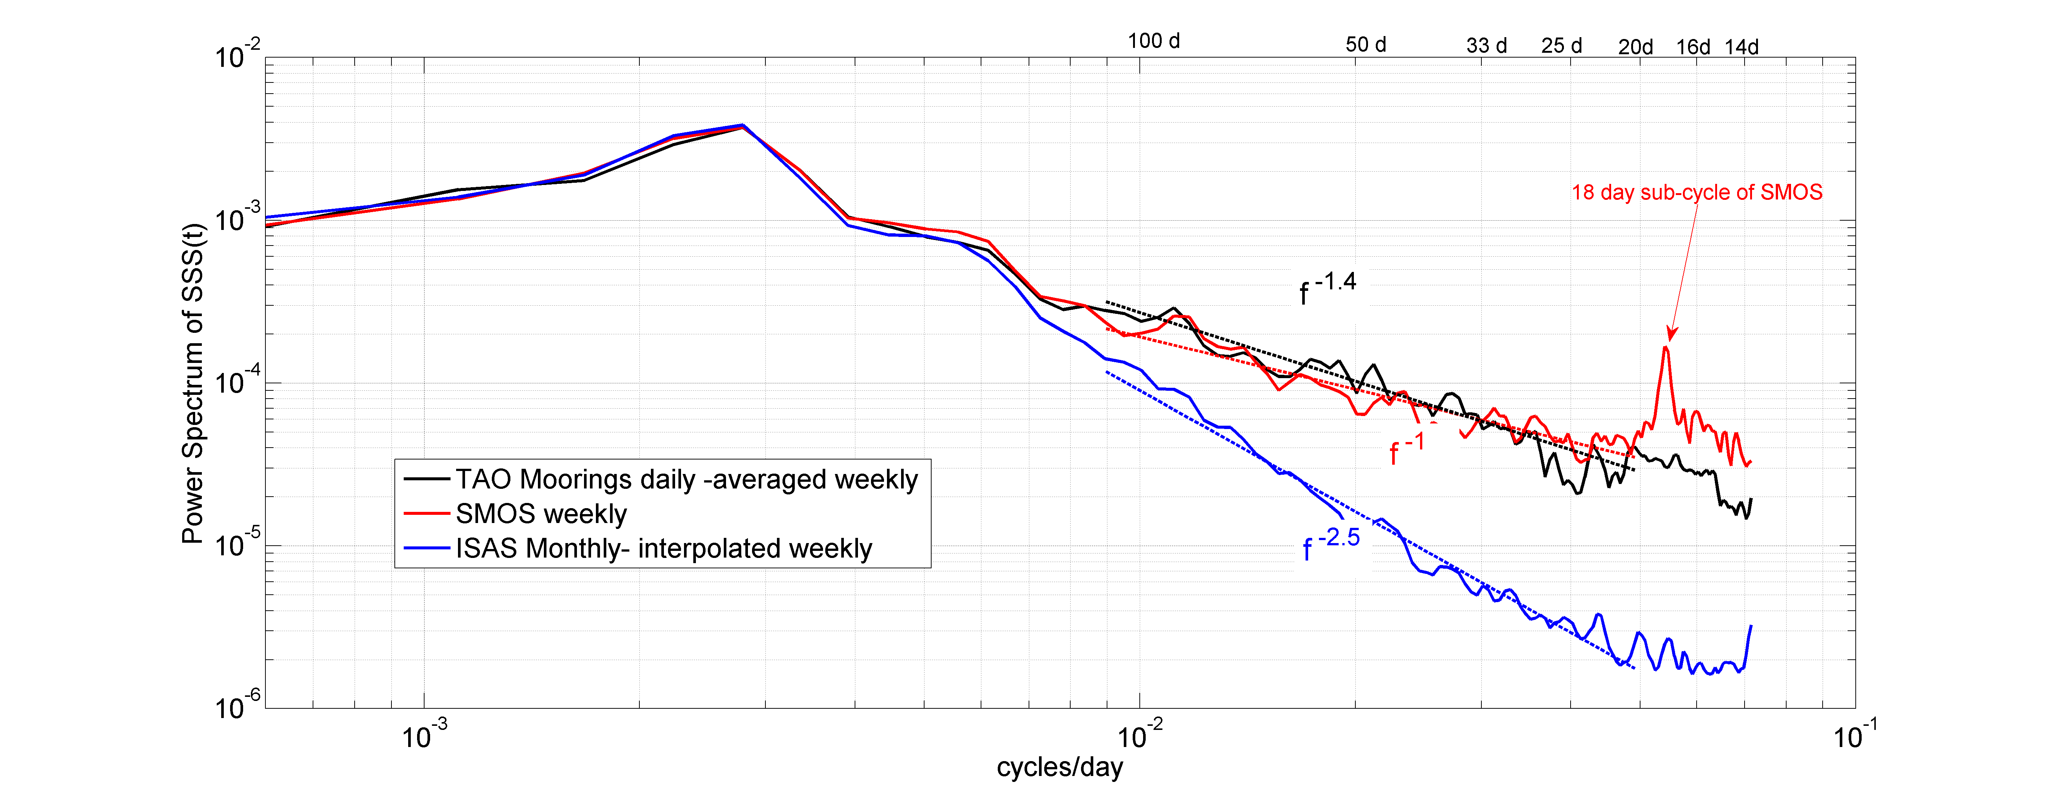
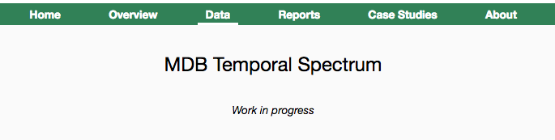
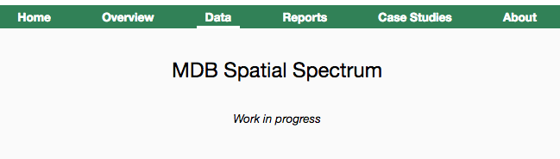
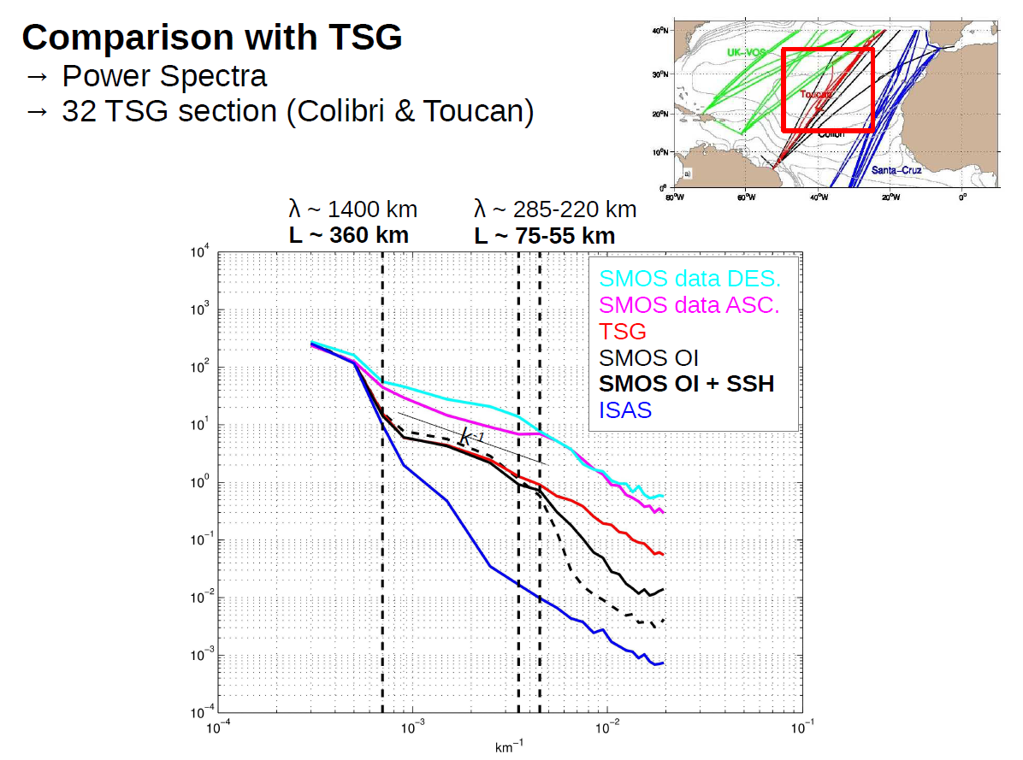
Work in progress
Give access to one NetCDF file containing all the data used to generate a specific report.
Using Moorings data
Using TSG data in predefined areas
Satellite inter-comparisons reports/metrics

Slide 19
Work in progress: Plot interface
Interface with five types of plots :
  Time series
  Scatterplots
  Histograms
  Hovmöller diagrams
  Maps
Options:
1 and 4 : Size of time bins (day, month, year)
2 and 5 : Time aggregation method (mean, std, etc...)
3 and 8 : Space aggregation method (mean, std, etc...)
6 : Either longitudinal or latitudinal aggregates
7 : Statistic displayed on the Y axis (number of values per bin by default)

Slide 20
Work in progress: MDB interface
Interface to query MDB data and :
  Extract match-ups (CSV, JSON or NetCDF)
  Generate plots for match-up metrics
  Produce custom PDF reports
Many controls to tune data filters

Slide 21
Work in progress:
Jupyter:
Python console in a webpage
Code executed on the platform (direct access to data)
Results displayed in the web browser
Python environment pre-installed
Authenticated/Trusted users only

Slide 22
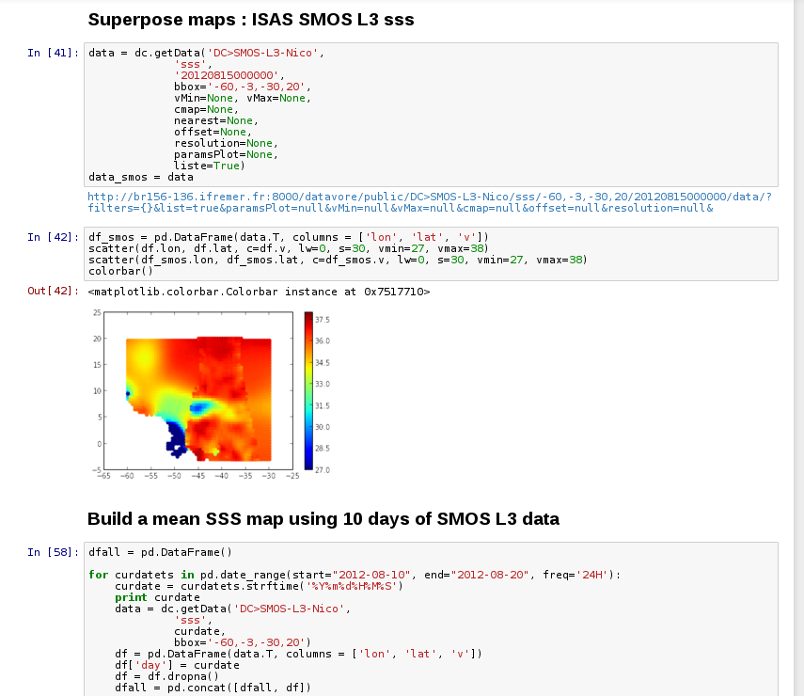
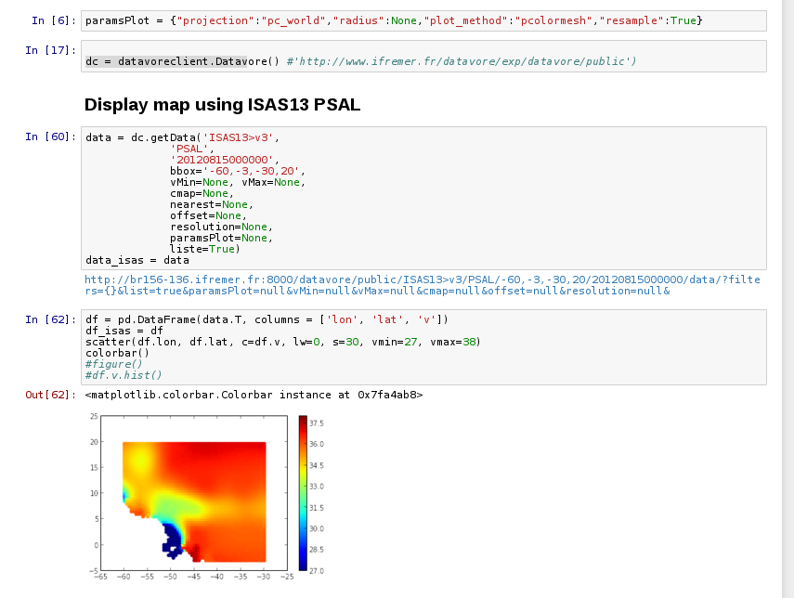
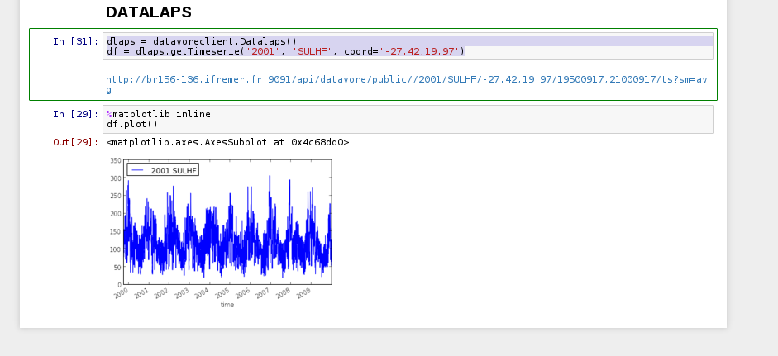
Jupyter
Interactive analysis of data on a distant server via a web browser

