Slide 1


SMOS
Pilot-Mission Exploitation Platform
(Pi-MEP)
Test-platform: Features and functionalities
Sébastien Guimbard¹, Nicolas Reul², Sylvain Herlédan¹, Ziad El Khoury Hanna¹, Jean-Francois Piollé², Frédéric Paul², Roberto Sabia³
1. OceanDataLab, Plouzane, France
2. Ifremer, Laboratoire d’océanographie physique et spatiale, Plouzane, France
3. Telespazio-Vega UK Ltd for ESA, ESRIN, Frascati, Italy
SAG CM#2, ESA-ESRIN
May 24, 2018

Slide 2
Outline
Input data description
In situ SSS database
Analyses Regions
MDB files and reports

Slide 3
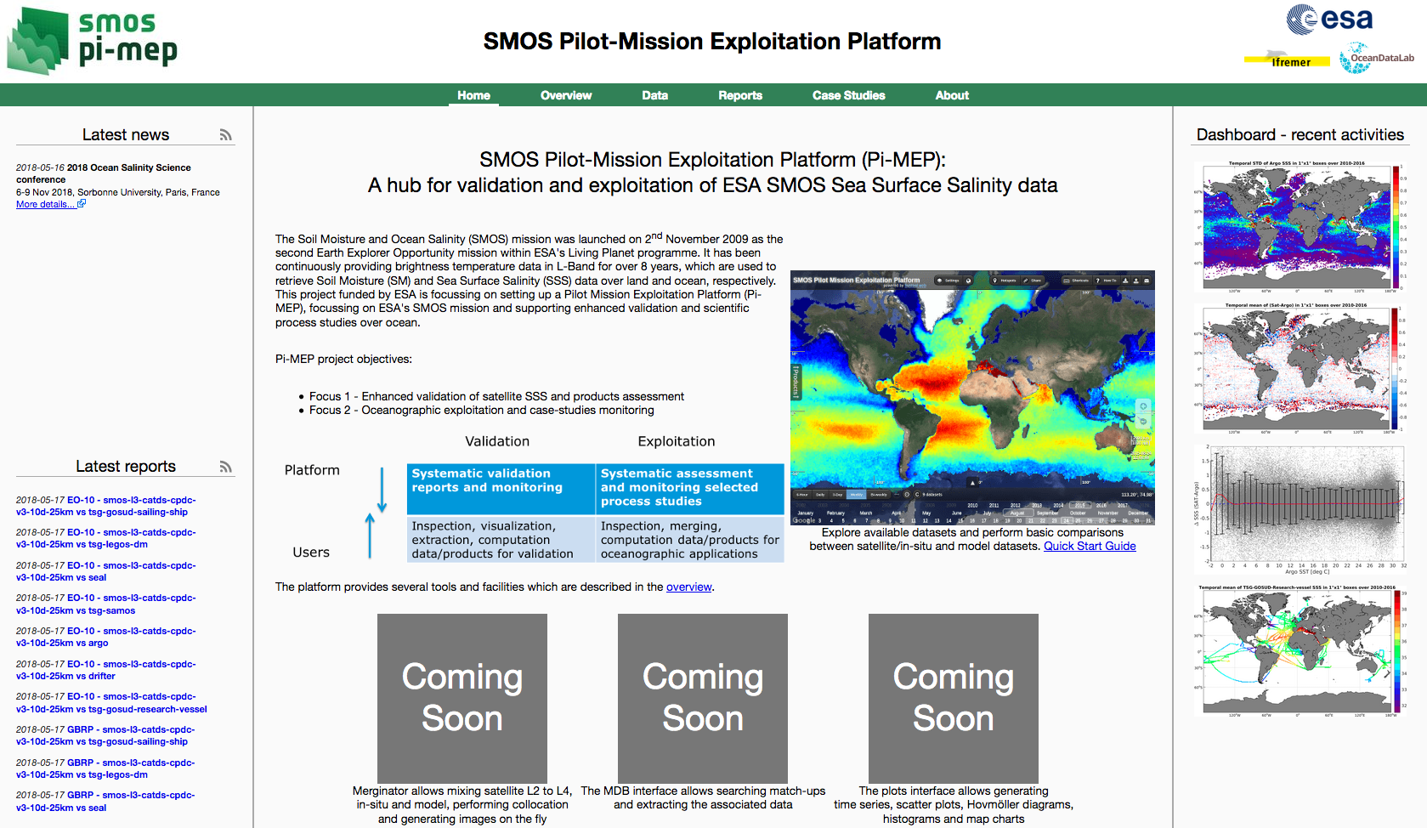
Pi-MEP website

Slide 4
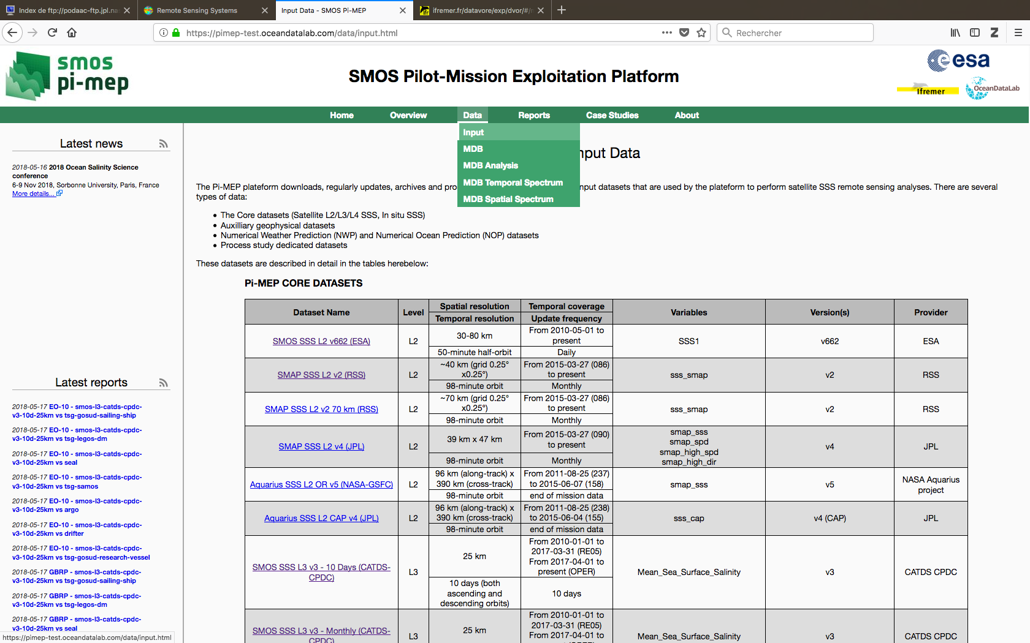
Input data

Slide 5
SSS satellite products
28 satellite SSS products are stored in the PiMEP
Coming from 8 different providers

Slide 6
SSS satellite products
Processing levels
Spatial resolutions
Temporal resolutions
L2/L3/L4 are stored but not L1 (CCI+salinity)
8 different spatial resolutions
8 different temporal resolutions

Slide 7
Too much SSS satellite products
Aquarius OR: 68 products
SMOS CATDS-CPDC: 48 products
SMOS CATDS-CEC-IFR: 7 products
(Asc/Des/both, spatial resolution, temporal resolution, bias adjusted, rain corrected …)
We have arbitrarily selected 6 different products over the 123 possible for these 3 providers.

Slide 8
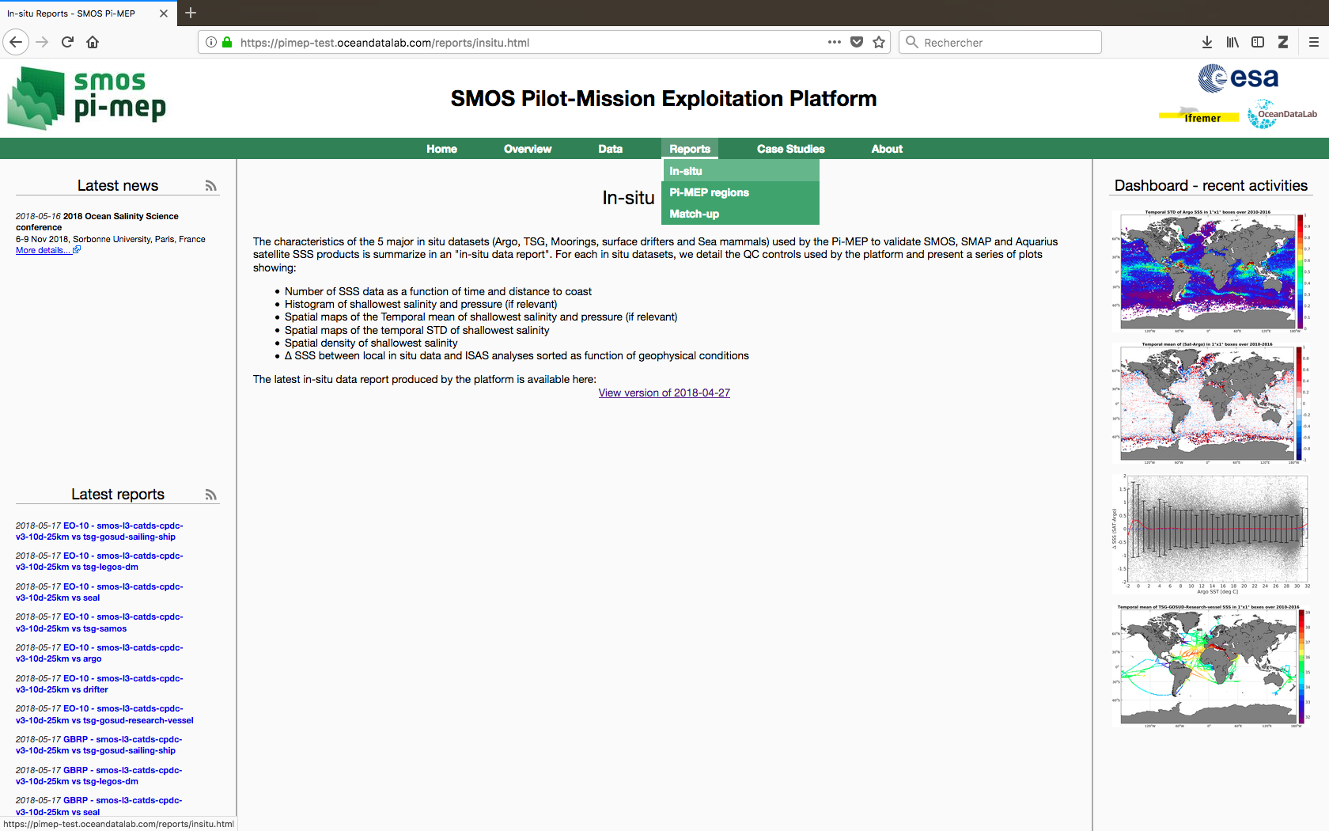
In situ SSS database

Slide 9
In situ SSS database
  ARGO floats (Coriolis)
  Tropical Moorings Array (TAO,TRITON, PIRATA)
  Surface Drifters (LOCEAN)
  TSG (LEGOS, GOSUD, SAMOS)
  Marine mammals (MEOP)

Slide 10
In situ SSS report

Slide 11
In situ SSS report: ARGO

Slide 12
In situ SSS report: ARGO

Slide 13
In situ SSS report: ARGO

Slide 14
In situ SSS report: ARGO

Slide 15
In situ SSS report: summary
Temporal Mean
Temporal STD

Slide 16
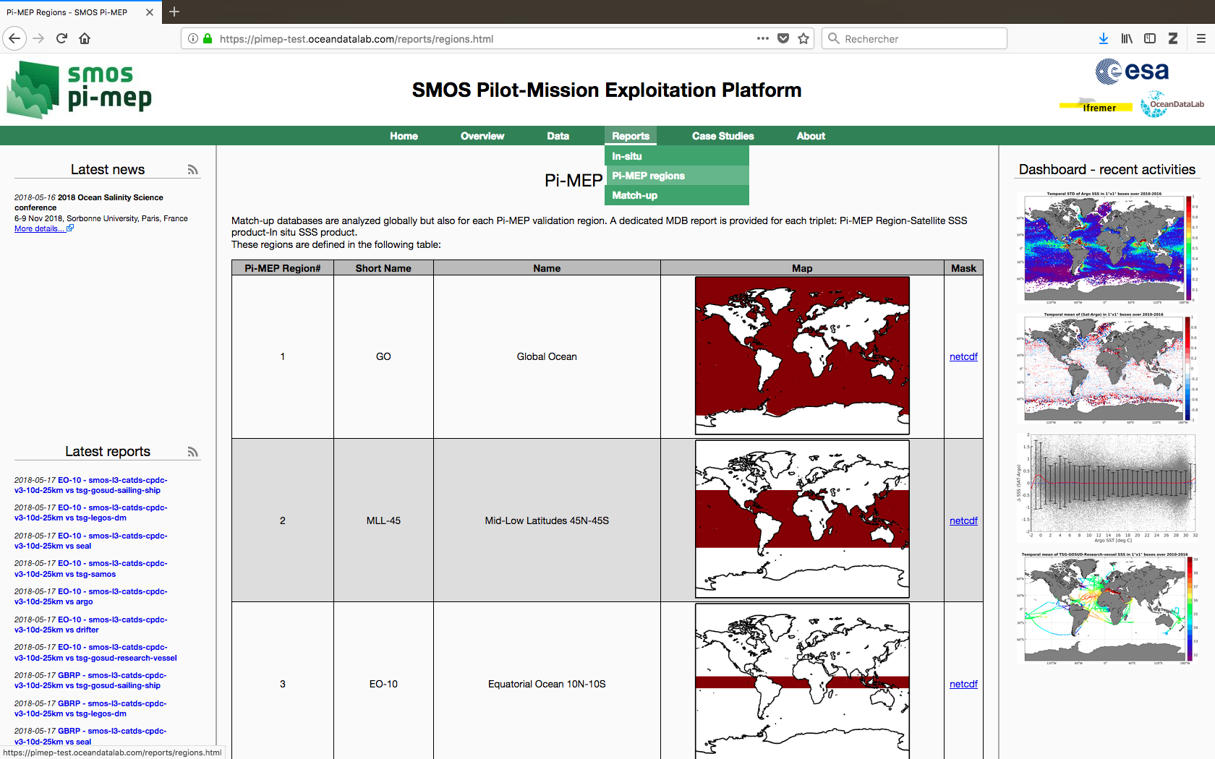
Analyses Regions

Slide 17
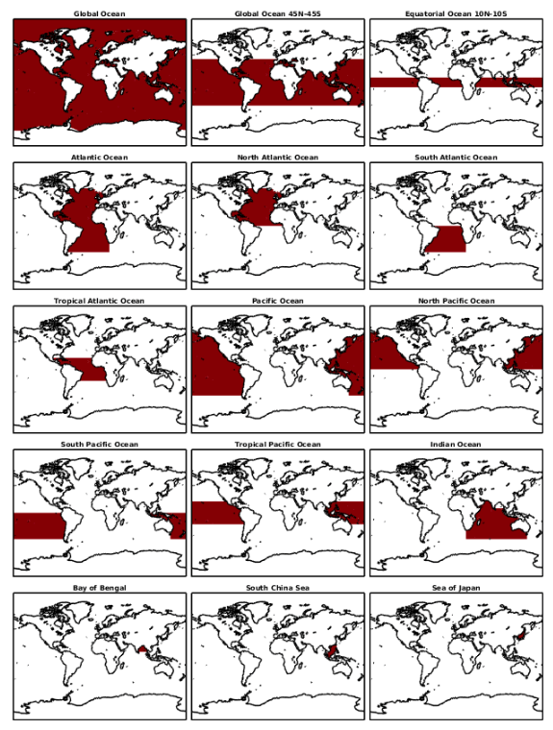
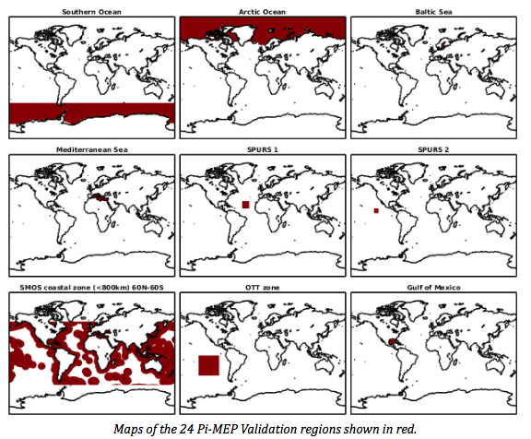
24 regions
+ 6 case study regions
+ user-defined regions

Slide 18
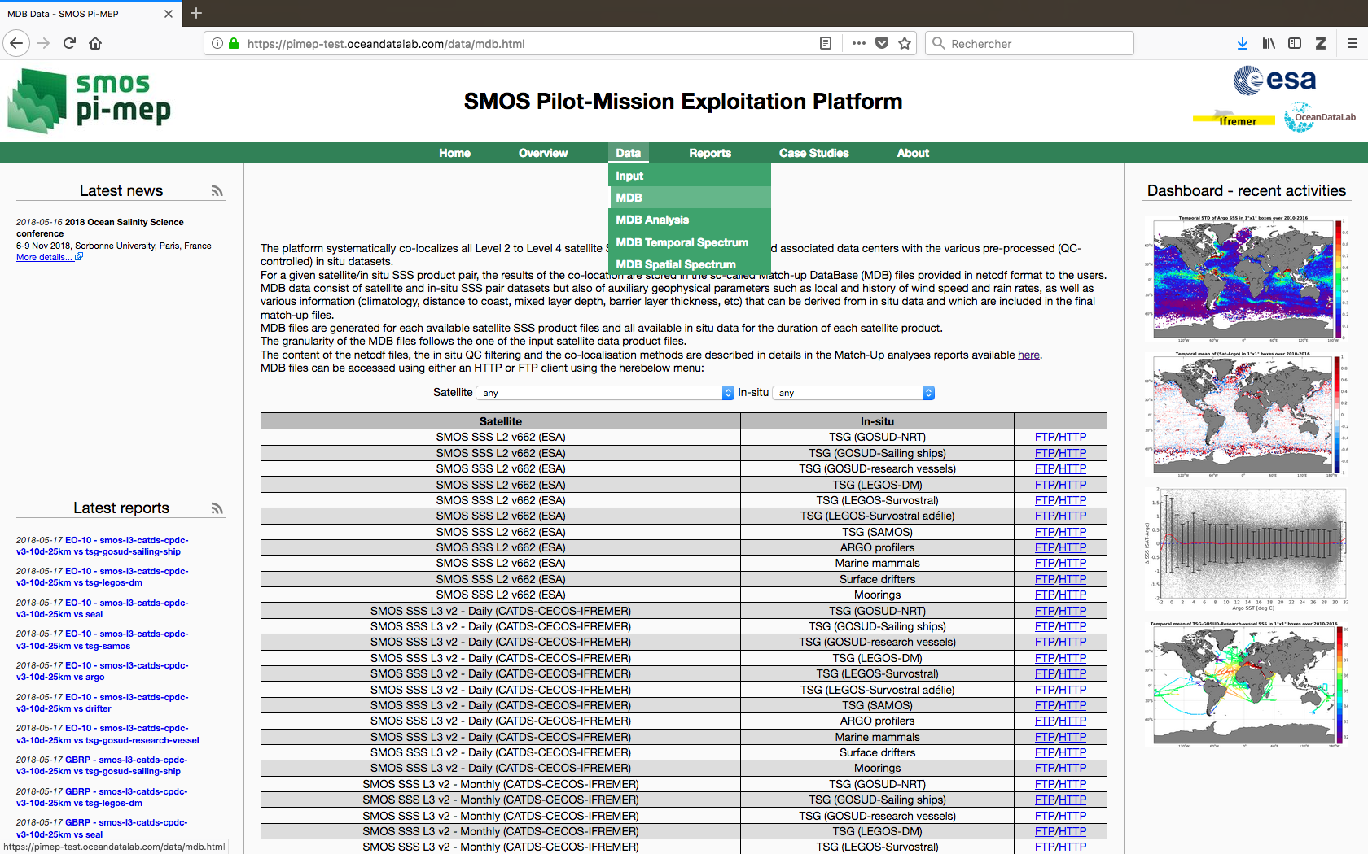
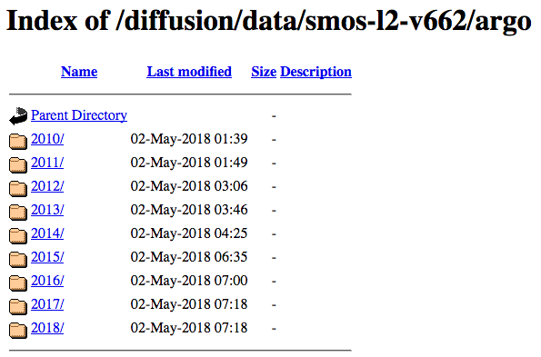
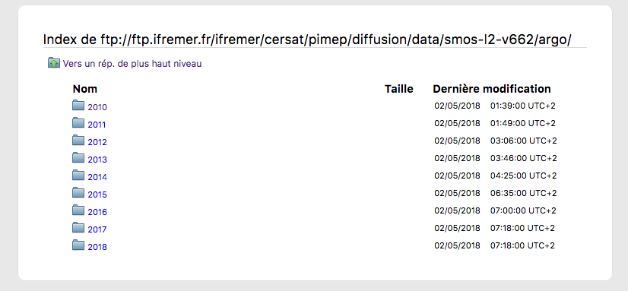
Match-up database NetCDF

Slide 19
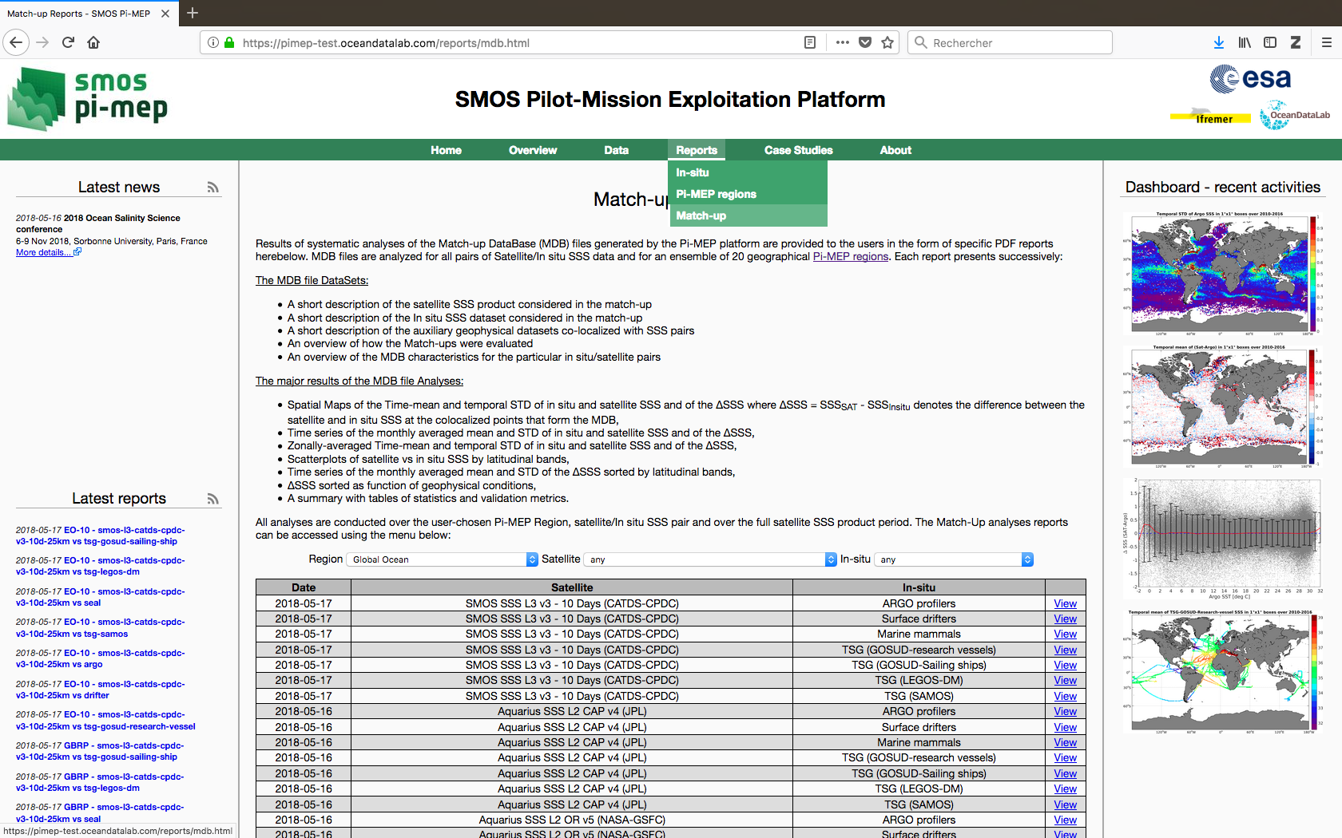
Match-up database reports

Slide 21
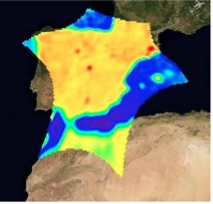
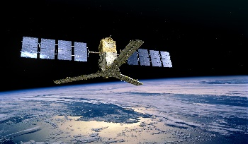
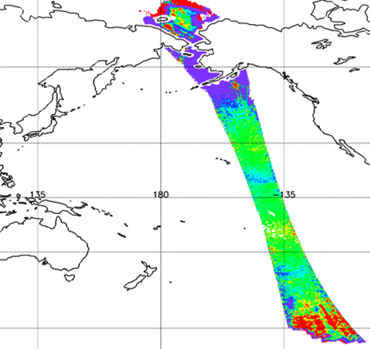
SMOS SSS products
Operational Products :
10 d, 1 month, asc/desc/both
25 km, 50km, 100 km, 200 km
CNES/IFREMER
CATDS
L3/L4
Research Products
CEC-LOCEAN L3 debiased ¼°, 9 d, 18d
CEC-IFREMER L3 ¼°,1/2°,1°, 1d, 10d, monthly
CEC-IFREMER L4, 1/2°, weekly
ESA
LEVEL 2
Operational
+ reprocessing SSS products
BEC
ESA
Level 1 SMOS DPGS
SMOS BEC L3 OA, ¼°,9days
SMOS BEC L4 FUSION, 0.05°, 9 days
Hamburg
Univ
SMOS ICDC L3 1°, monthly
CCI

Slide 22
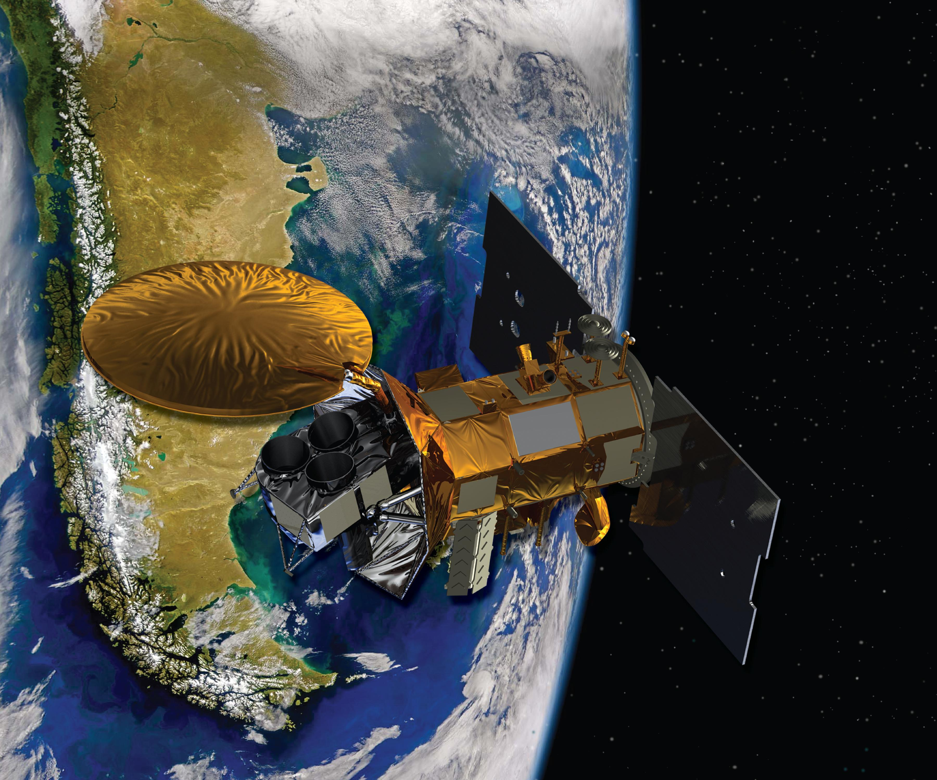
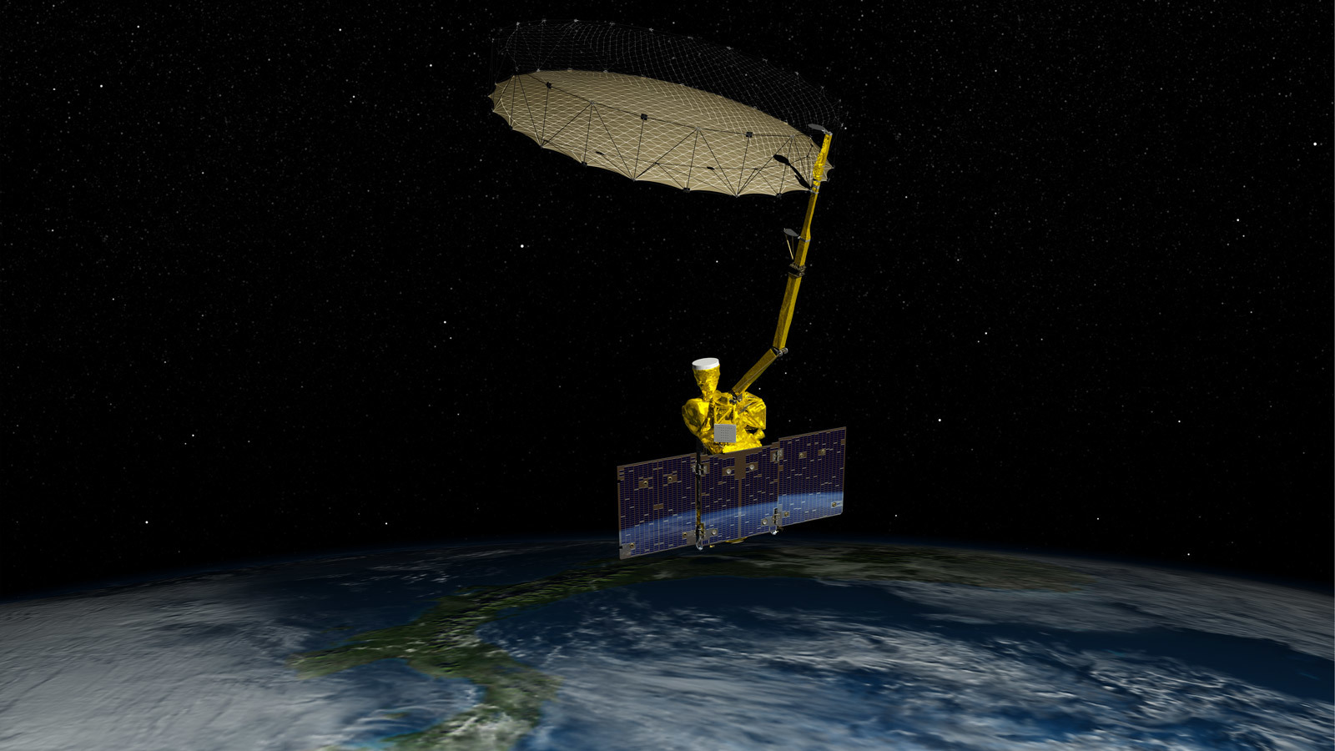
Other SSS satellite products
L2
Aquarius
JPL
Aquarius JPL L3 : 1° / 7d, 7d merge, monthly, monthly merge
Aquarius OR/RSS L3 : 1° / 1d, 7d, 7d running, 28d running, monthly, 3 month, annual, climatology monthly/seasonal, cumulative)
RSS
Aquarius IPRC L4 OI: 0.5° / 7d, monthly
SMAP
JPL
SMAP JPL L3: 0.25° / 8 days running, monthly
RSS
SMAP RSS L3: 0.25° / 8 days running, monthly

Slide 23
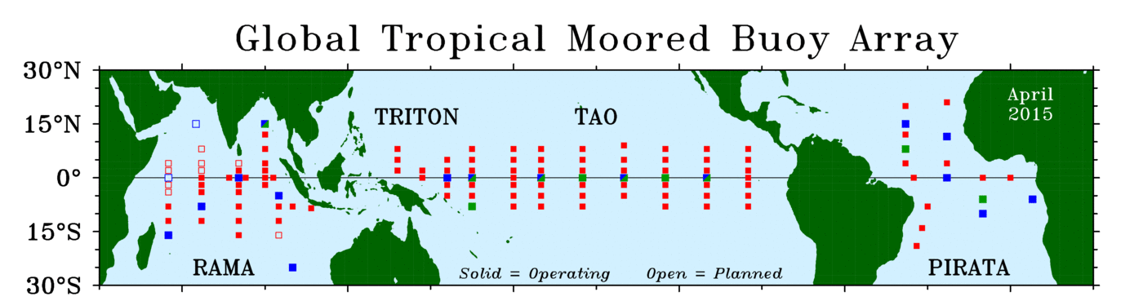
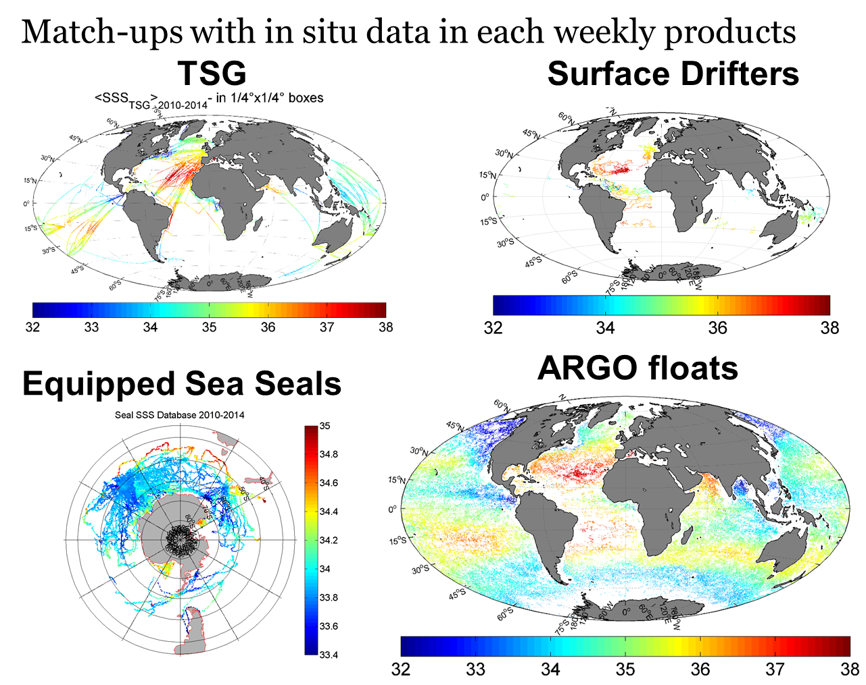
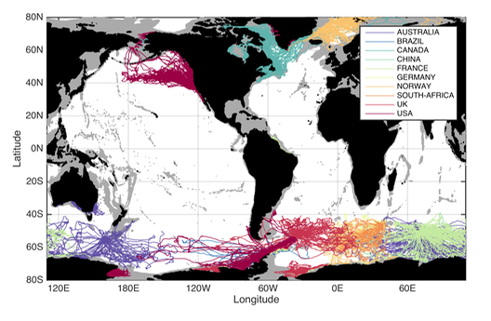
In situ salinity products:
  ARGO floats (Coriolis)
  Tropical Moorings Array (TAO,TRITON, PIRATA)
  Surface Drifters (LOCEAN)
  TSG (LEGOS, GOSUD, SAMOS)
  Marine mammals (MEOP)

Slide 24
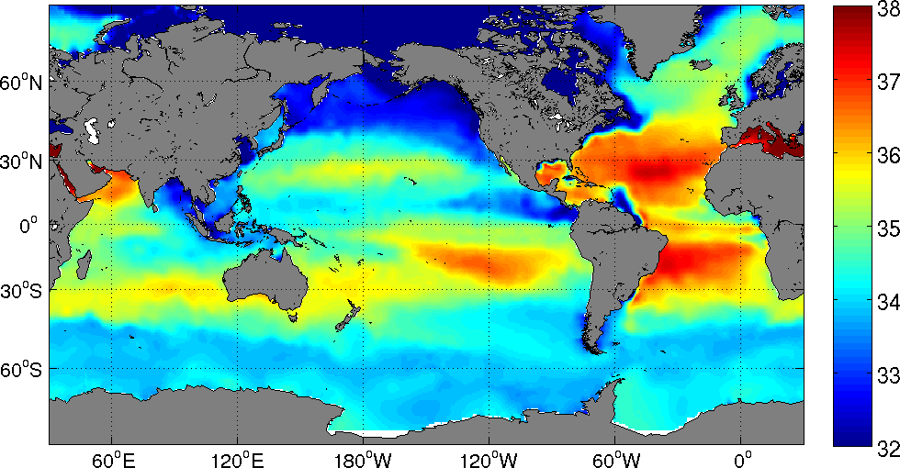
Analyzed and model products:
In Situ salinity analyzed products:
  ISAS (0.5°, monthly, 0m/3m/5m/10m)
  EN4.2.0 (1°, monthly, 5m/15m)
  JAMSTEC (1°, monthly, 10m/20m)
  SCRIPPS (1°, monthly, 2.5m/10m)
  IPRC (1°, monthly, 0m/10m)
  World ocean atlas 2009 (1°, monthly/seasonal/annual climatology, 0m/10m)
  World ocean atlas 2013 (0.25°, monthly/seasonal/annual climatology, 0m/5m)
Numerical models :
  HYCOM (0.25°, daily)
  GLOBAL ANALYSIS FORECAST PHY 001 024 (NEMO, 1/12°, daily)
  ECCO (MitGCM, 0.5°, Monthly)

Slide 25
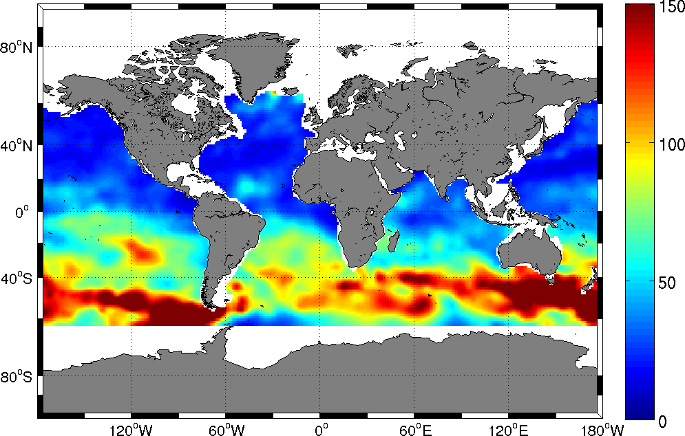
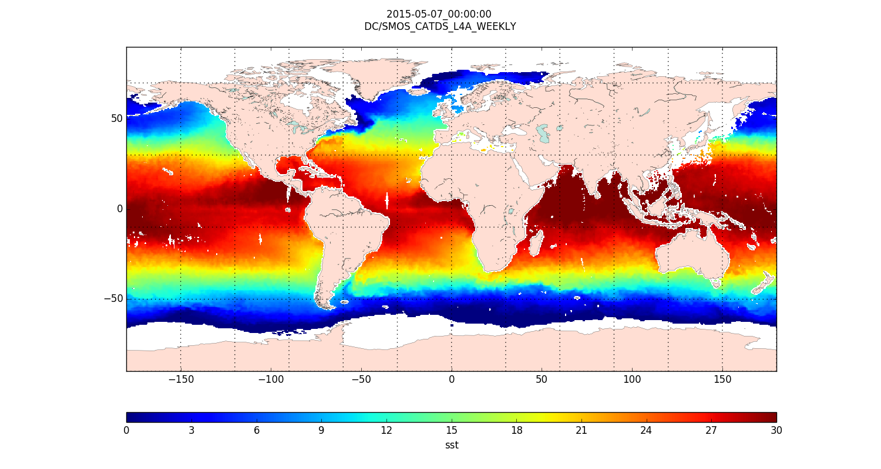
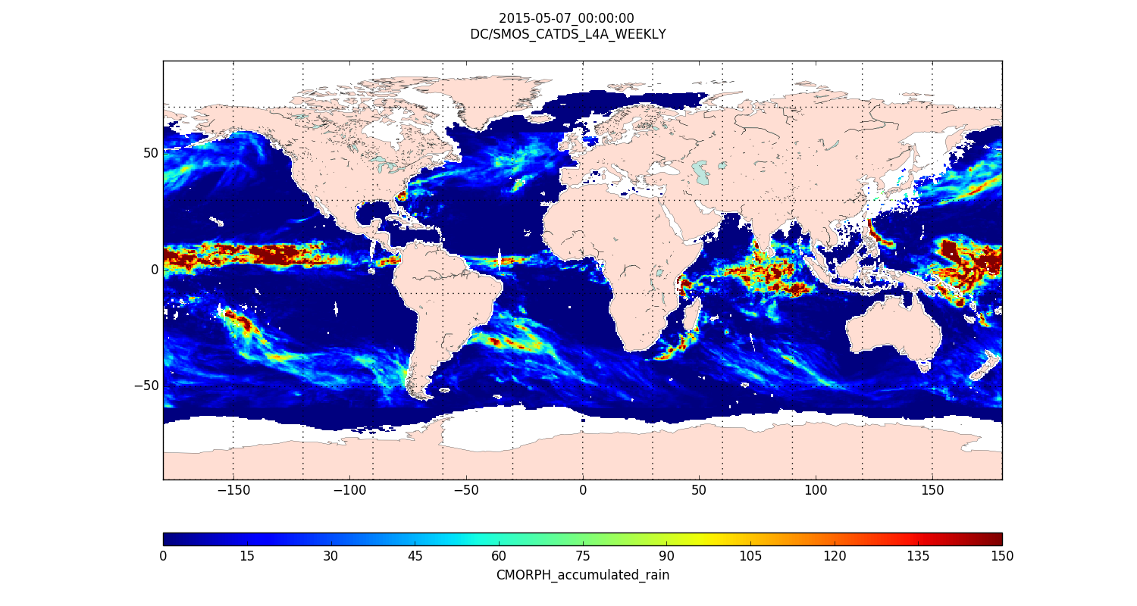
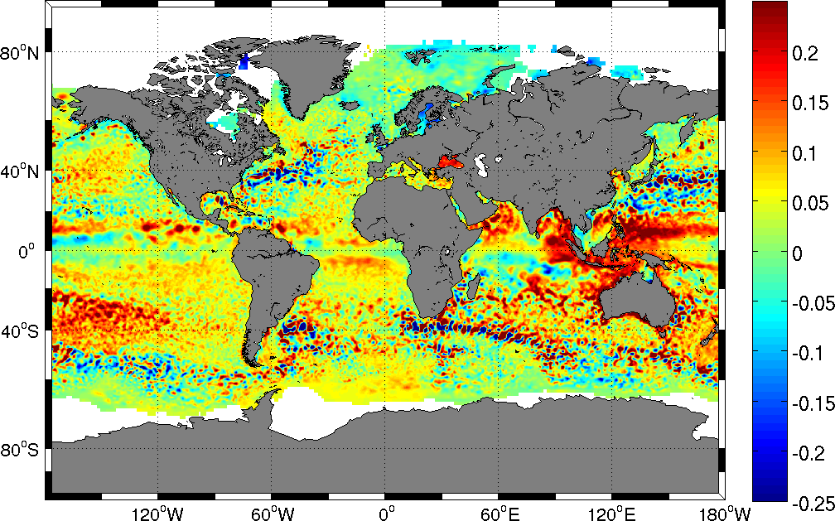
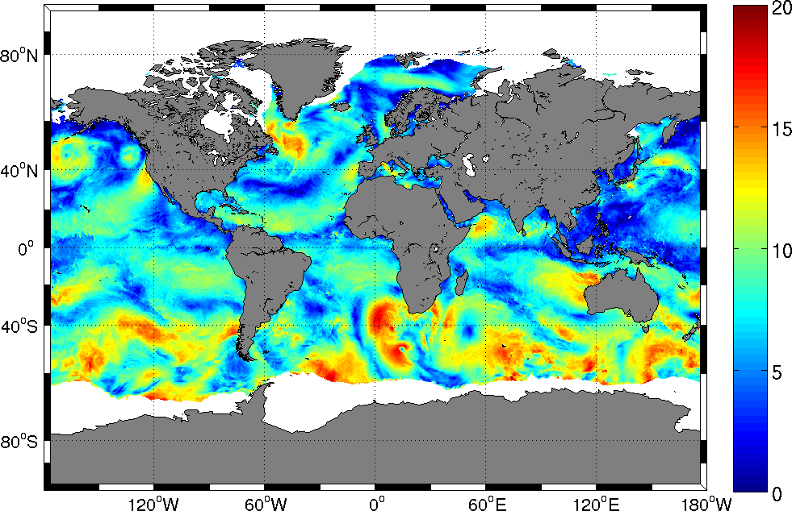
Thematic datasets
  Mixed layer depth (APDRC, 1°, Monthly)
  AVHRR (Reynolds OI V2, 0.25°, Daily)
  SST OSTIA (0.05°, Daily)
  RSS (MW_IR Fusion, 0.25°, Daily)
  CMC (0.2°, Daily)
  CMORPH (0.25°, 3H)
  Rain rate GPCP v3
  IMERG(0.1°, 30 min)
  Chlorophyl-A (GlobColour, 0.25°, 8 Days/monthly)
  Coloured dissolved and detrital organic materials (GlobColour, 0.25°, 8 Days/monthly)
  Surface currents (OSCAR, 1/3°, 5 days)
  Evaporation (WHOI OAFLUX, 1°, Daily)
  Sea level anomalies heights (AVISO MSLA, 0.25°, Daily)
  Wind stress (ASCAT, 0.25°, Daily)
  Altimeter waves
  subsurface temperature at the base of the mixed layer
  Ekman upwelling velocity

Slide 26
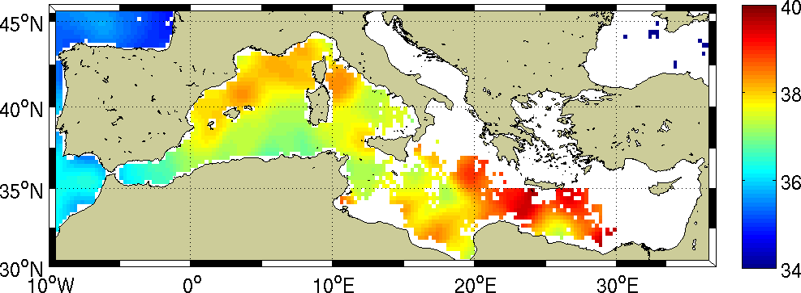
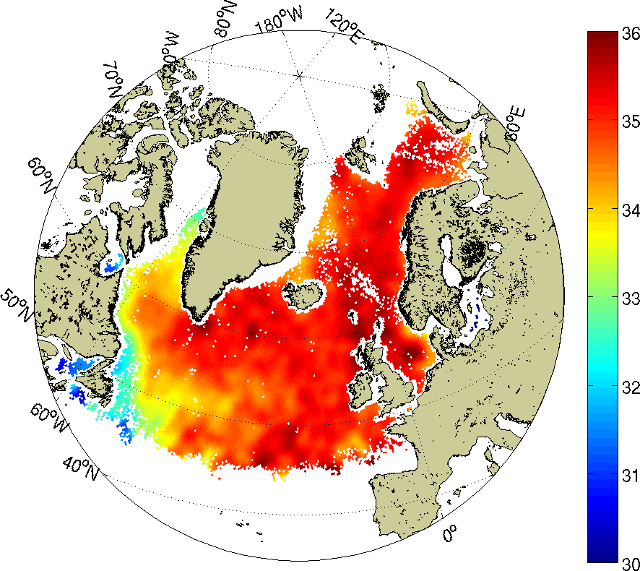
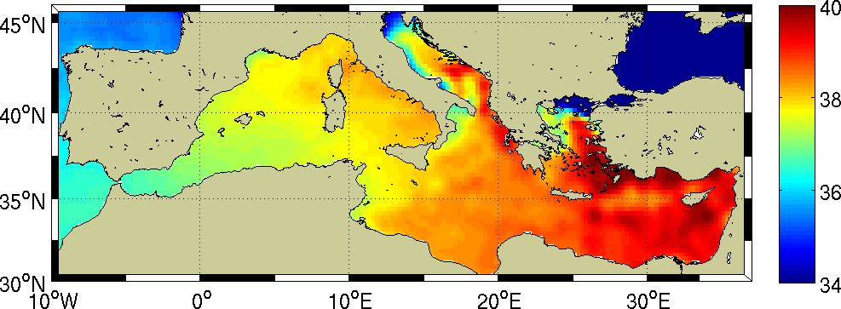
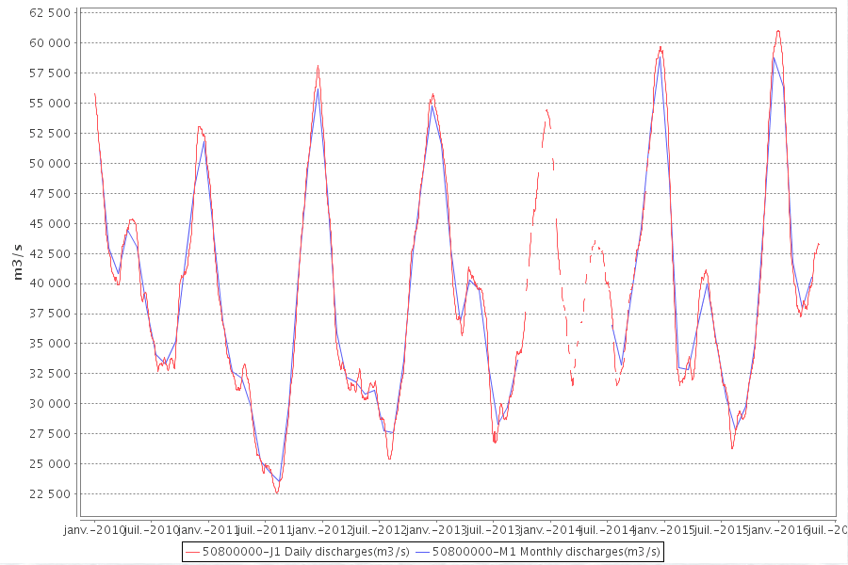
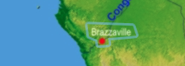
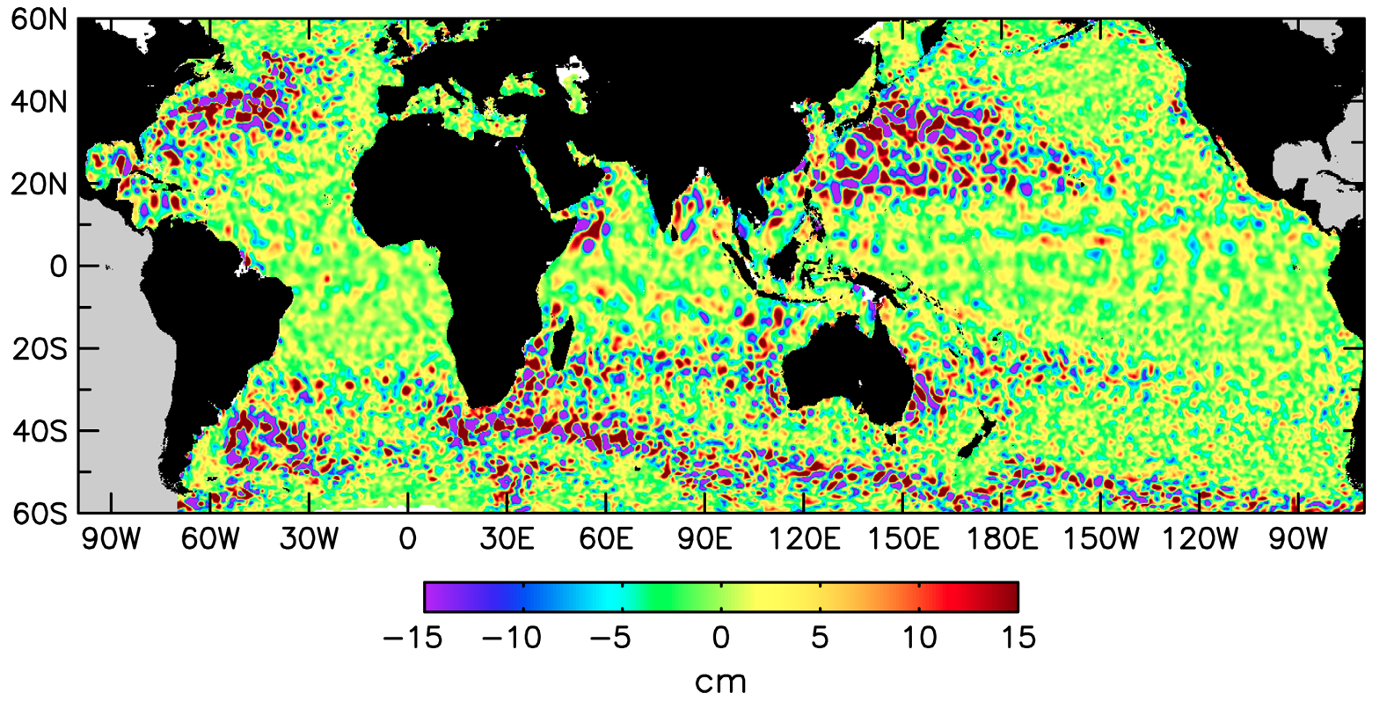
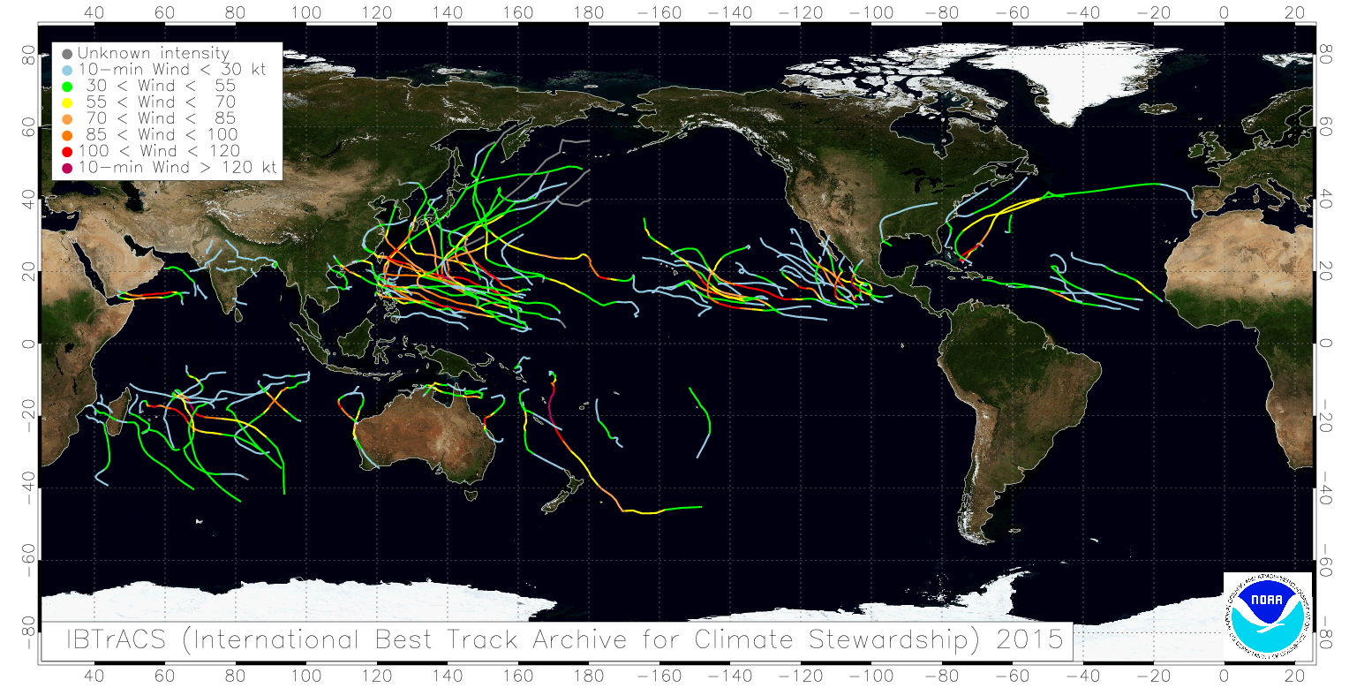
Process study dedicated datasets
Satellite products:
  Level 3 / Level 4:
    CP34/BEC L3 SSS OI (9 Days, 0.25°) Mediterranean sea and Arctic
    CATDS/CPDC SMOS L3 Soil Moisture (3 days/10 days/monthly)
    CP34/BEC L4 SSS Fusion (9 Days, 0.25°) Mediterranean
Other products:
  River discharges
  Mesoscale eddies
  Tropical Cyclone tracks

Slide 27
Datasets summary
28 SSS satellite datasets (11 SMOS / 8 Aquarius / 9 SMAP)
  > 120 different SSS satellite sub-datasets
5 in situ datasets (ARGO, TSG, Moorings, Surf. drifters, Marine mammals)
8 analysed salinity datasets (ISAS, EN4, JAMSTEC, SCRIPPS, IPRC, WOA09-13)
3 numerical models (HYCOM, MERCATOR (NEMO), ECCO (mitGCM))
21 thematic datasets (MLD, SST, RAIN RATE, Surf. Currents, evaporation …)
8 process study dedicated datasets
= > 64 datasets (30 min to Monthly, 0.05º to 1º, Surface to 100 m depth)
= > 10 To (up to 50 To in 2019) [new release, reprocessings]
= > Netcdf/HDF/Binary

Slide 28
Pi-MEP systematic reporting
By satellite products
By in situ database
By Pi-Mep region

Slide 29
Pi-MEP in situ database report

