Slide 1

Proposed Analyses & Processings for the « SMOS Pilot-Mission Exploitation Platform (Pi-MEP) »
Nicolas Reul
SMOS Pi-MEP –SAG meeting ESTEC 03/05/2017

Slide 2
Outline
3. Definition of the Analyses/Processing to be implemented
13:45-14:30: 3.1 Presentation of proposed Analyses/processing (N. Reul)
The SMOS Level 2 SSS Validation protocol
The Satellite/In situ Match-Up Database production
Product inter-comparison Metrics
Enhanced Validation Protocols & Metrics

Slide 3
SMOS validation protocol used by Level 2 ESL
Courtesy : J. Boutin, F. D’Amico, S. Marchand (LOCEAN)

Slide 4
Data filtering strategy of L2OS SSS
According to validation protocol:
- Dg_af_fov >130
science_flag_set
- SC_LOW_WIND
- SC_LAND_SEA_COAST1
science_flag_clear
- SC_ICE
- SC_SUSPECT_ICE
Valid salinity values:
30<= SSS<=40 for |lats| in ]30,90]
25<= SSS<=40 for |lats| in [0,30]
control_flag_set
- CTRL_ECMWF
control_flag_clear
- CTRL_NUM_MEAS_MIN
- CTRL_NUM_MEAS_LOW
- CTRL_MANY_OUTLIERS
- CTRL_SUNGLINT
- CTRL_MOONGLINT
- CTRL_REACH_MAXITER
- CTRL_MARQ
- CTRL_CHI2_P
- CTRL_SUSPECT_RFI
4

Slide 5
SMOS L3 SSS monthly map computation
- 100kmx100km L2 SSS weighted* averages over a 0.25x0.25deg-resolution grid
Valid map value if :
- Num.SSS averaged per grid point > 30 (if A or D)
- Num.SSS averaged per grid point > 50 (if A+D)
*Weight applied:
W[k] = 1 / (D²[k]*σ²[k]) ,
where:
D is the equiv. footprint diameter,
σ is the theoretical uncertainty.
ISAS DATA
5 m-deep salinity
PCTVAR < 80%
5

Slide 6
Time series of mean, std and rmsd of monthly-100x100km² (SMOS-ISAS) SSS, in several regions
Example

Slide 7
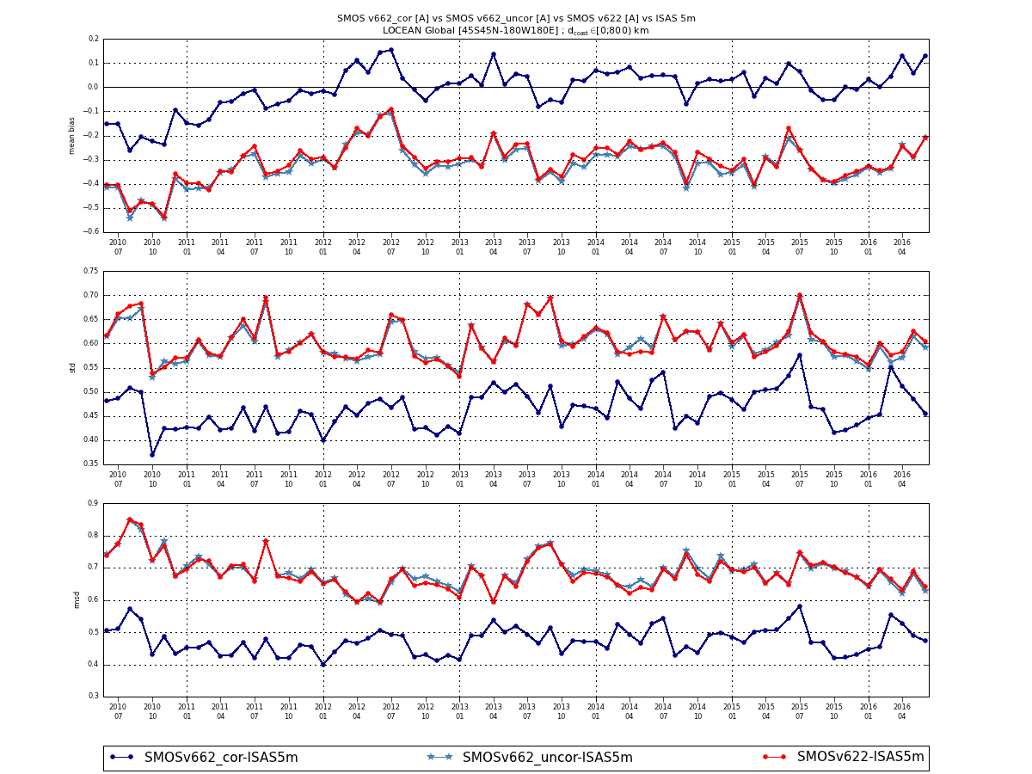

Dcoast<800km, A
mean
V662corr
V662unc
v622
In LSC areas, for L3 pixel,
v662 corrected consistently improves the statistics wrt v622:
mean abs bias
almost null: 0.01 pss
std decreases by more than 0.1 pss (std=0.48pss).
std
rmsd
L3 pixel stats, 45S-45N, Dcoast<800km, Asc
 | N | Mean bias | std
V662(corr)-ISAS | 4415547 | -0.01 | 0.48
V662(unc)-ISAS | 4076555 | -0.32 | 0.60
V622-ISAS | 3820000 | -0.31 | 0.61

Slide 8
The Satellite SSS/In situ Match-Up DataBase
In situ data & processings to obtain the match-ups
File format
An important acronym :
MDB files≡Match-Up DataBase files

Slide 9
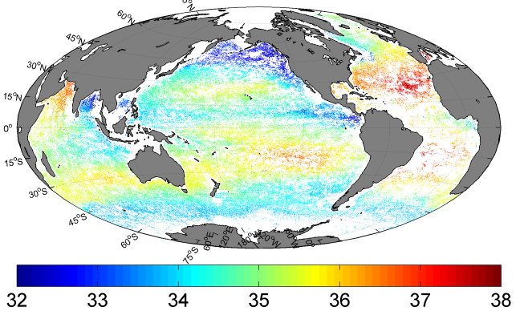
The Satellite/In Situ SSS Match-Up Database for Pi-Mep
ARGO floats upper level data (1)
Salinity and Temperature measurements from Argo floats are provided by the Coriolis data centre (http://www.coriolis.eu.org/).
We will consider both delayed mode & NRT ARGO salinity and temperature float data with Quality index quality=1 and 2 observations.
For L1 & L2 data:
We will collect the float data within
R/2 of the satellite product pixel center where R is the spatial resolution of the product
and with a time lag (Satellite-ARGO) < ± 12 h
For L3 & L4 data:
We will collect the float data over each of the L3/4 composite product period and performed a co-location with satellite SSS products. If an observation happened during the period of the composite SSS product it will be compared to the SSS from that product at the closest location in space within R/2 radius from the ARGO float location where R is the spatial resolution of the product

Slide 10
ARGO floats upper level data (2)
The upper ocean salinity and temperature values recorded between 0m and 10m depth will be considered as ARGO sea surface salinities and will be referred to as Argo SSS and SST.
The following variables and auxilliary data will be as well included into each in situ match-up netcdf file:
-latitude of the location where co-localized ARGO floats surfaced
-longitude of the location where ARGO floats surfaced
-date at which ARGO floats surfaced
-sss ARGO (the upper in the upper 10 m)
S(z) at ARGO
T(z) at ARGO
Density(z) at ARGO
Climatology of S(z) & T(z) at ARGO from ISAS13 or/& EN4
-sst ARGO (the upper in the upper 10 m)
-depth of the SSS & SST measurement (m)
-surface density ARGO (the upper in the upper 10 m)
- platform number
-Rain rate (from IMERG or TRMM-3B42) at ARGO float location and date
-7days -long time series of the 3-hourly rain data (from IMERG or TRMM-3B42) colocated at ARGO float location and prior to and including ARGO data surface time,
-Wind speed components from ASCAT daily fields interpolated at ARGO float location and date,
-7days -long time series of the Daily wind speed components from ASCAT daily fields colocated at ARGO float location and prior to and including ARGO data date
-Satellite L2-L4 SSS closest in space (within R/2 radius) from ARGO observation and
Δt & Δdistance between product pixel & ARGO float
Mixed Layer & thermocline Depths
Barrier Layer thickness
buoyancy frequency N(z)
Climatology of SSS std

Slide 11
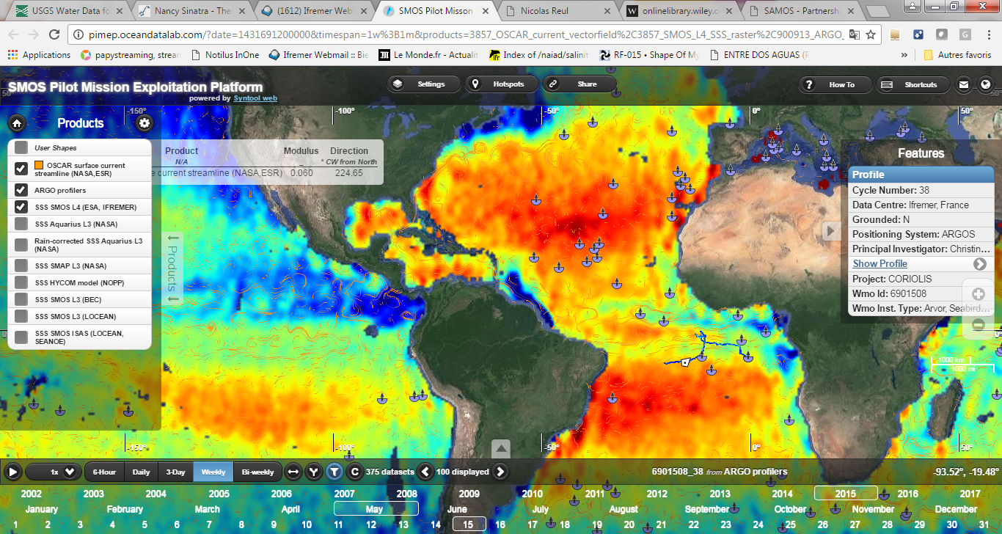

Slide 12
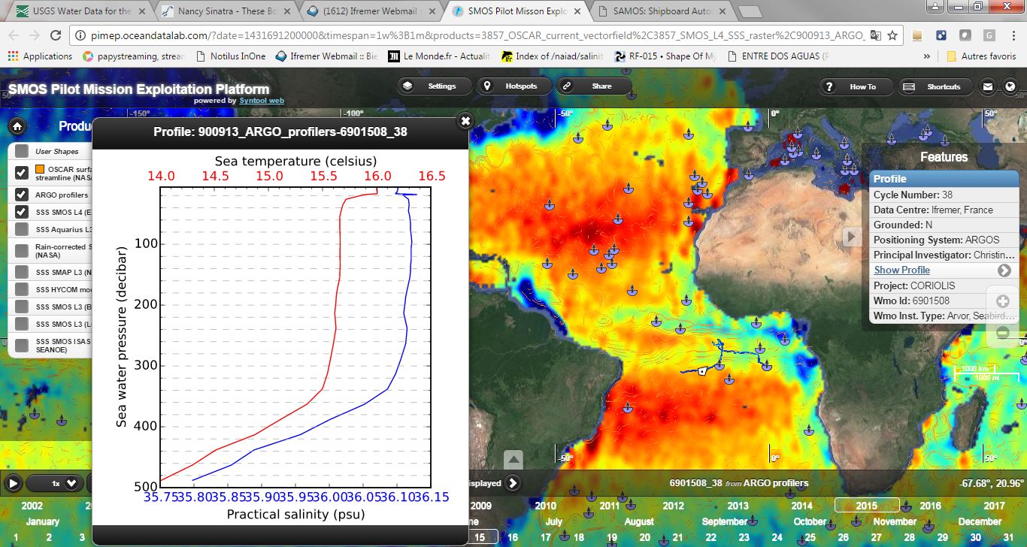

Slide 13
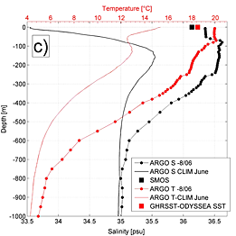
Satellite SSS product value

Slide 14
Additional Information Determined for each ARGO profile
Mixed Layer Depth
Thermocline Depth
Brunt-vassila frequency
Density (z)

Slide 15
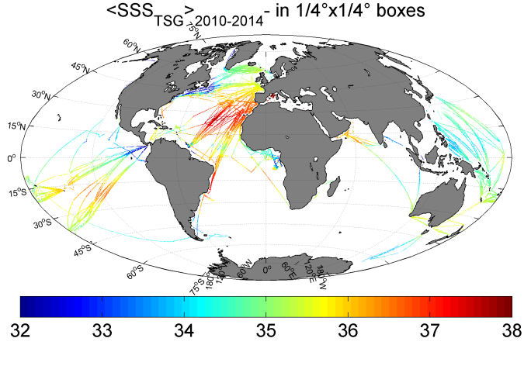
Ship ThermoSalinograph Data (1)
The GOSUD database
Thermo-salinograph data are provided by the GOSUD V3 datasets (see http://www.gosud.org/), 2015 release
GOSUD data include 3 subdatasets:
Sea Surface Salinity from French RESearcH Vessels : Delayed mode dataset, annual release
Sea Surface Salinity from Sailing ships : Delayed mode dataset, annual release.
Sea Surface Salinity data from Voluntary Observing Ships Network
We will consider only Delayed Mode data for start, used only adjusted values and only collected TSG data that exhibit quality flags=1 & 2.

Slide 16
Ship ThermoSalinograph Data (2)
The SAMOS database
Thermo-salinograph data will be also provided by the SAMOS initiative (see http://samos.coaps.fsu.edu/html/)
SAMOS data include 3
subdatasets:
“research“-quality datasets
(10-Day Delay)
Intermediate Data (10-Day Delay)
Preliminary data (Day received)
=> we will use the “research” quality data
Cover 2005-now

Slide 17
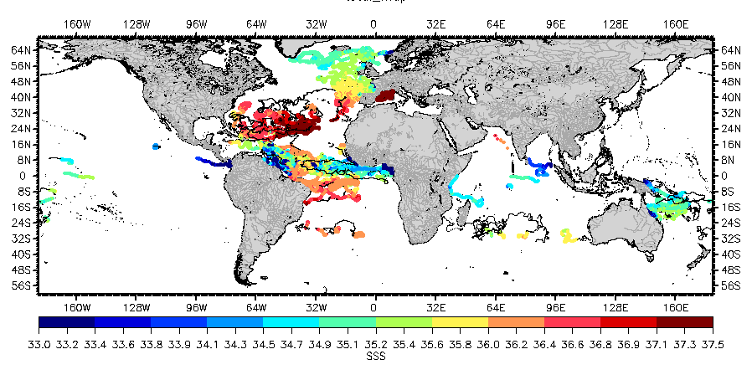
Surface Drifter Data
Surface Drifter data are provided by the LOCEAN datasets
see https://www.locean-ipsl.upmc.fr/smos/drifters/.
The skin depth of the L-band radiometer signal over the ocean is about 1cm
whereas classical surface salinty measured by ships or ARGO floats are
performed at a few meters depth. In order to improve the knowledge of the
SSS variability in the first 50cm depth, to better document the SSS variability in a
satellite pixel and to provide ground-truth as close as possible to the sea surface for validating satellite SSS, the L-band remotely sensed community proposed to deploy numerous surface drifters over various parts of the ocean.
The French GLOSCAL Cal/Val project concentrates on depoyments in the northern Atlantic, the Bay of Biscay and the tropical oceans. Funding of drifters are supported by CNES and Meteo France.
The Spanish Cal/Val project concentrates on deployments in the western Equatorial Atlantic (near Amazone plume, April 2010), along a circunnavigation cruise (Malaspina, October 2010 - May 2011), S. Atlantic, S. Indian, Eq. Pacific, in the Mediterranean Sea, the Bay of Biscay and the subtropical north Atlantic. Funding of drifters are mostly supported by SMOS Barcelona Expert Centre.
The German Cal/Val project concentrates on deployments in the tropical Pacific ocean and the subpolar north Atlantic Ocean, in association with the NOAA Global drifter Program.

Slide 18
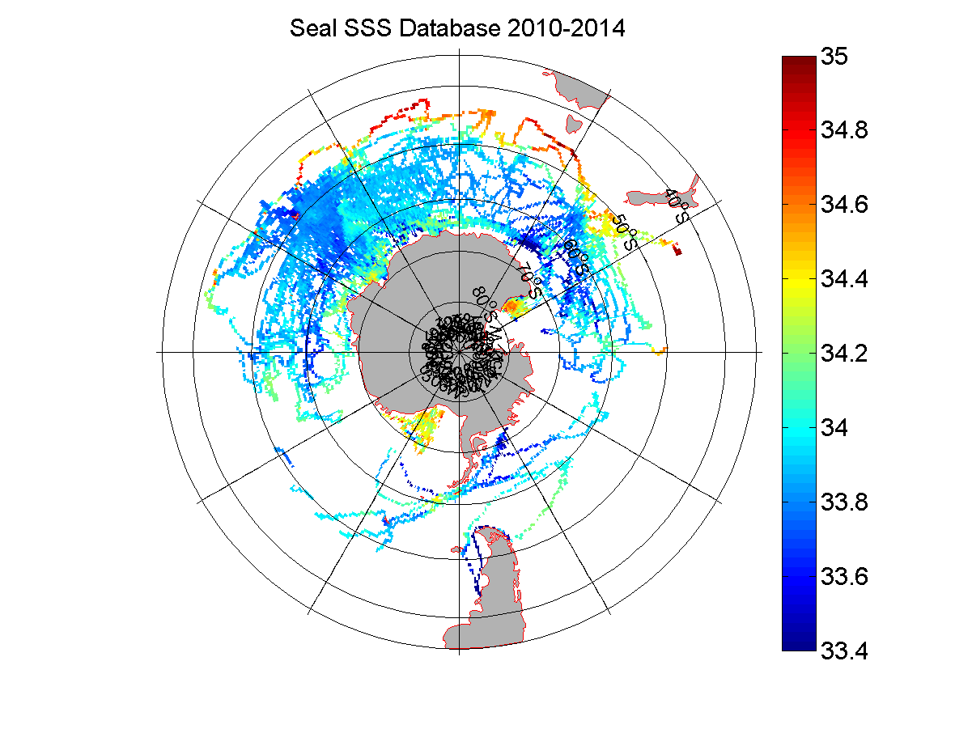
Sea seals Southern ocean Data
The instrumentation of southern elephant seals with satellite-linked CTD tags has offered unique temporal and spatial coverage of the Southern Oceans since 2004. This includes extensive data from the Antarctic continental slope and shelf regions during the winter months, which is outside the conventional areas of Argo autonomous floats and ship-based studies. This landmark dataset of around 75,000 temperature and salinity profiles from 20–140 °E, concentrated on the sector between the Kerguelen Islands and Prydz Bay, continues to grow through the coordinated efforts of French and Australian marine research teams. The seal data (MEOP-CTD in-situ data collection) are quality controlled and calibrated using delayed-mode techniques involving comparisons with other existing profiles as well as cross-comparisons similar to established protocols within the Argo community, with a resulting accuracy of ±0.03 °C in temperature and ±0.05 in salinity or better.
The seal SSS dataset is acessible at the Coriolis data center (http://www.coriolis.eu.org/Observing-the-Ocean/Marine-Mammals).

Slide 19
TSG, Drifter & Sea Seals data processing
Processings:
We spatially average the 1 mn TSG/Drifter data records at the L2 –L4 SSS product spatial resolution:
2 choices: either
one TSG/Drifter value is evaluated per satellite product pixel (averaged within R/2 around the sat pixel center)
or/and
using a running (R/2) averaging window to determined a smoothed TSG data but sampled at high res (1 mn intervals)
or
both

Slide 20
TSG, Drifter & Sea Seals Match-Up files
TSG Match-Up database files will contain the following information (replaced TSG by drifters or Sea seals for the 2 others MDB data files):
-latitude of the location where the co-localized SMOS/TSG data were acquired,
-longitude of the location the co-localized SMOS/TSG data were acquired,
-date at which TSG data were acquired,
-sss measured by TSG (the upper in the upper 10 m),
-sst measured by TSG (the upper in the upper 10 m),
-spatially filtered TSG SSS data, using a running median filter of R/2 km half-width, where R is spatial resolution of satellite SSS product
-spatially TSG SST data, using a running median filter of R/2 km half-width,
-depth of the TSG intake at which SSS & SST measurements are conducted,
- platform number,
- ship call sign,
- Rain at TSG location and date,
- 7days -long time series of the 3-hourly rain data colocated at TSG location and prior to and incuding TSG data date,
-Wind speed components from ASCAT daily fields interpolated at TSG sample location and date,
-7days -long time series of the Daily wind speed components from ASCAT daily fields colocated at TSG sample location and prior to and incuding TSG sample date
-Satellite L4 SSS closest in space (within 0.25° radius) from TSG observation and generated during the week including the TSG SSS observation
-providing center

Slide 21
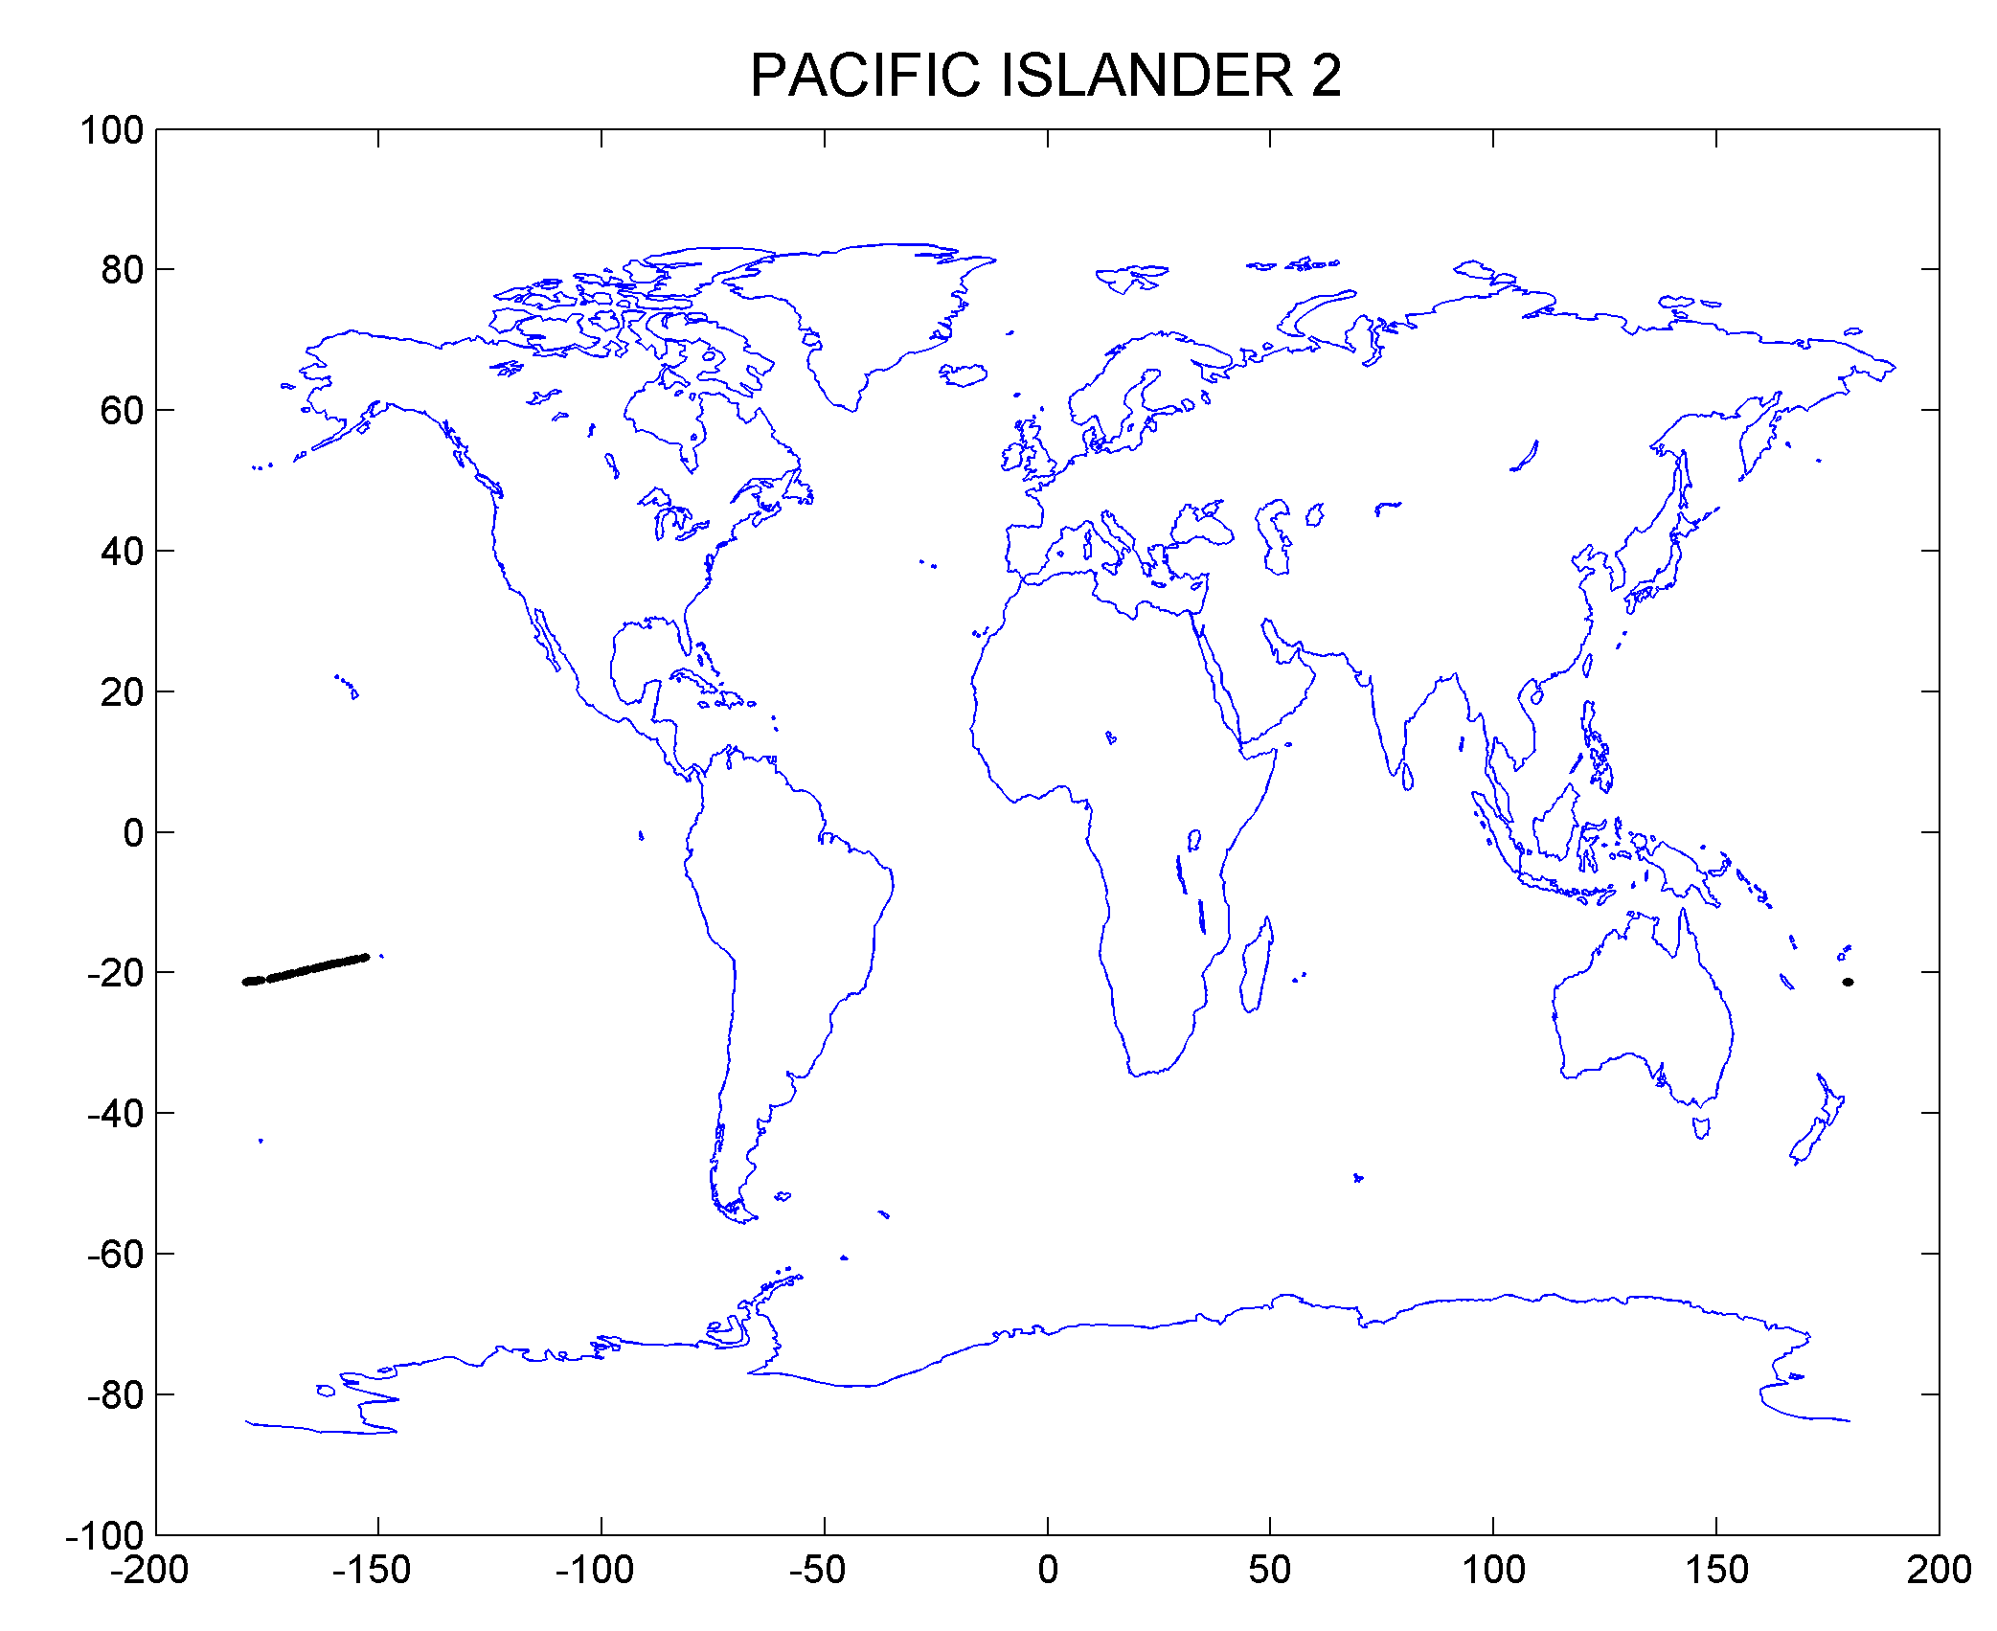
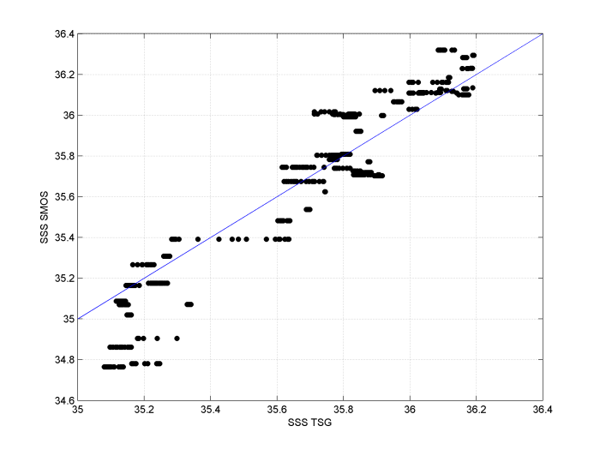
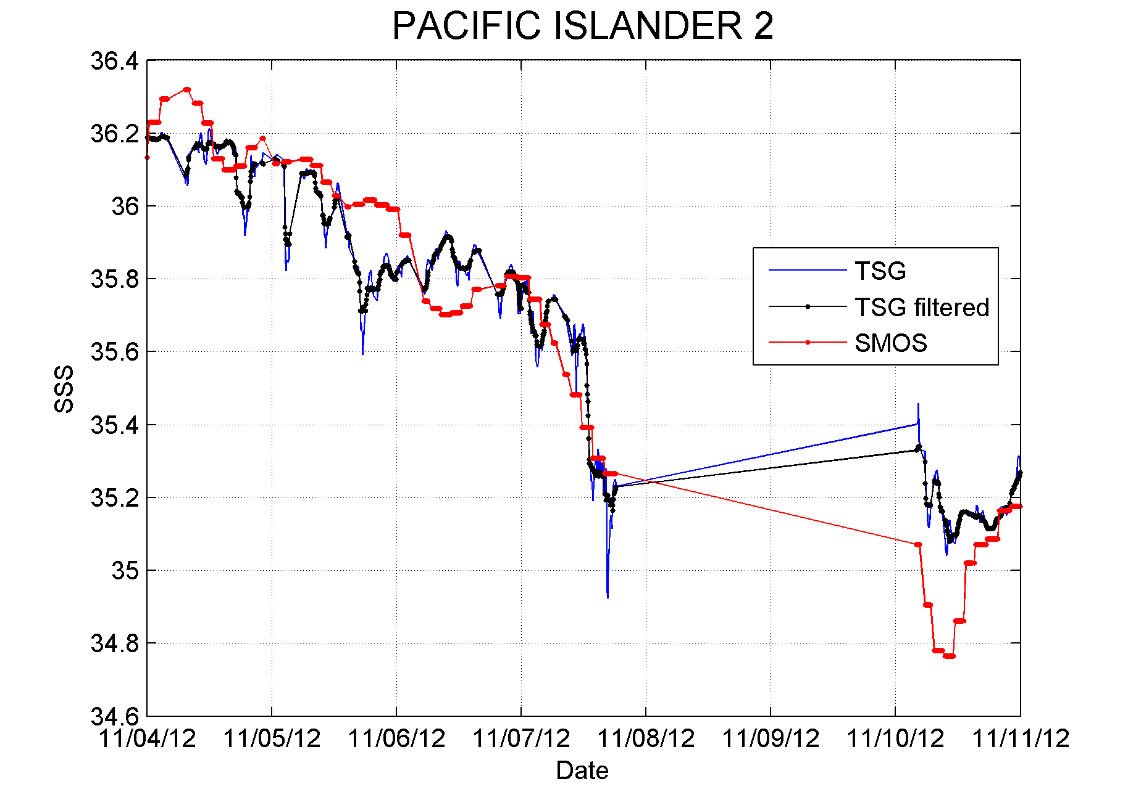
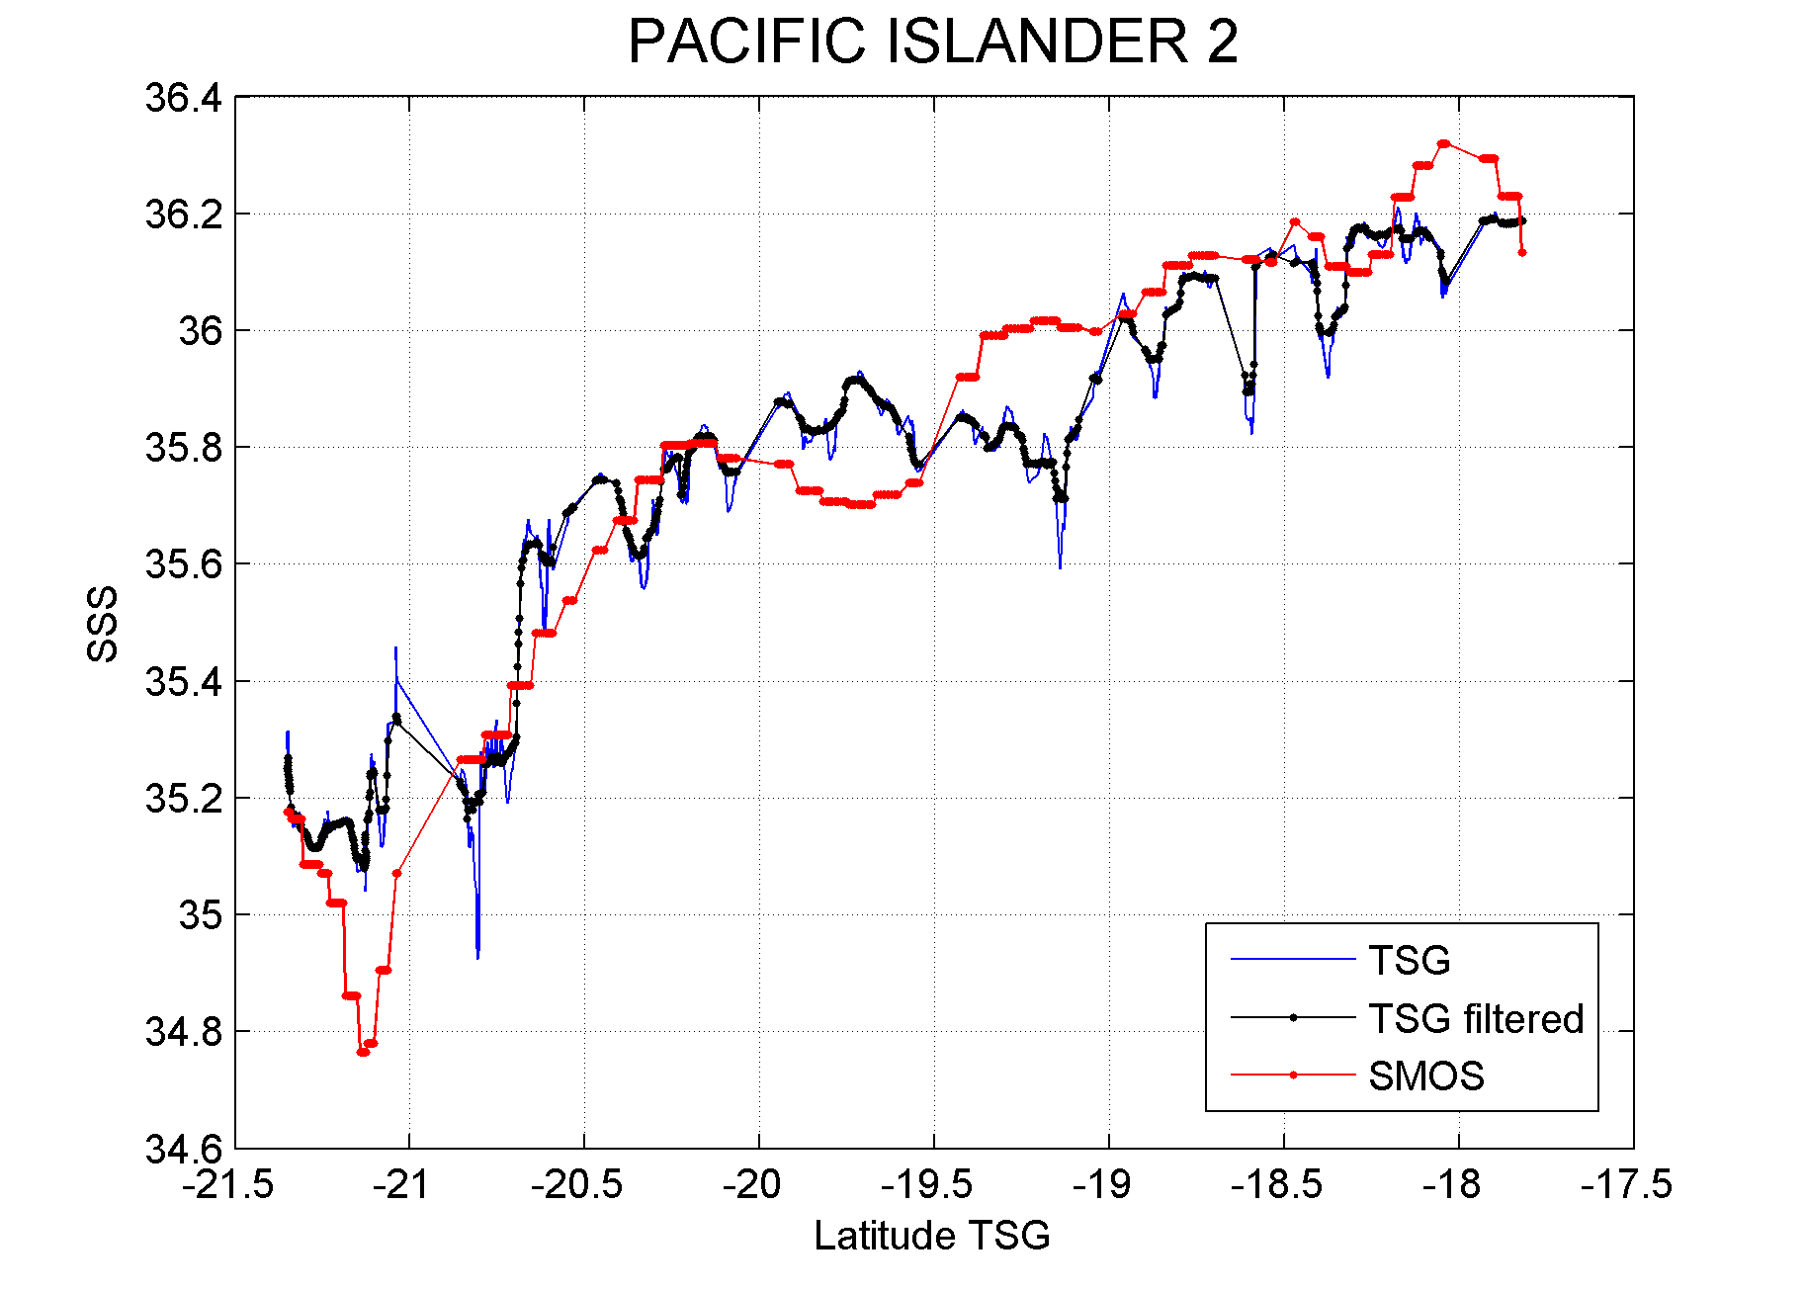
For each TSG (& Drifters) Match-Up files
+ Statistics
Figure 6: Example of co-localized TSG SSS data and SMOS weekly SSS product.

Slide 22
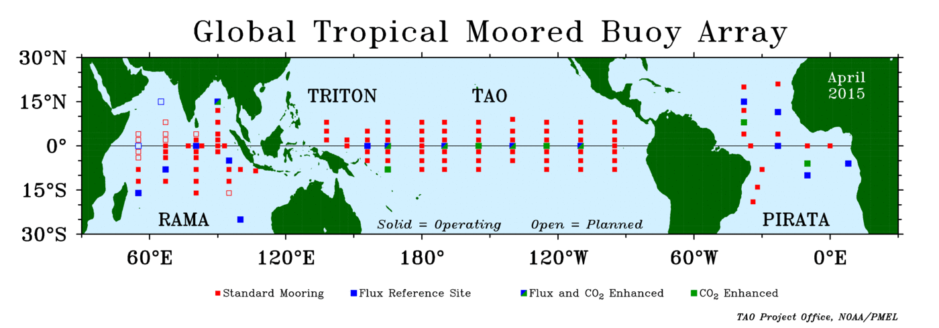
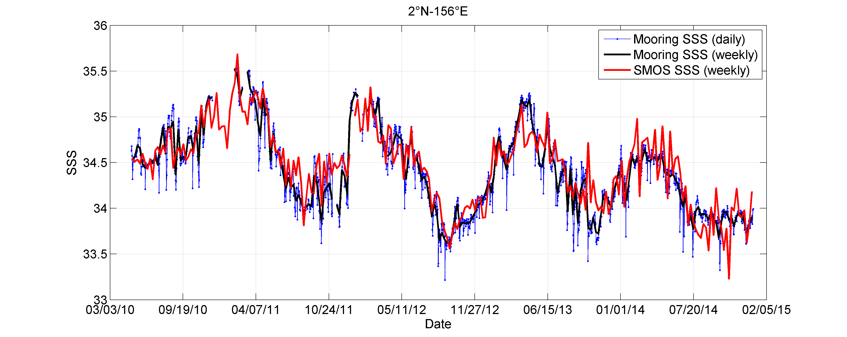
The Pi-Mep Global Tropical Moored Buoy Array MDB
The Global Tropical Moored Buoy Array is a multi-national effort to provide data in real-time for climate research and forecasting. Major components include the TAO/TRITON array in the Pacific, PIRATA in the Atlantic, and RAMA in the Indian Ocean.
The Global Tropical Moored Buoy Array is a contribution to the Global Ocean Observing System (GOOS), Global Climate Observing System (GCOS), and the Global Earth Observing System of Systems (GEOSS).
Data collected within TAO/TRITON, PIRATA and RAMA comes primarily from ATLAS and TRITON moorings. These two mooring systems are functionally equivalent in terms of sensors, sample rates, and data quality.
We will select data measured at 1 meter depth and standard quality (pre-deployement calibration applied) & highest quality (pre/post calibration agree)
Example of time series at TAO/TRITTON mooring (2°N,156°E) showing the daily mooring SSS (blue), the weekly mooring SSS (black) and the SMOS L4SSS.

Slide 23
Generic Pi-MeP Systematic Validation Zones

Slide 24
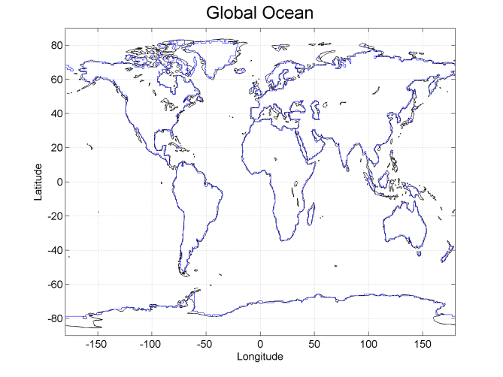
Generic Pi-MeP Systematic Validation Zones
The validation statistics of the Pi-Mep products will be evaluated over the following 10 specific oceanic domains defined following the convention in MyOcean & CMEMS
Global Ocean
Arctic Ocean
North Atlantic
Tropical Atlantic
South Atlantic
North Pacific
Tropical Pacific
South Pacific
Indian Ocean
Southern Ocean
SMOS Coastal zones
(<800km)

Slide 25
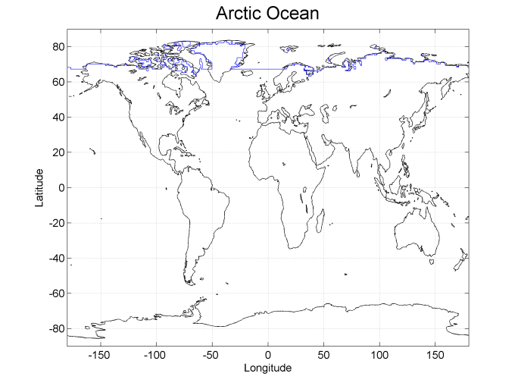
Arctic Ocean

Slide 26
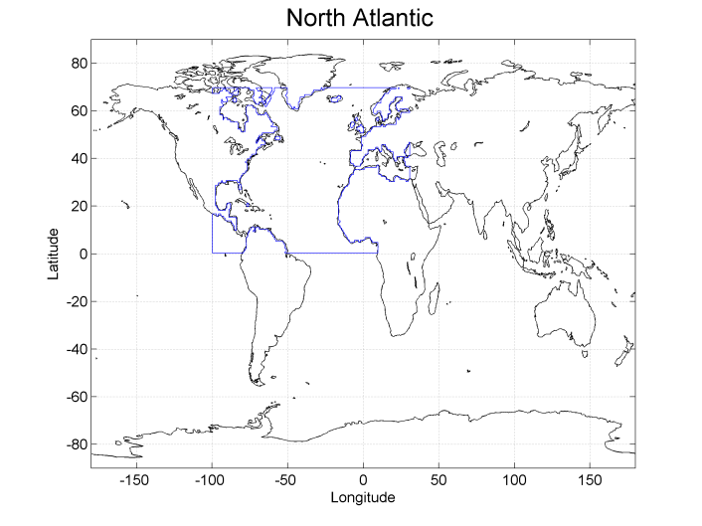

Slide 27
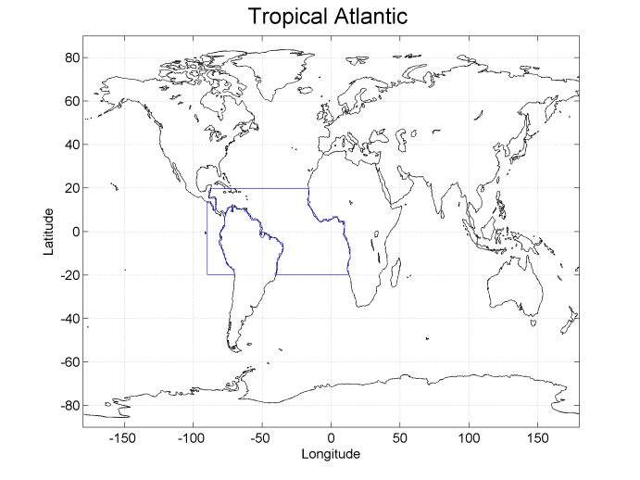

Slide 28
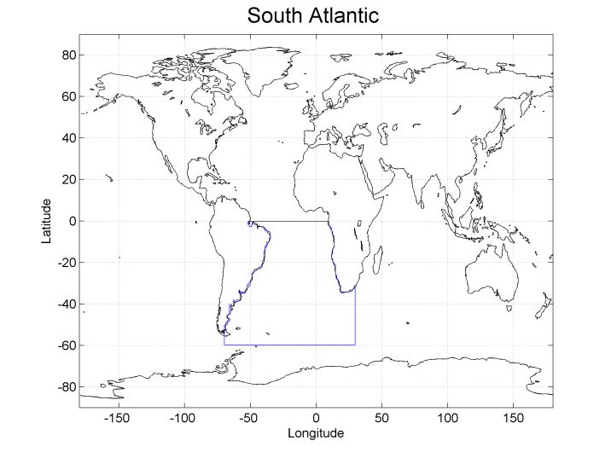

Slide 29
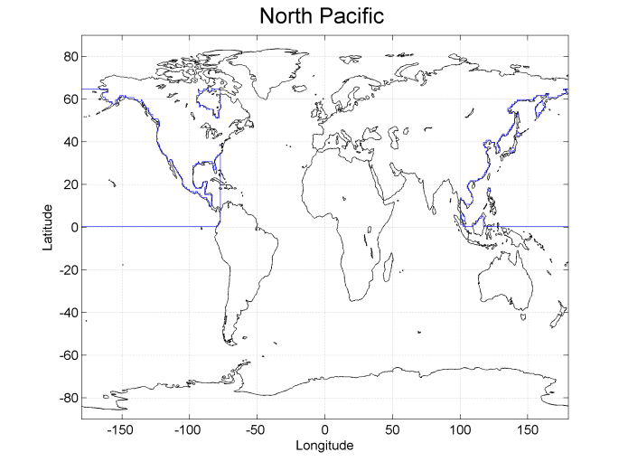

Slide 30
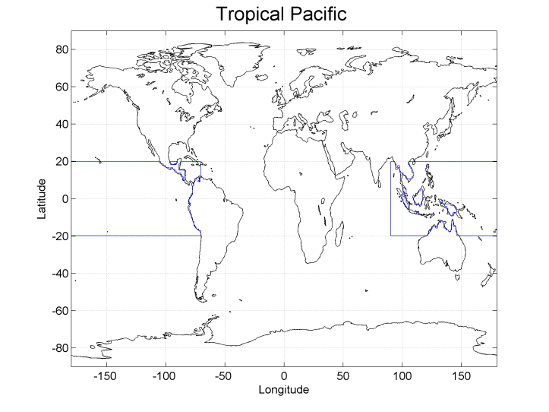

Slide 31
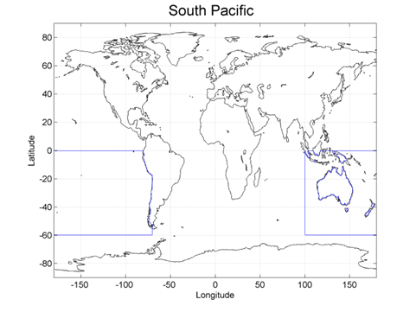

Slide 32
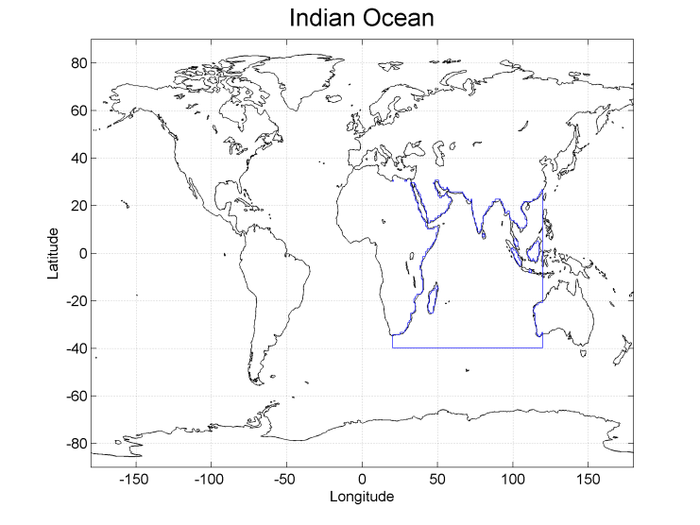

Slide 33
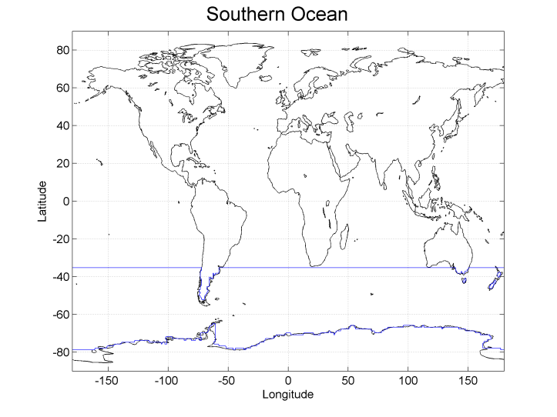

Slide 34
Delayed Mode versus Near Real Time
In situ data are provided with different ‘Quality stamps’:
ARGO,TSG, mooring, drifters, campaign data are obtained either
-In Delayed Mode (DM) => best ‘research’ quality after re-analysis
& Near Real Time (NRT)=> least confidence
We will regularly update the MDB files to include new DM data provided by in situ sensors
We will split the MDB database for the matchup according to QC control. Any further insight?

Slide 35
MDB file format
MDB file will be made available per SMOS product, per In situ Sensor type & regions
MDB files will be provided in NETCDF 4 format
Match-Up Database netcdf Files Naming conventions
The generic filename convention for the Pi-MEP MDB products will be given as defined below: PiMEP_MDB_sensor_Res_YYYY.DD_YYYY.DD_V01.nc
Colored symbols indicate digital variables defined as follows:
The first variable sensor indicate the in situ sensor types:
Sensor=
"ARGO" for Coriolis DM ARGO floats Match-Ups Sensor
"TSG" for GOSUDV3 TSG DM Match-Ups Sensor
"TSG_SAMOS" for SAMOS TSG Match-Ups Sensor
« TSG_Research_Vessel » for french research vessel data
« TSG_Sailing_ship » for equipped racing sailing boat
"TAO" for NOAA/AOML TAO moorings Match-Ups Sensor
"PIRATA" for NOAA/AOML PIRATA moorings Match-Ups Sensor
="RAMA" for NOAA/AOML RAMA moorings Match-Ups Sensor
="drifter" for LOCEAN surface drifter Match-Ups
Sensor="seal" for Coriolis DM sea seals CTD Match-Ups

Slide 36
The second YYYY (4 digits) and third DD (3 digits) variables indicate the year and the ordinal number of the day in year corresponding to the start date of the time period over which the SMOS product data were considered to generate the composite product (if L3 & L4).
The fourth YYYY (4 digits) and fifth DD (3 digits) variables indicate the year and the ordinal number of the day in year corresponding to the end date of the time period over which the SMOS data were considered to generate the composite product (if L3 & L4).
The last variable 01 (2 digits) indicate the product processing version.
Example: for the ARGO MDB product at 0.5 degree resolution generated from 27 aug 2010 (day of year=239) to 2 of Sep 2010 (day of year=245) using the processing version 1, the file name is:
PiMEP_MDB_ARGO_0.5deg_2010.239_2010.245_V01.nc

Slide 37
Generation of systematic Pi-MeP Validation Reports

Slide 38
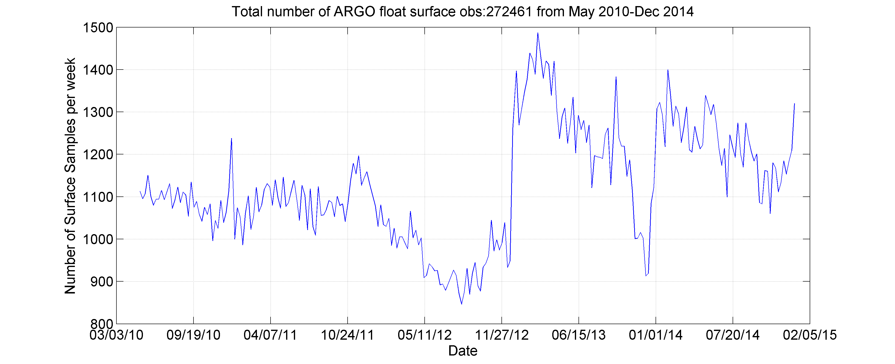
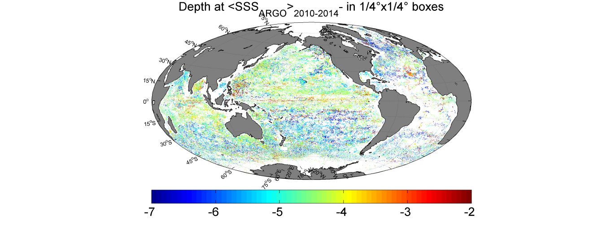
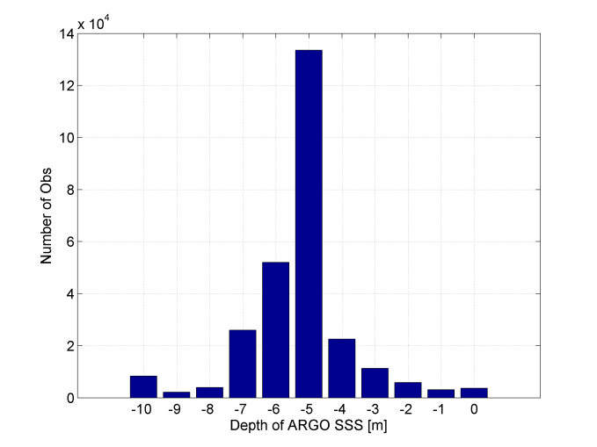
Generation of (monthly) Systematic Validation Reports
Input :MDB files
Reports =>
MDB Data availability
MDB Data specificities
Figure : Left: Global average depth of ARGO qualified SSS data collected. Right: histogram of the depth of ARGO SSS match-ups.

Slide 39
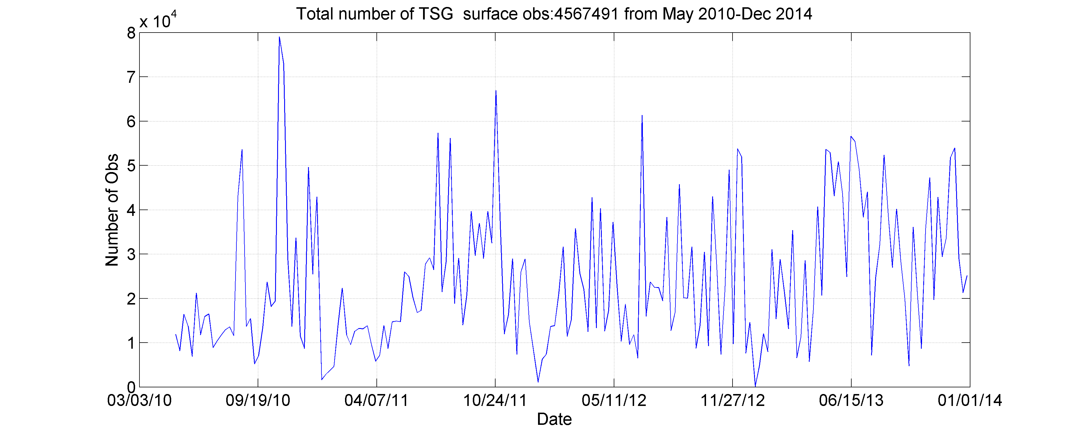
Generation of (monthly) Systematic Validation Reports
Input :MDB files
Reports =>
MDB Data availability
MDB Data specificities
Figure : Global average number of TSG qualified Gosud SSS data collected.
Figure : Global coverage of TSG qualified Gosud SSS data collected.

Slide 40
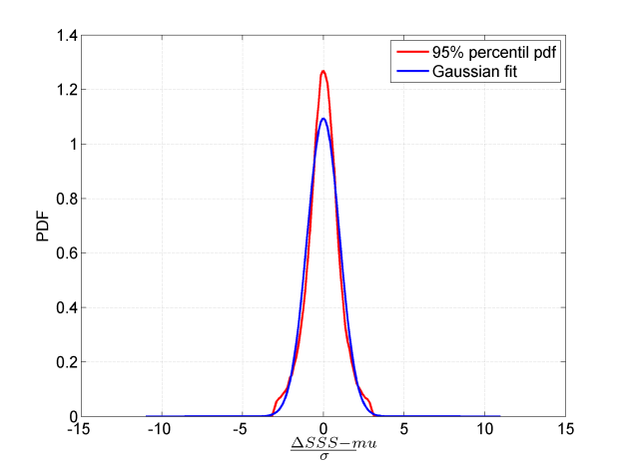
Generation of (monthly) Systematic Validation Reports
For each product, each region
Generic statistics per region
+ RMSD

Slide 41
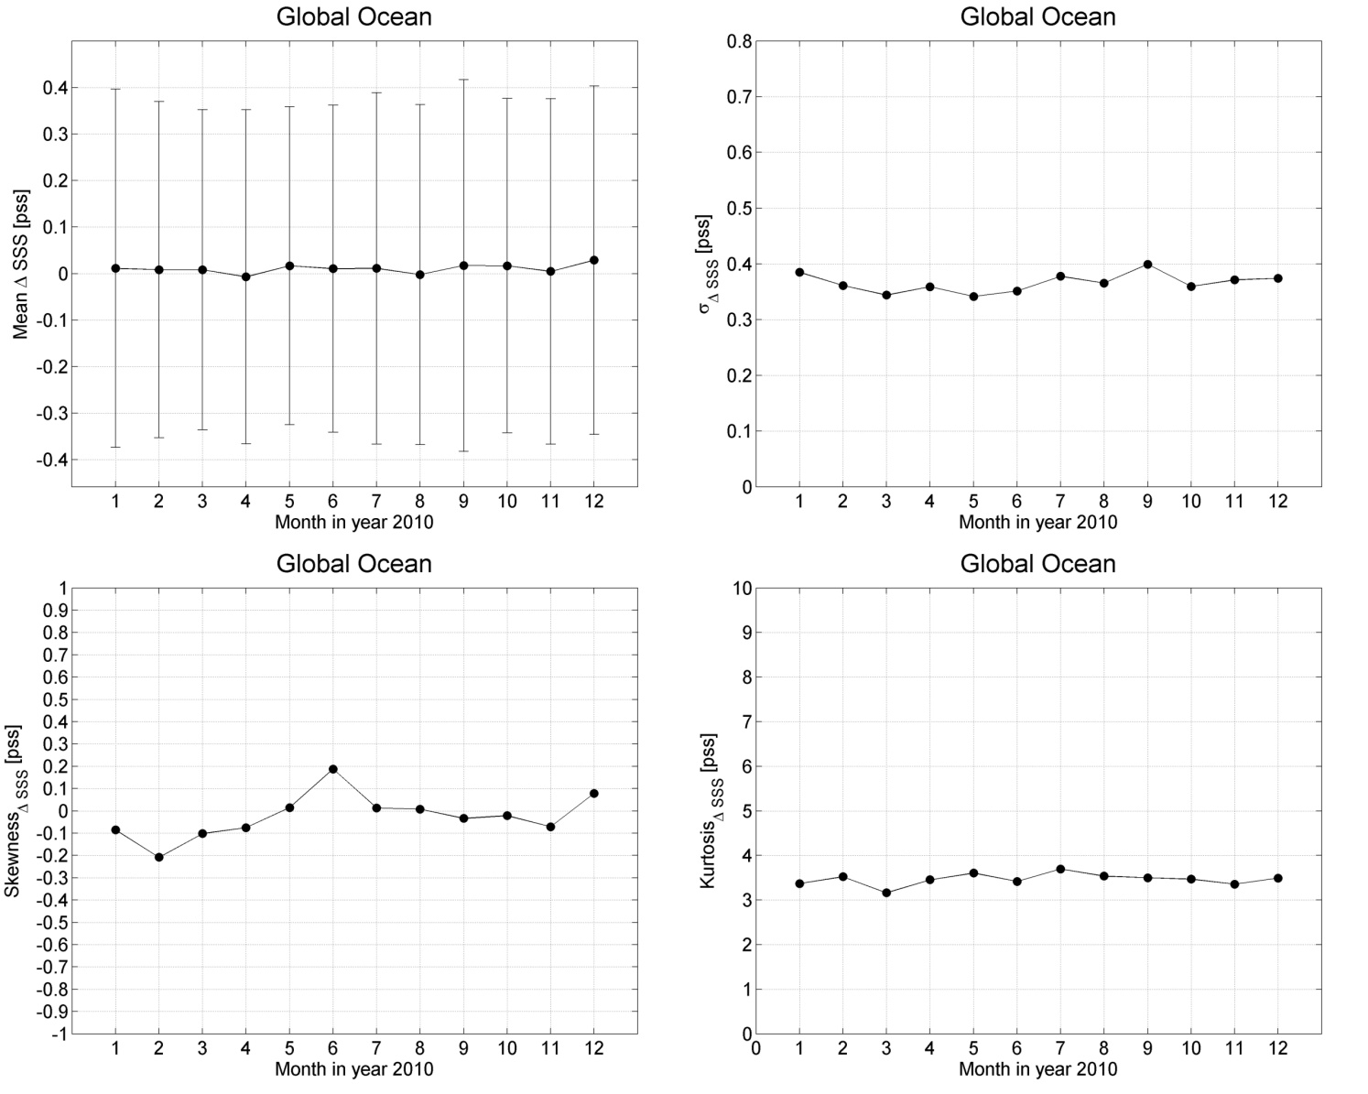
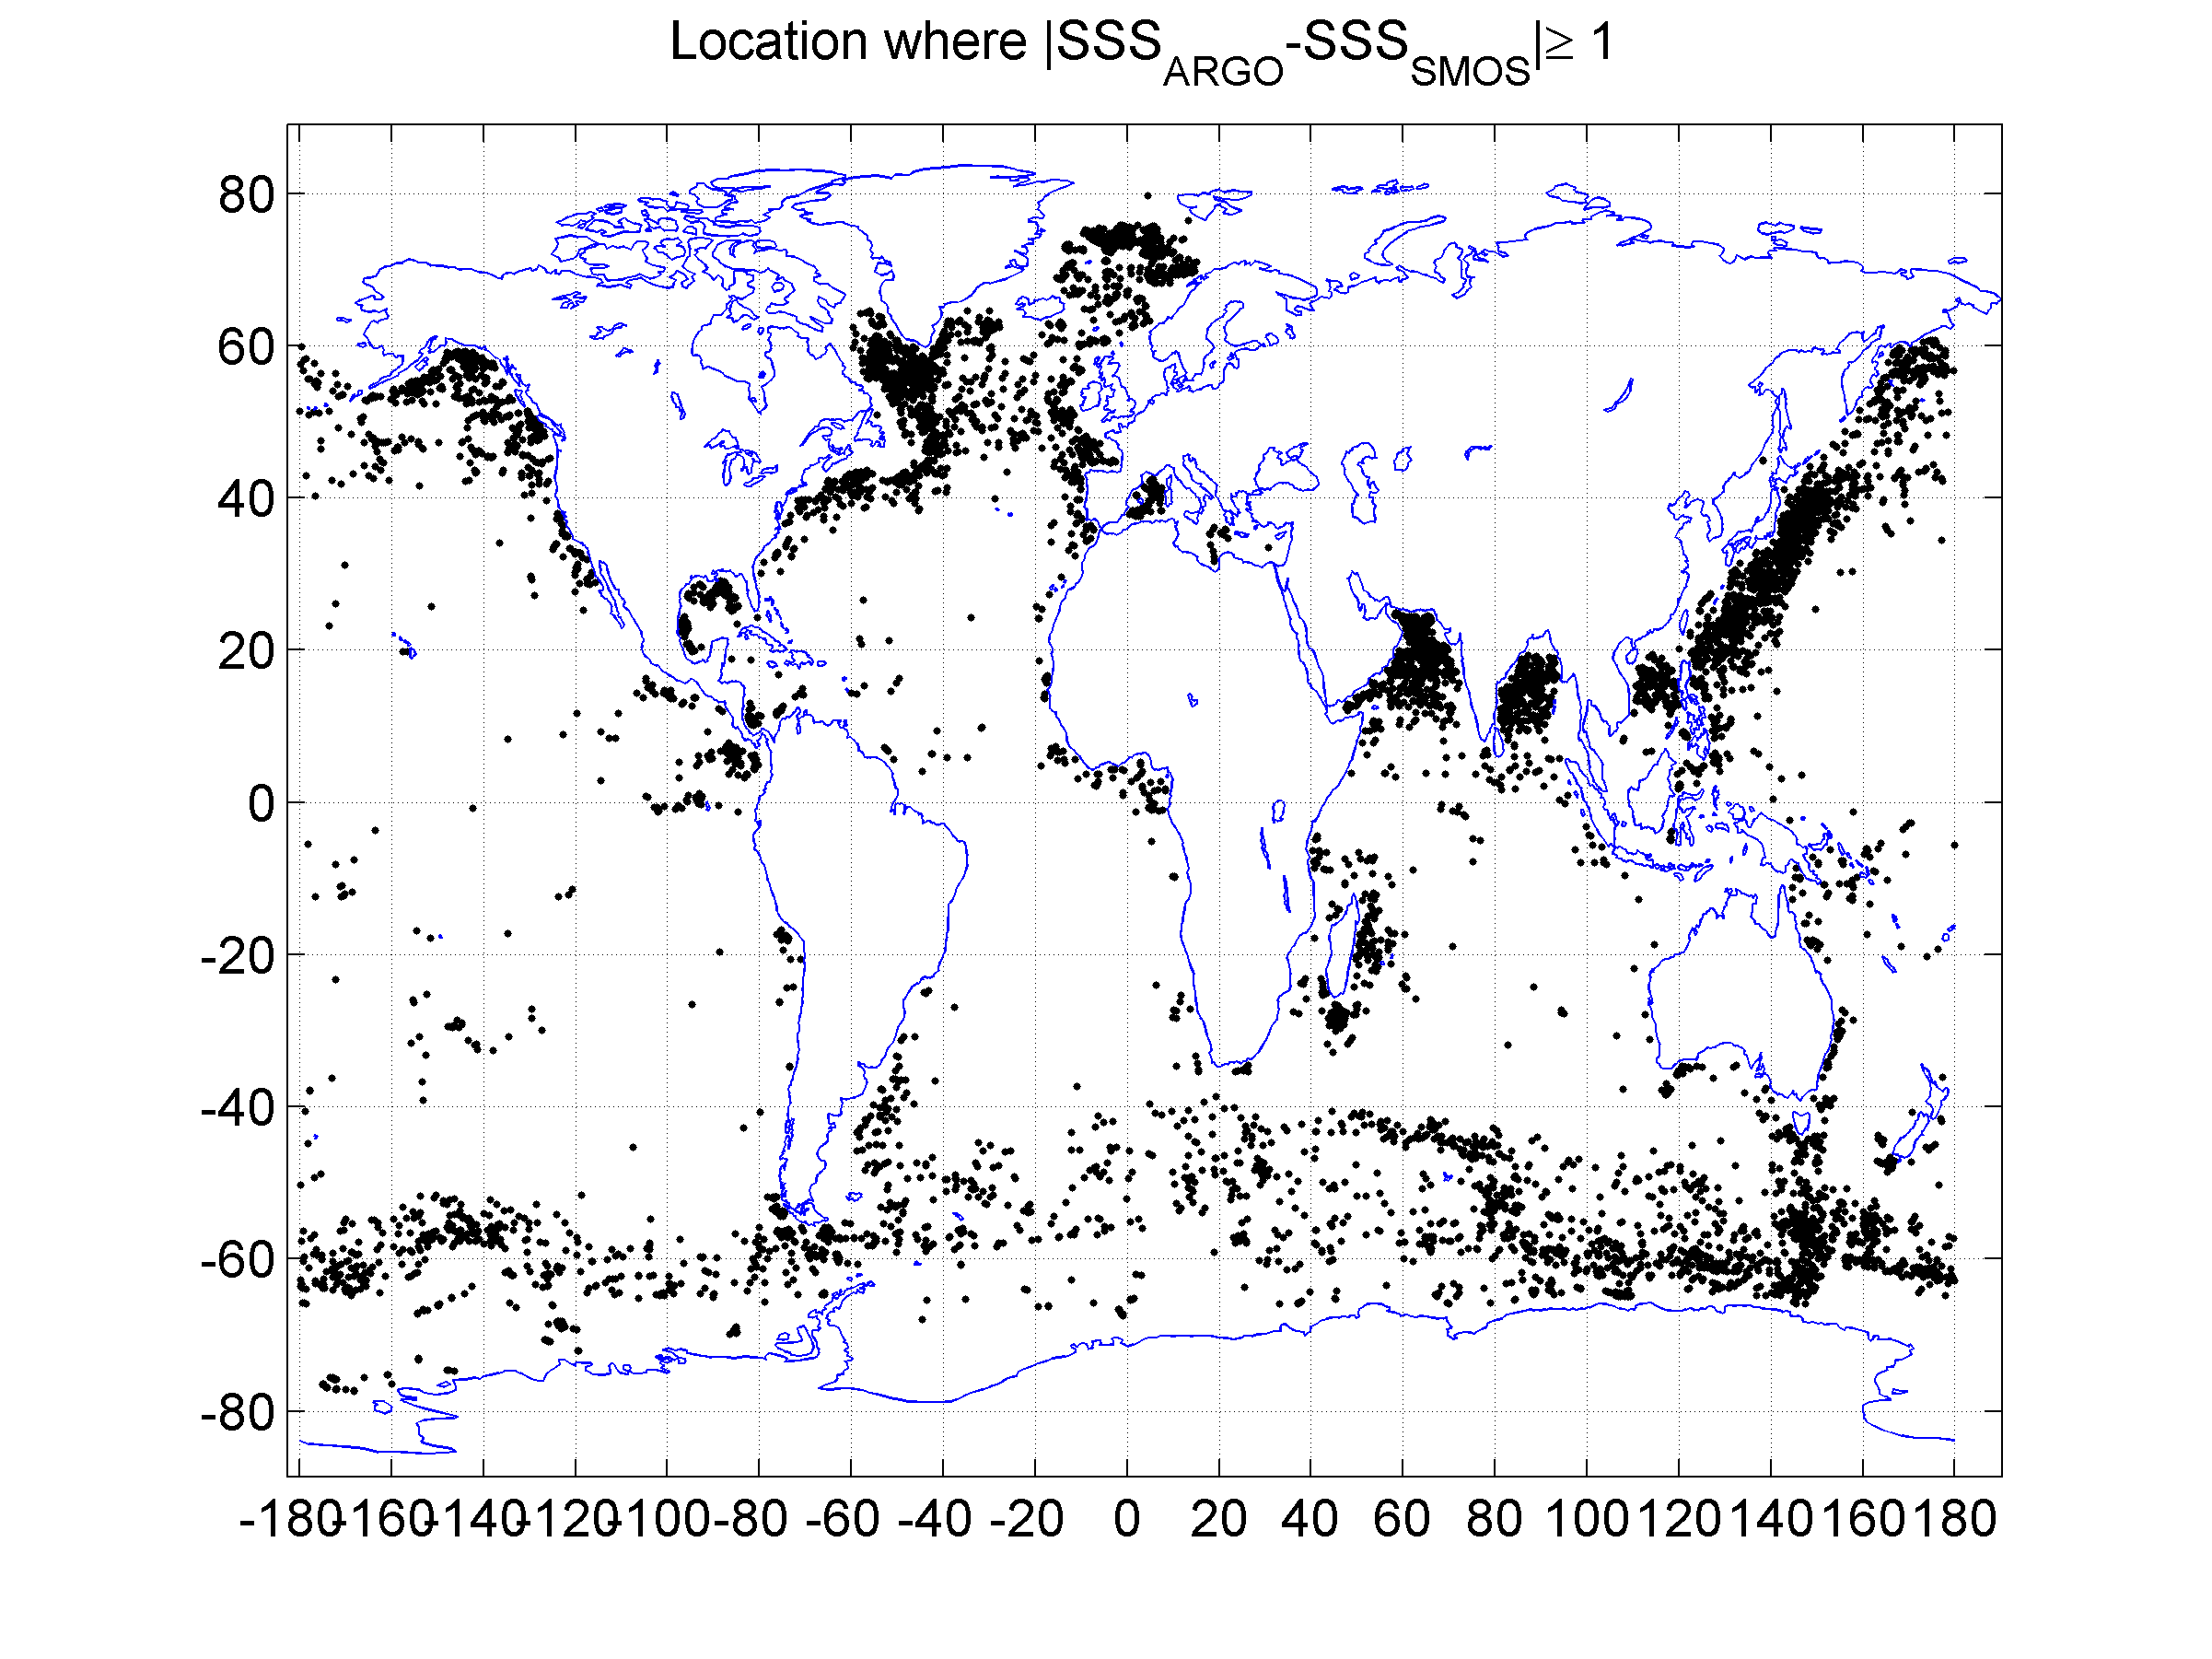
Generation of (monthly) Systematic Validation Reports
For each product, each region
Generic statistic per region
Plot of the statistics evolution in time

Slide 42
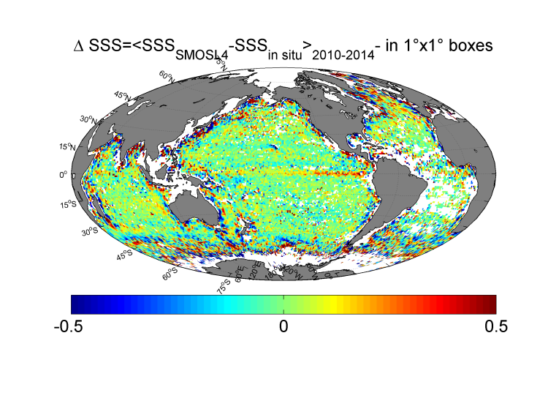
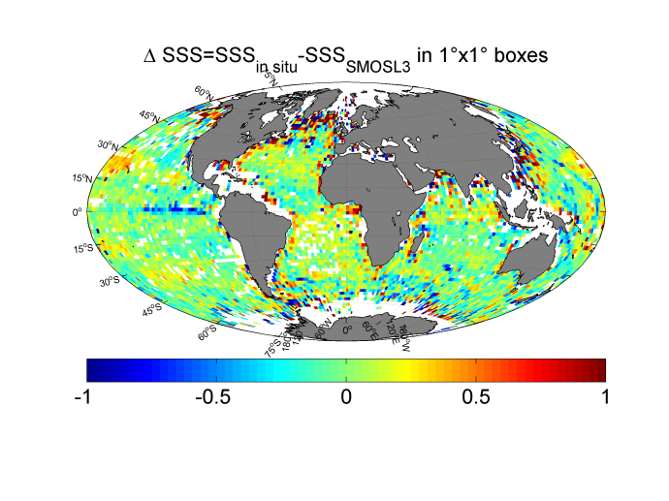
Figure: Spatial distribution of the mean SSSSMOS-SSSin situ where SMOS are the weekly L4 composite data at 0.5° resolution after averaging
the ΔSSS 2010-2014 data over 1°x1° boxes. Left:

Slide 43
Enhanced Validation Metrics

Slide 44
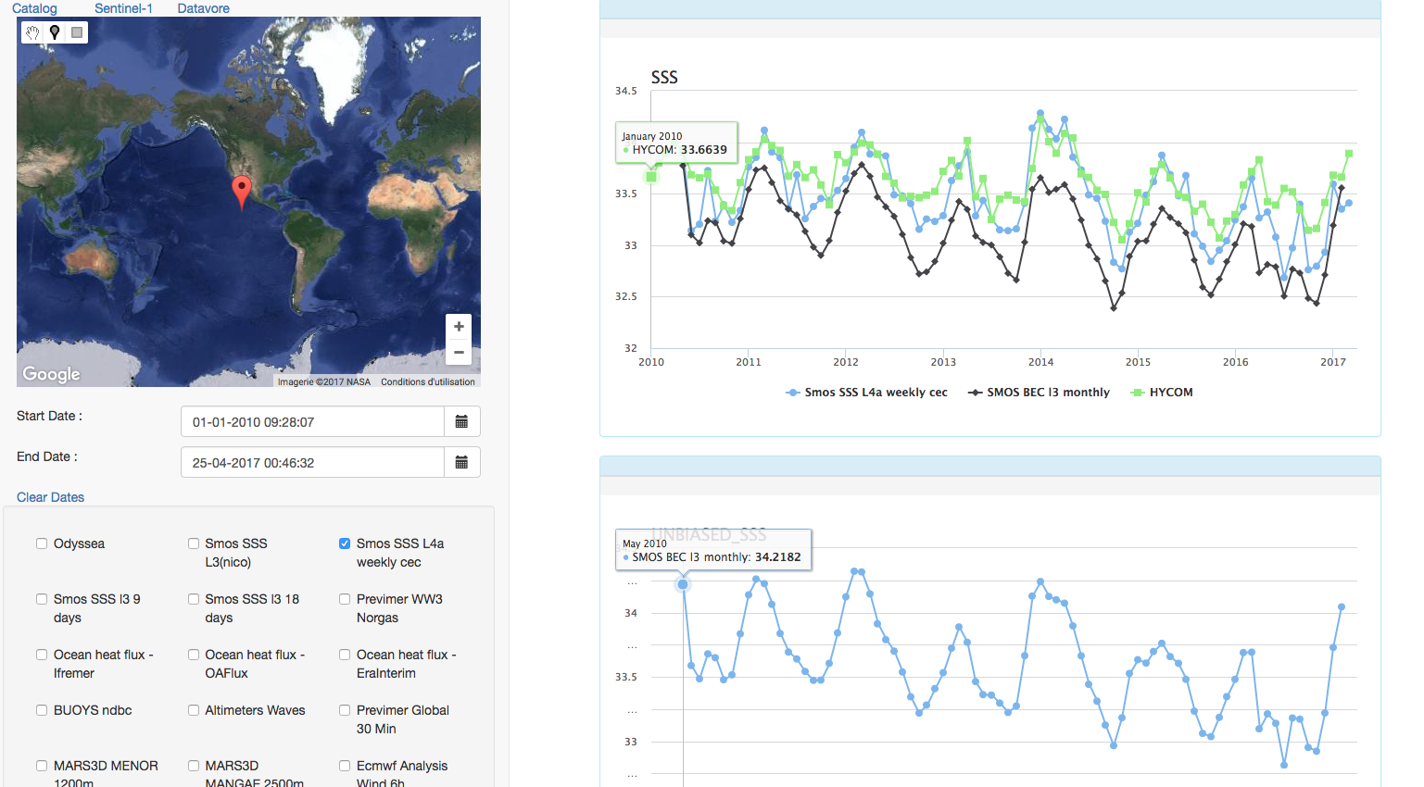
MDB For a user-selected Region, a given virtual mooring, a given time period=> see S. Guimbard pres on tools
Comparison statistics between user-driven choice
Of products

Slide 45
Other Proposed Enhanced Metrics
SSS Biais dependencies with other EO variables
Spectral Analyses
Temporal at real or virtual moorings
Spatial spectral analyses
Correlation Analyses
2D Cross-correlation between SSS (L2->L4) & other varaibles:
SSS SMOS & SSS SMAP
SSS SMOS & SLA
Etc…
Frontal Analyses:
Meridional and zonal gradient mapping

Slide 46
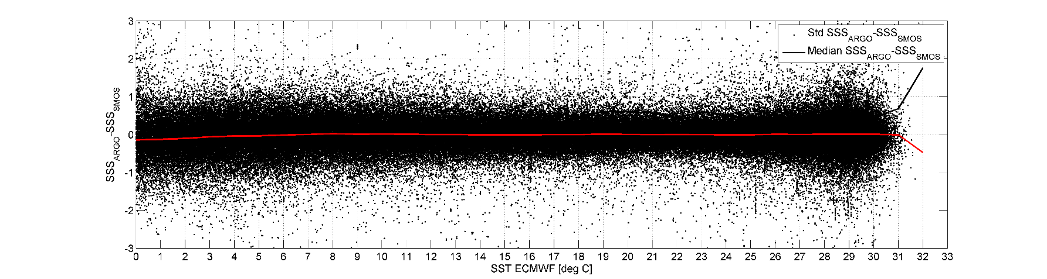
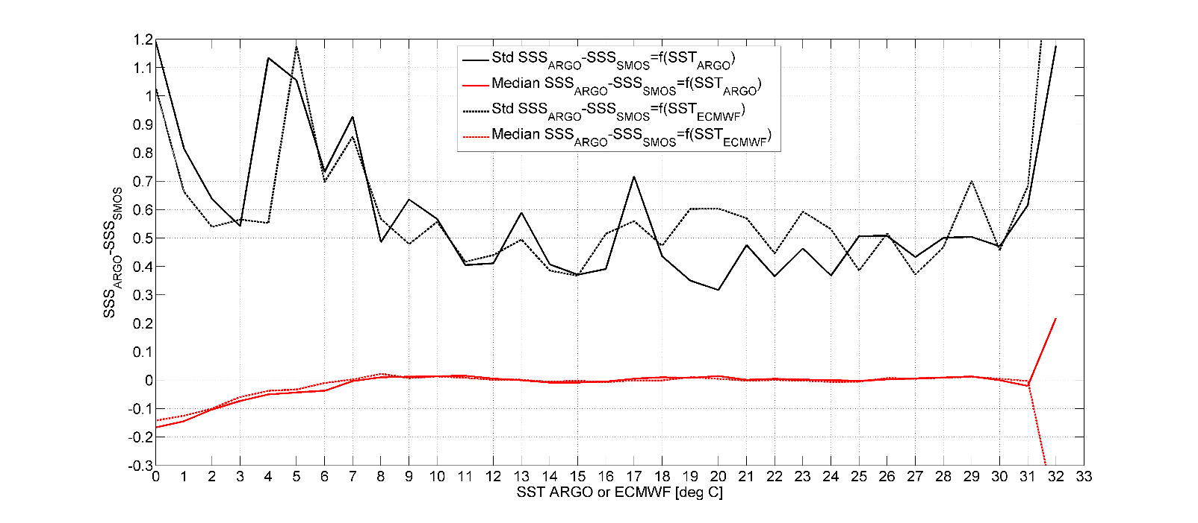
Satelitte SSS bias geophysical dependencies
For each region & each MDB types, we propose to monitor:
SSS_{sat}-SSS _{in situ} properties as function of the following EO variables:
_{SST (local+history)}
_{Wind (local+history)}
_{Rain (local+hirstory)}
_{Others ???}

Slide 47
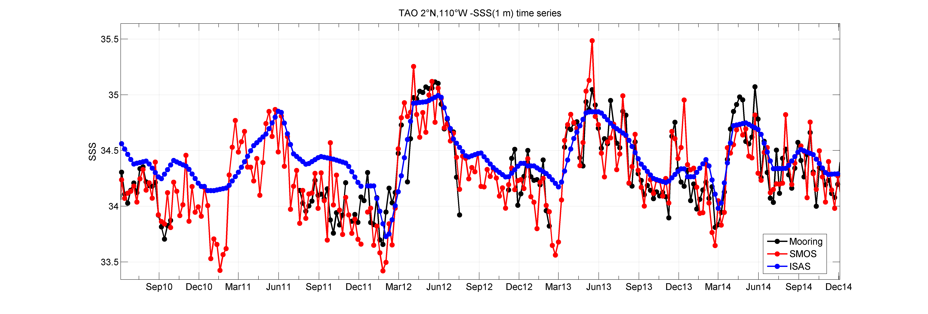
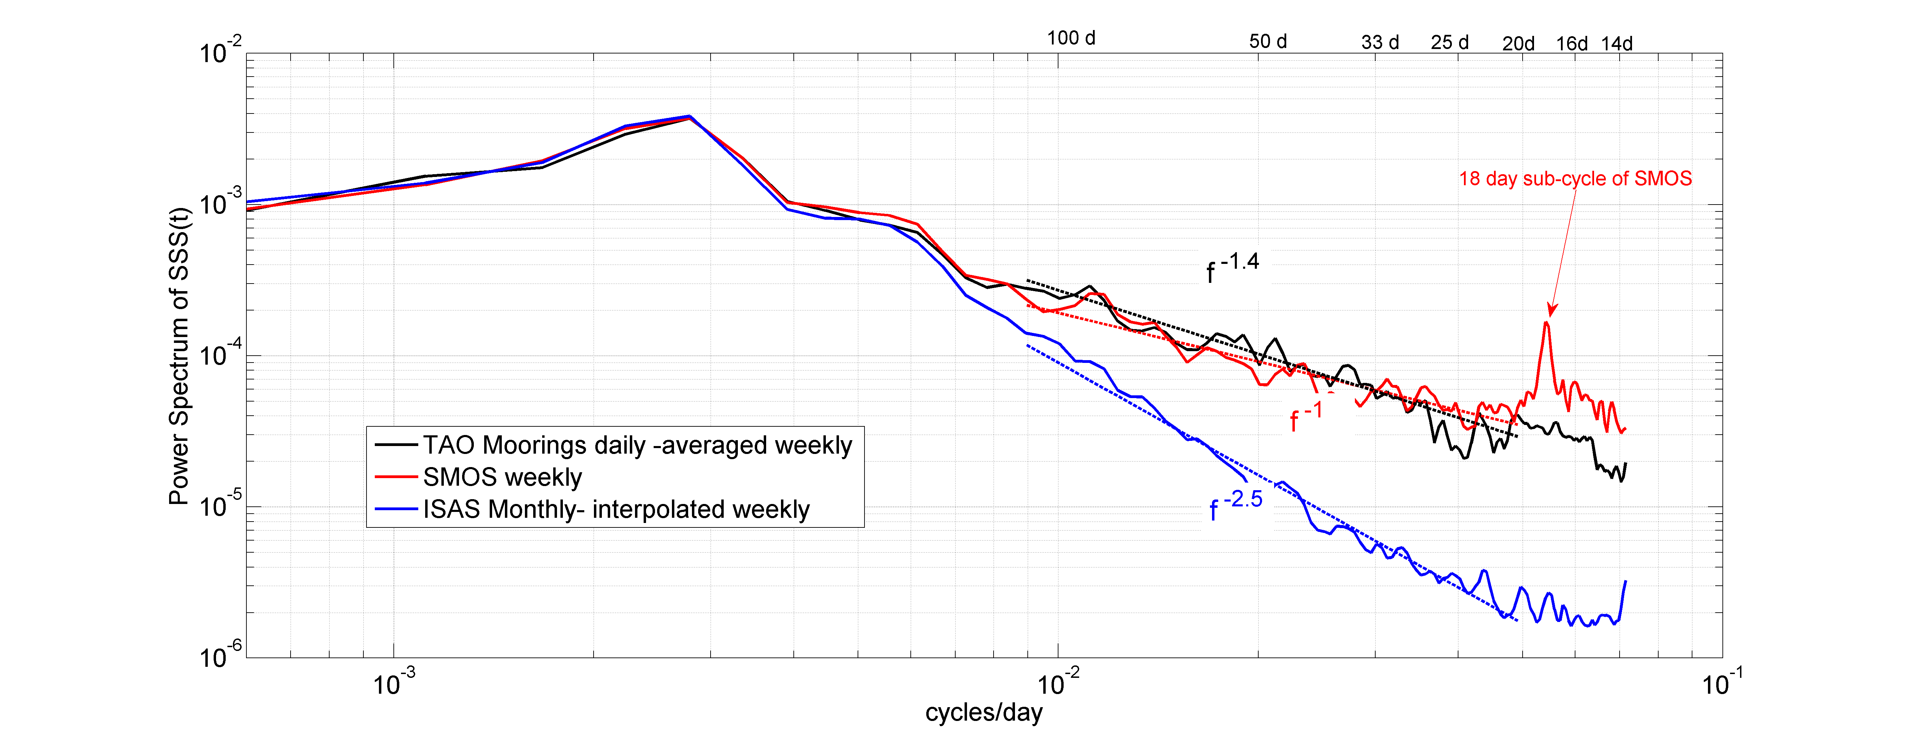
Temporal Spectra
At Moorings
Can be done at
Any virtual location
Relevant SMOS SSS variability down to ~20 days
Mooring weekly SSS
SMOS weekly 50 km
In situ OI monthly 50 km

Slide 48
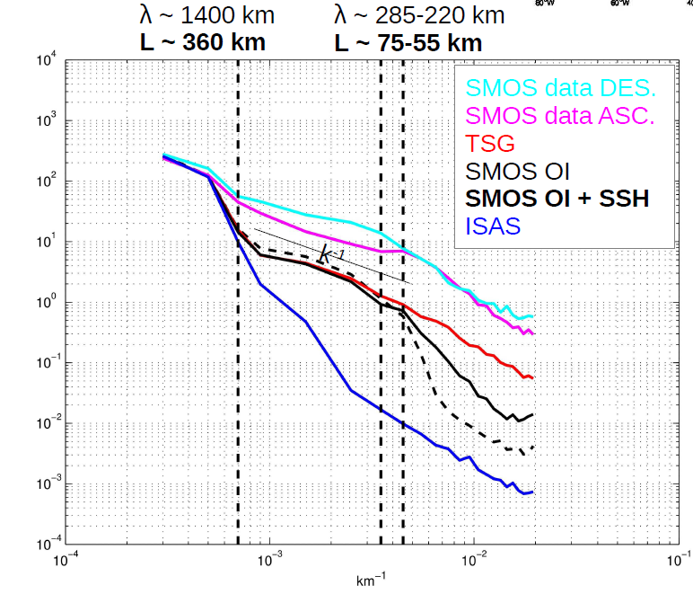
Spatial Spectra in sub-domains
Spatial Spectra
In Spatial boxes

Slide 49
2D correlation coefficients between SSS and SSH (black curve) and between SST and SSH (blue curve) within the 5x 5 box defined by [49.75W-44.75W;40.25N-45.25N]. Surface salinity used corresponds to
SMOS (top), Aquarius (middle) and SMAP (bottom) satellites.
For the selected ocean process case study
(see next talk by NR)
We propose to evaluate the 2D correlation
coefficients between:
SMOS user-chosen SSS product and
SSS from Aquarius & SMAP
SST from reynolds, GHRSST & ECMWF
SLA from Aviso
Chla
CDOM
Correlation SSS/SLA SMOS
Correlation SSS/SLA Aquarius
Correlation SSS/SLA SMAP

Slide 50
Discussions
Suggestions ?
Comments ?

