Slide 1

Overview of the
« SMOS Pilot-Mission Exploitation Platform (Pi-MEP) »
Nicolas Reul
SMOS Pi-MEP –SAG meeting ESTEC 03/05/2017

Slide 2
Outline
Introduction & context
The project team & interaction with SAG
The « Ifremer » ICT infrastructure

Slide 3
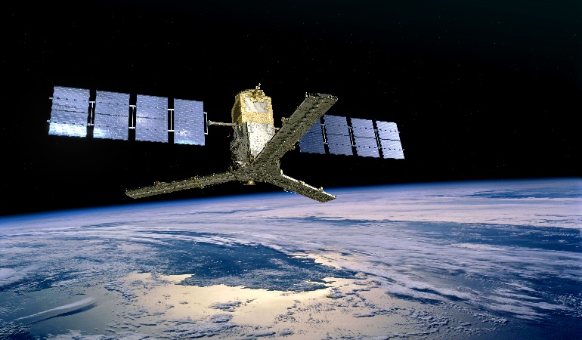
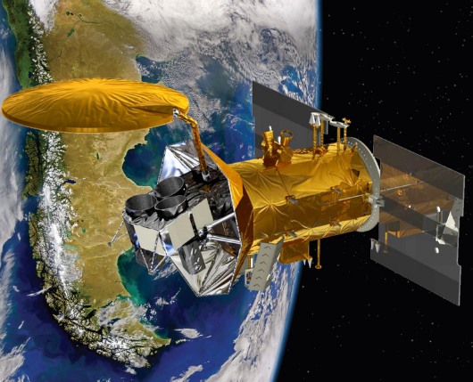
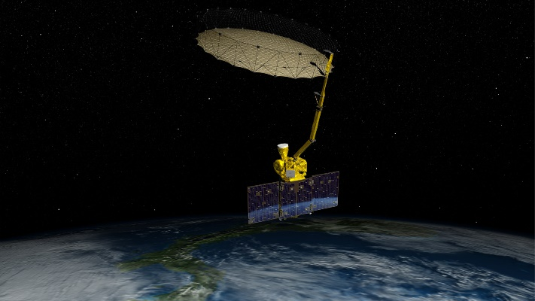
Context
SMOS and other satellite SSS missions are relatively « new »
ESA SMOS: launched in 2009-now
First discovery of « radiometric interferometer EO data from Space» at L-band
=> continuous progresses in reconstructed image quality
First discovery of SSS measurement from Space
=> continous progresses in SSS retrieval quality
swath ~1000 km, spatial resolution 30-80 km (mean 43 km), revisit time ~3days
NASA Aquarius: june 2011-june 2015:
First discovery of «real aperture radiometer EO data from Space» at L-band
SMOS & Aquarius SSS & Tb data can be compared
swath ~300 km, spatial resolution 100 km, revisit time ~7days
NASA SMAP launched Jan 2015-now
Continuity of «real aperture radiometer EO data from Space» at L-band
SMOS & SMAP SSS & Tb data can be compared
swath ~1000 km, spatial resolution 40 km, revisit time ~3days

Slide 4
A collection of SMOS SSS data products
Today, the SMOS SSS user community is proposed with
1 L2 SSS product (there were 3 SSS values within each L2 data product before the next version release!)
~ 30 level 3 & 4 SSS products !!!!
Not mentioning the different SMOS data reprocessing versions….
This large number of datasets is explained by the exploratory nature of the SMOS mission : new instrumental concept, discovery of the first spaceborne SSS measurements
=> continuous research efforts are carried with associated developements
=>the diversity of approaches developed is in response to the diversity of scientific challenges faced at different levels by different datacenters team (raw and swath data at ESA/DPGS, composite products at CATDS, BEC,..)
The Pi-Mep will allow systematic comparisons between available datasets by providing comparable QC metrics for all these SMOS data derived SSS products. This will help:
1) the user to chose which product is best adapted for their own specific application,
2) improving the L2-L4 SSS retrieval algorithms by better systematically identifying the conditions for which, and quantifying why, a given SMOS SSS product is better than the others
3) to in fine converge towards best approaches and generate less but better products

Slide 5
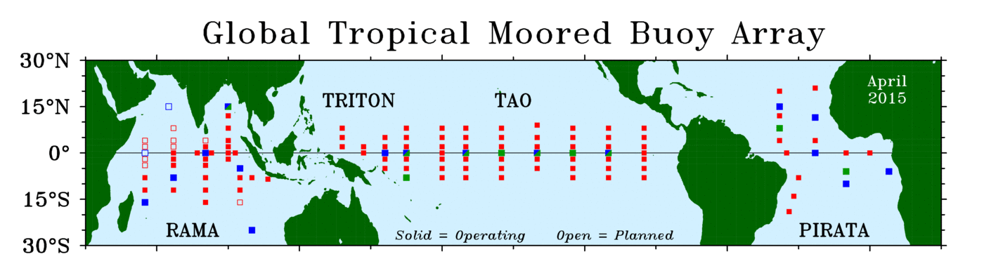
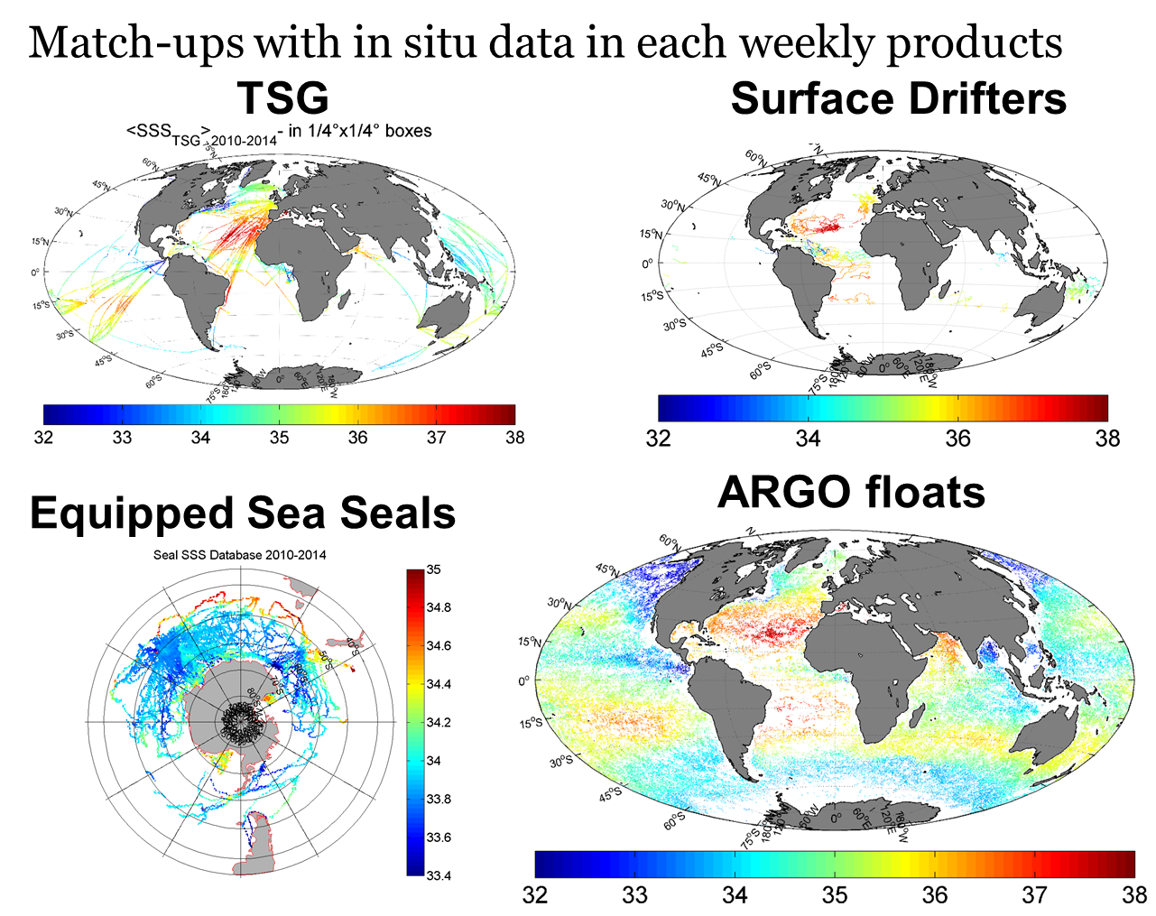
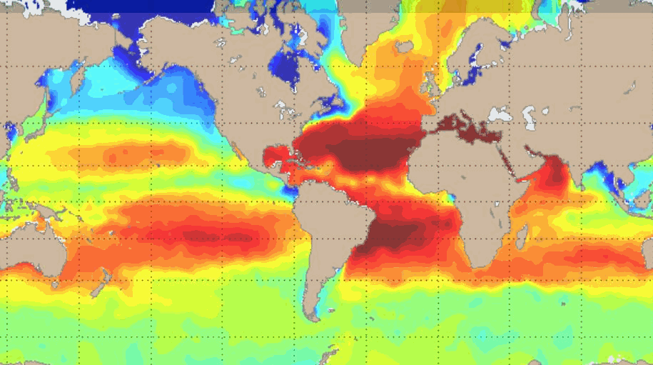
A collection of In Situ SSS validation datasets & approaches
A large ensemble of In situ SSS data distributed by different data centers can be used to infer SMOS SSS data product quality
ARGO float data (CORIOLIS)
Moored buoy Array (TAO,PIRATTA,TRITTON)
Thermo-Salinograph data installed on VOS (GOSUD, SAMOS)
research vessels & sailing ships
Surface Drifters (LOCEAN)
Equipped mamals (IFREMER)
Analysed in situ data fields
Dedicated Campaign (e.g. SPURS)
Moored buoy Array
Analyzed In Situ Data
=> These ins situ SSS data have different Quality Control (QC), horizontal, vertical & temporal sampling characteristics

Slide 6
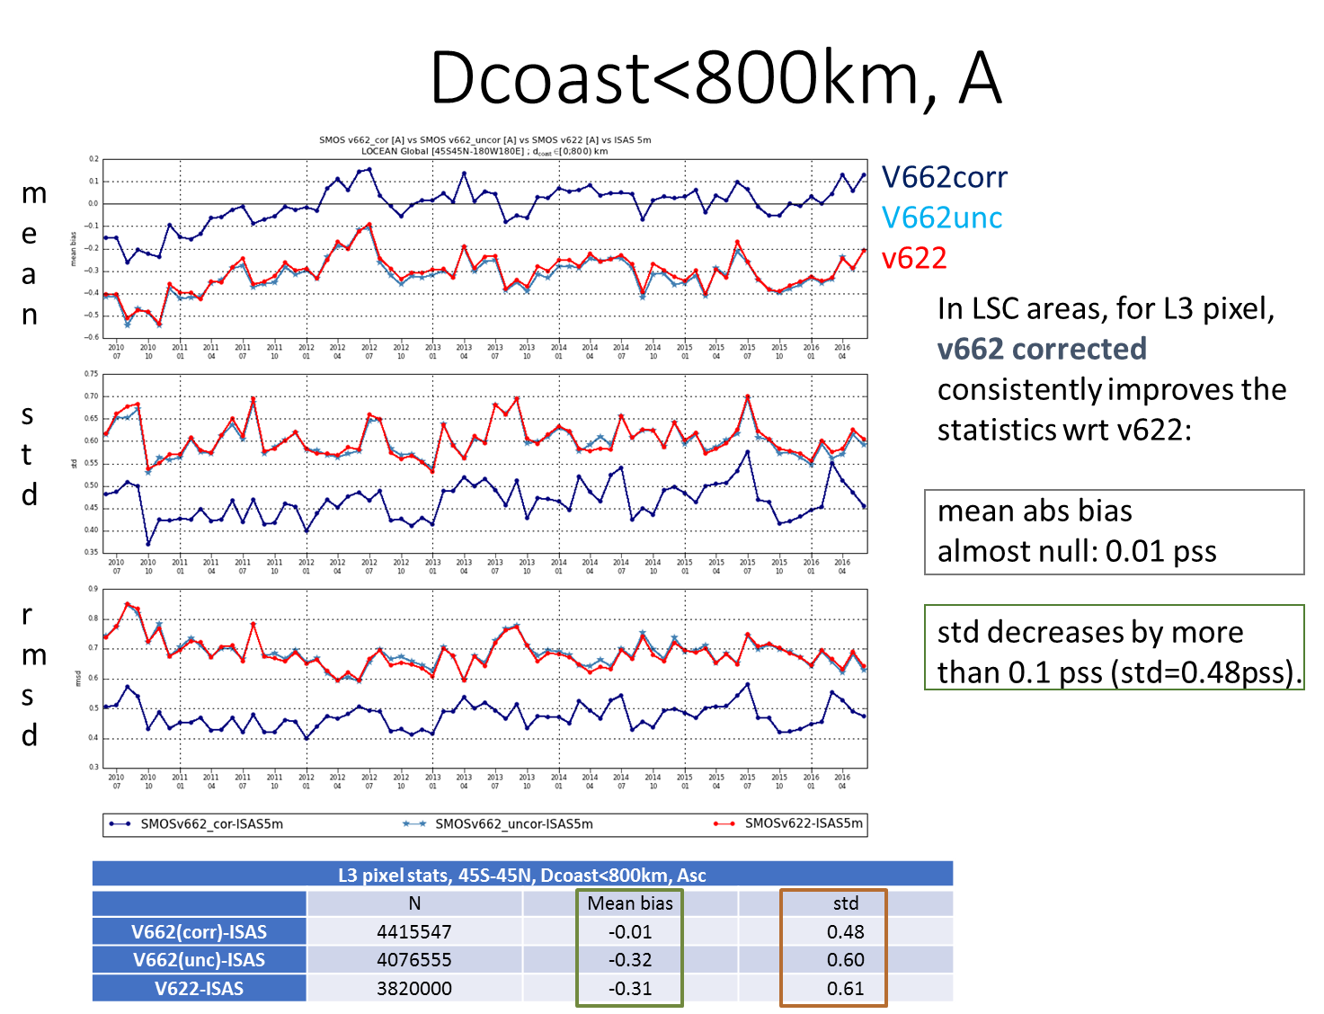
Cal/val In situ vs Satellite : a collection of possible metrics
Space & time averaging of SSS varies a lot between the different satellite SSS products available
How do we perform co-localisation in space/time
Between Satellite SSS and In Situ SSS ?
Which flags & QC for each products ?
Which Radius of co-localization ?
Which time lag is acceptable between satellite & in Situ SSS ?
product dependent metrics, consensus ?
Statistics
Regression coefficients
Root Mean Square Errors
Mean & Standard deviation
PDF statistics: higher order moments
Evolved analyses (spectral, EOF, hovmueller etc..)
Coherency analyses (correlation, multi-variate )
Temporal: swath data, 1 day, 7-days, 9-days, 10-days, monthly
Spatial: 15 km to 200kms

Slide 7
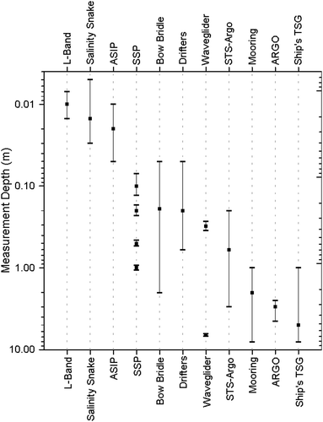
Cal/val SSS In situ vs Satellite
Sampling issues: Depth (i)
Calibration and validation of satellite-retrieved salinity is an ongoing process that requires comparison of satellite SSS values with spatially and temporally collocated in situ values.
There are two key differences between in situ & satellite SSS:
1) ≠ SSS Sampling Depths :
MW Satellite SSS is a measure of the SSS within the 1st cm
below the air-sea interface
In situ sensors usually sample SSS at differing (in general lower)
depths than satellite
=> In which condition can co-located in situ/satellite SSS be safely compared ?
Scale portraying the typical depth at which near-surface salinity is measured by various sensors/platforms. From Boutin et al., BAMS, 2016

Slide 8
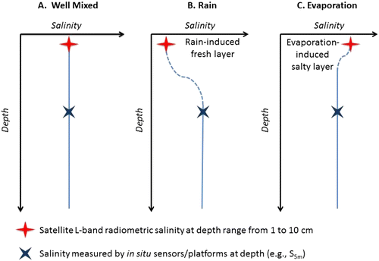
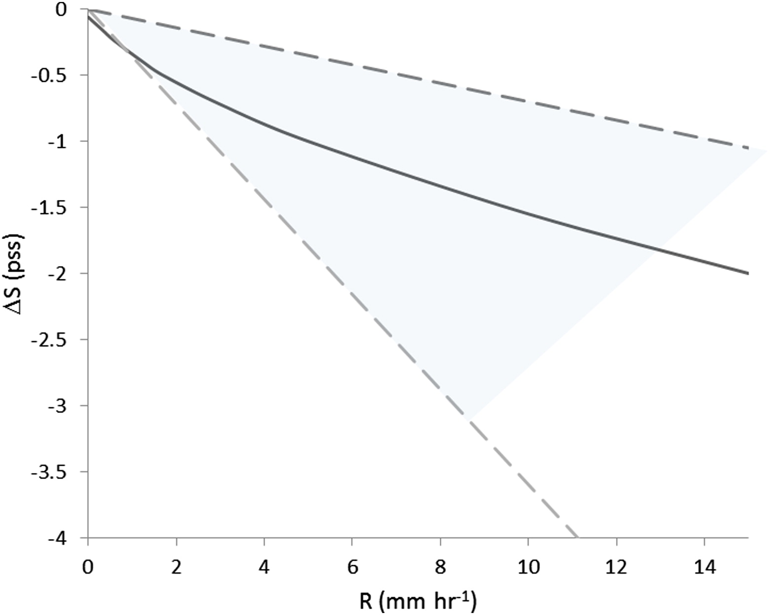
Cal/val In situ vs Satellite
Sampling issues: Depth (ii)
Rain effect:
Can be significant at low winds:
ΔSSS~0.15 pss/mm/h of rain
=> Need to obtain information on the history of Wind and Rain together with satellite/ In Situ match-up databases

Slide 9
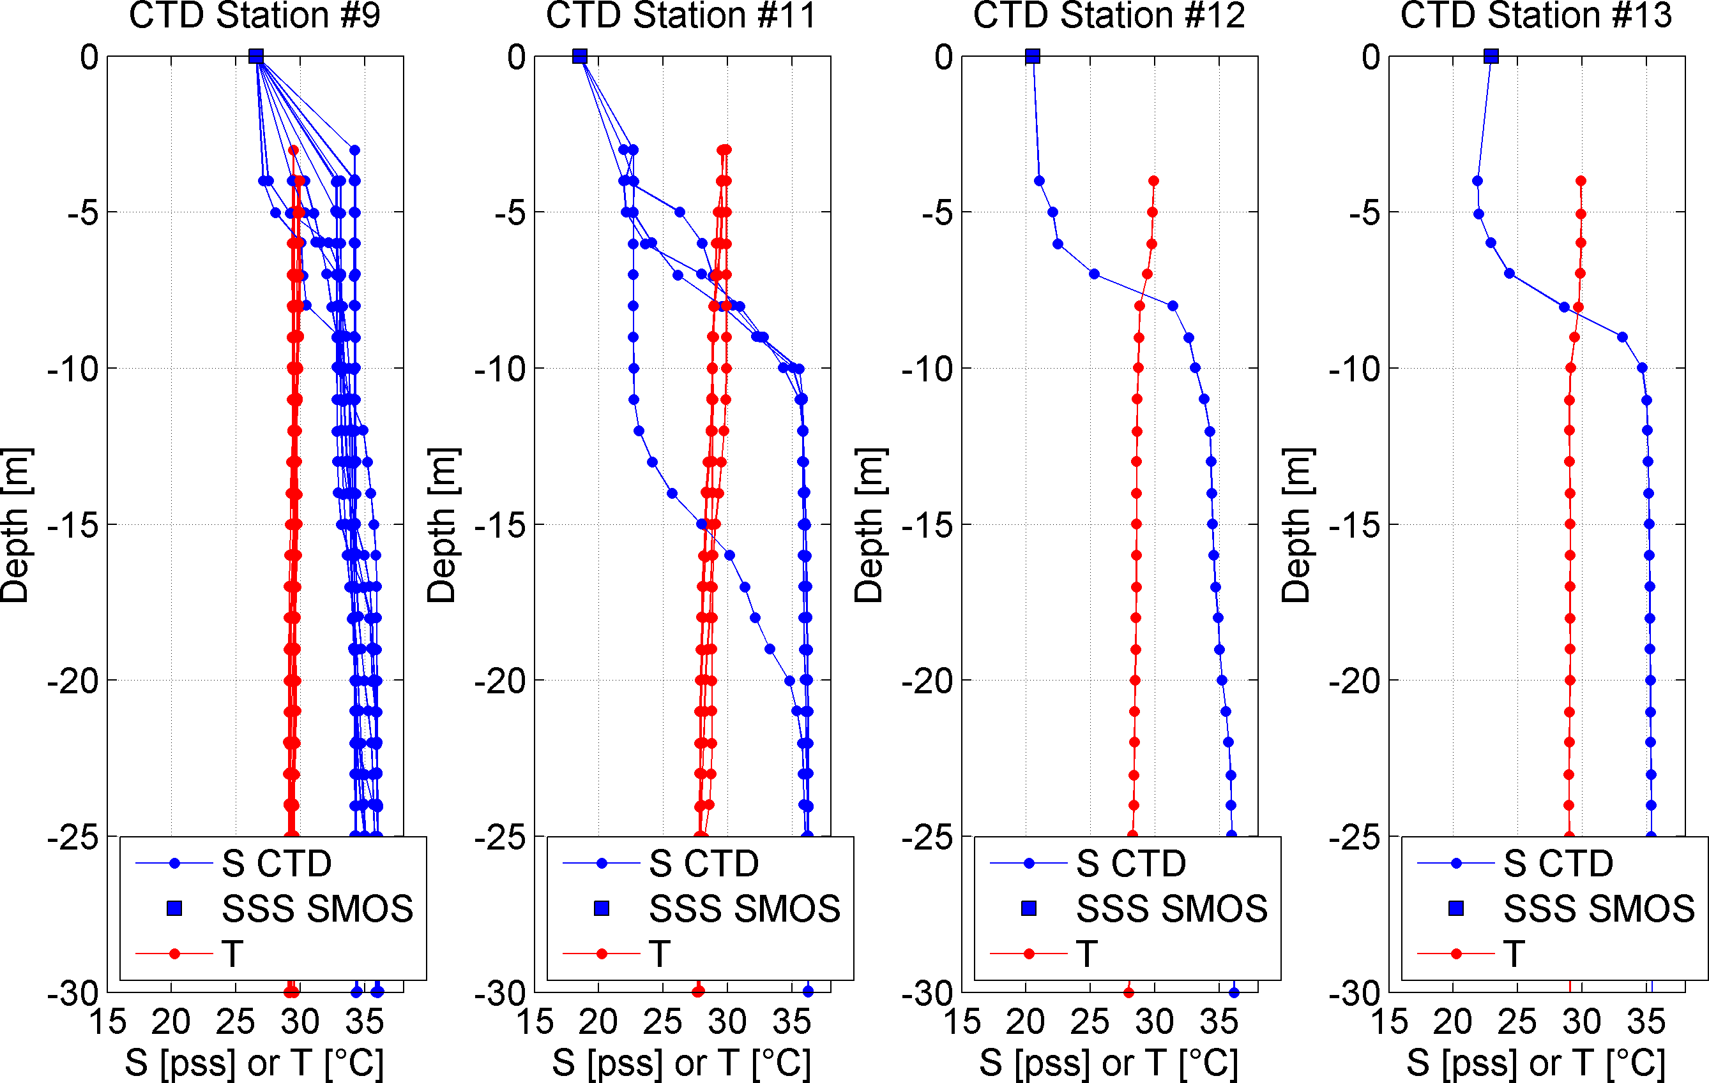
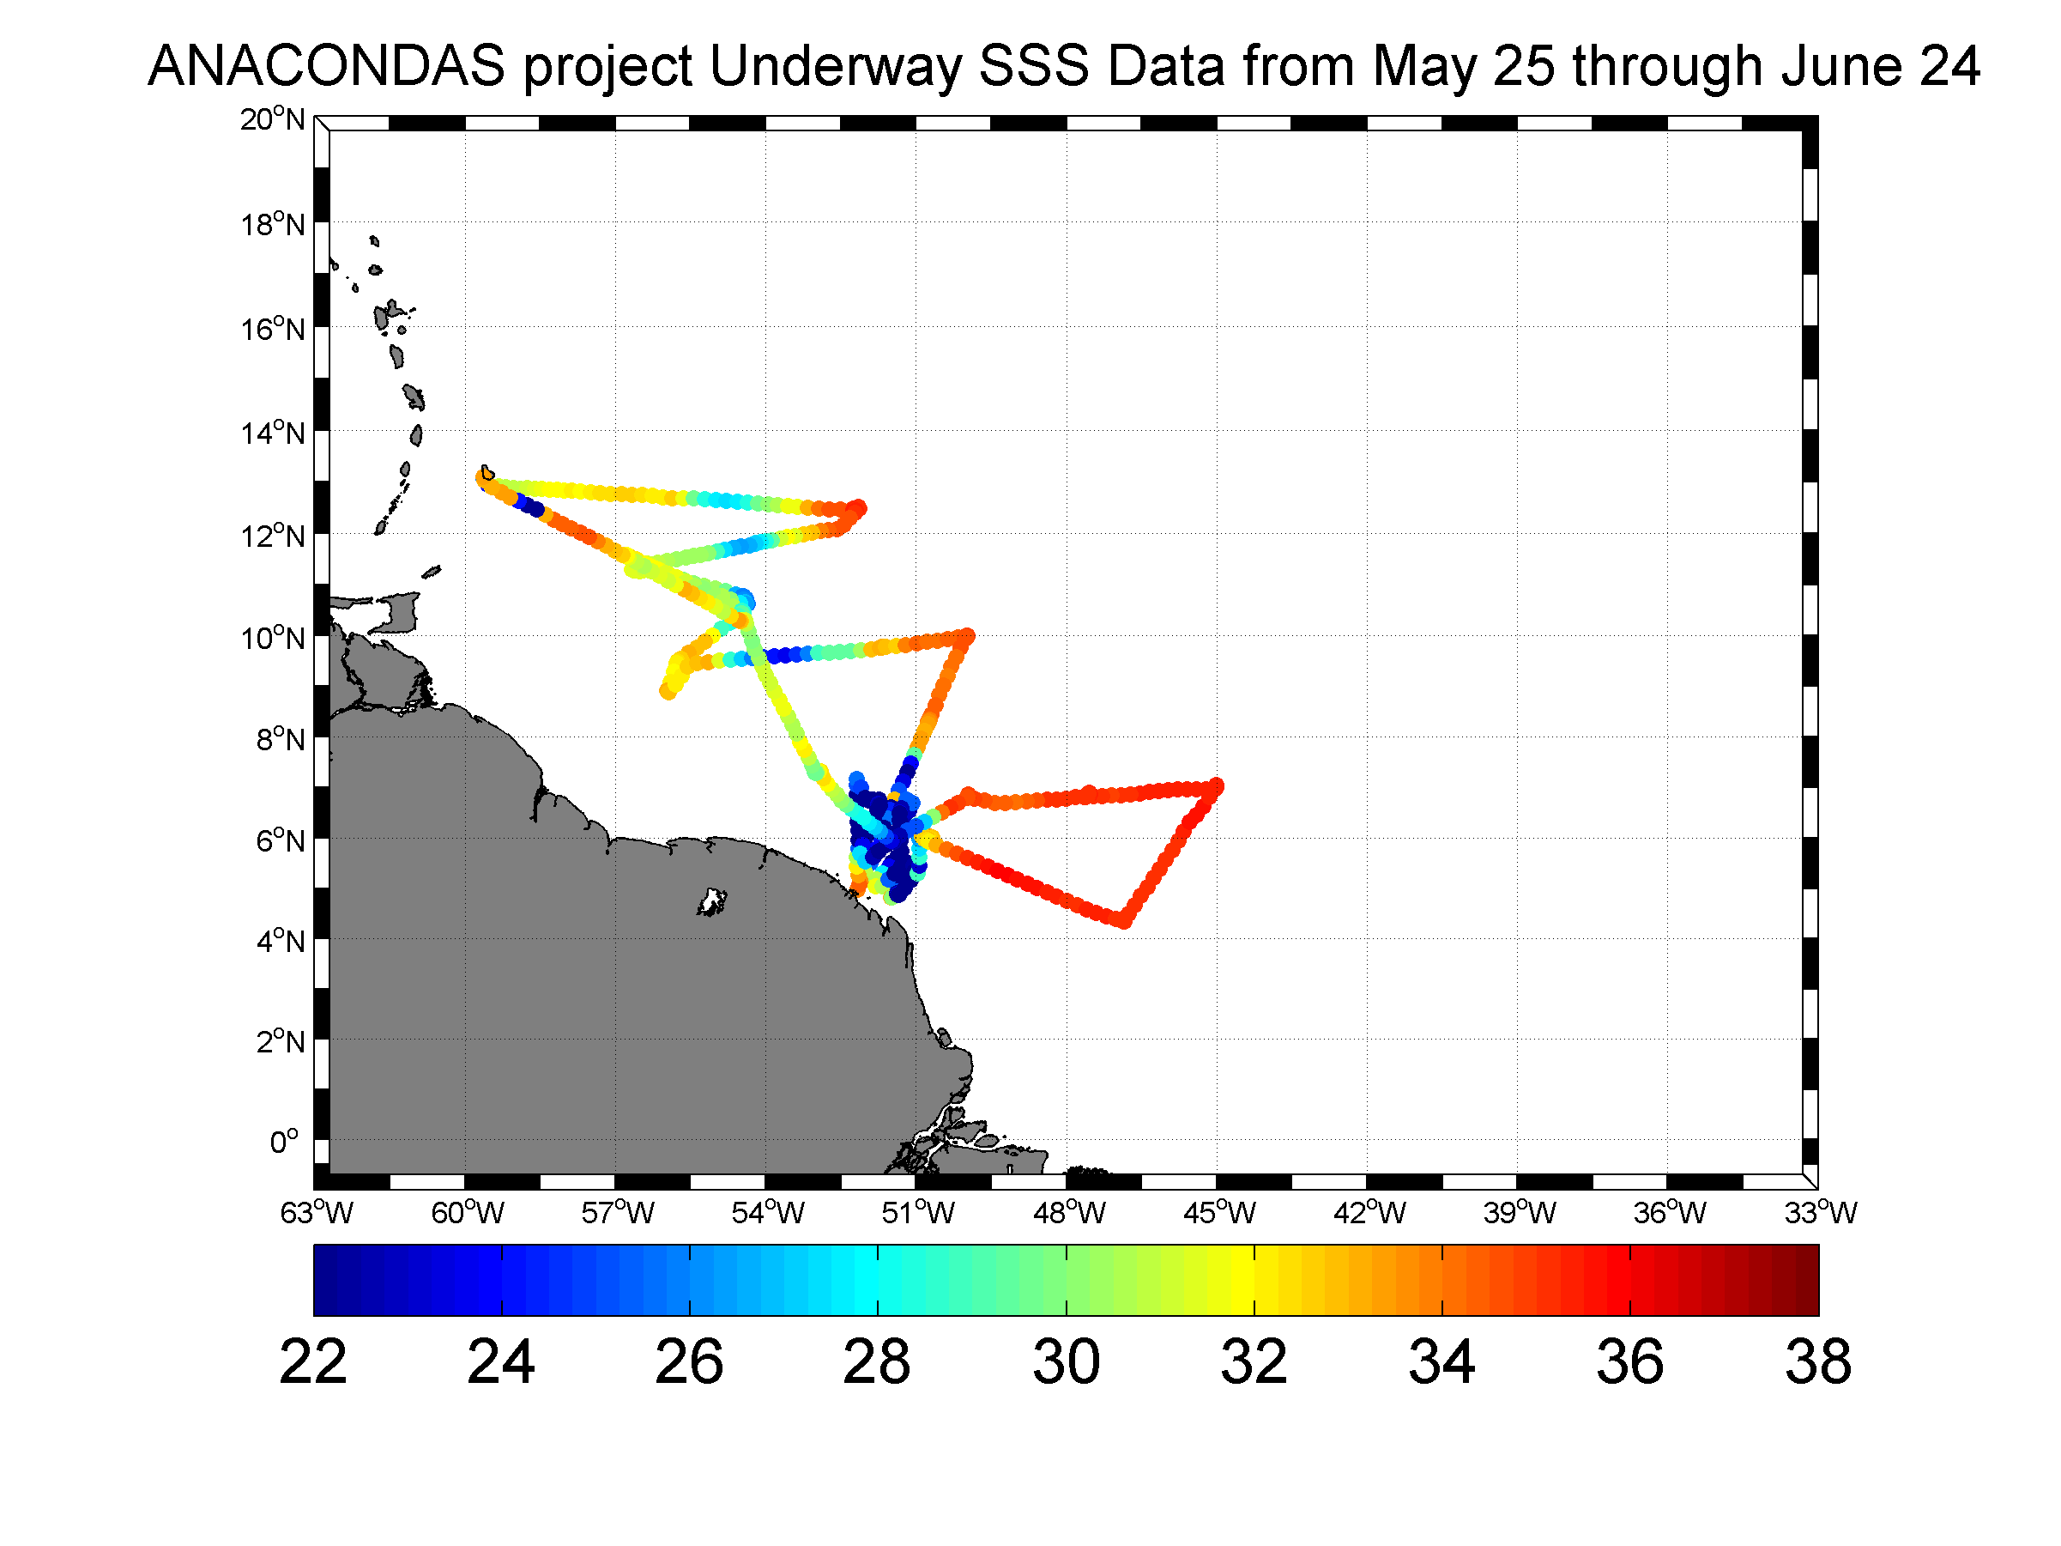
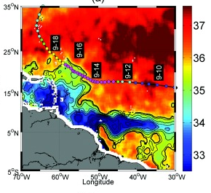
Cal/val In situ vs Satellite
Sampling issues: Depth issues in river plumes (ii)
River Plume effect:
As discussed for rain, near-surface vertical salinity gradients created by freshwater plumes can complicate the comparison of satellite and in situ salinity measurements, as seen with the 2–5 pss m−1 difference across the halocline shown by Lentz and Limeburner (1995) in the Amazon plume + tidal variations
=> Need to be considered when comparing satellite & In Situ SSS data in river plumes
Top left: 6hourly CTD profiles in the Amazon river Plume. Top right TSG
Sampling. Bottom :Plume thickness (y-axis in m) versus Salinity gradient
(x-axis)accross the halocline (pss/m) in the Amazon plume
River. Lenz & Limeburner, JGR, 1995

Slide 10
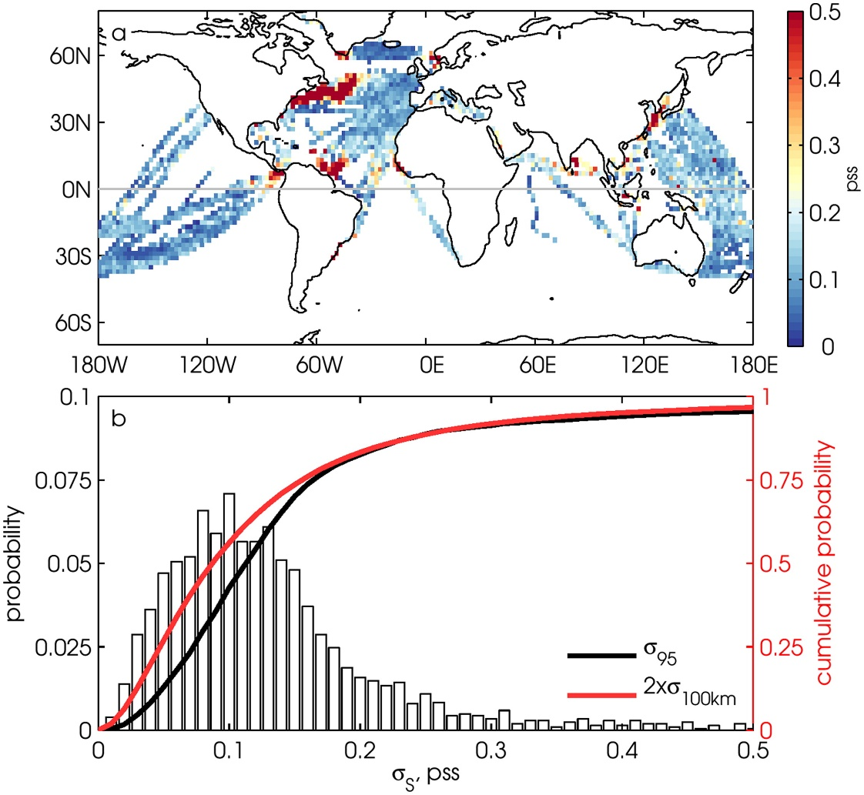
Cal/val In situ vs Satellite
Sampling issues: (ii) Horizontal variability
Ship SSS variability in a satellite pixel
Calibration and validation of satellite-retrieved salinity is an ongoing process that requires comparison of satellite SSS values with spatially and temporally collocated in situ values.
There are two key differences between in situ & satellite:
2) ≠ SSS horizontal Sampling :
Satelite SSS is a spatial average over ~40-100 km pixels
In situ measurements are either pointwise (ARGO, moorings)
Or provide High resolution horizontal sampling (TSG, drifters)
SSS variability within 1° × 1° bins can be as high as 0.2 pss near western boundary currents and in river outflow regions.
=> When comparing salinity data taken at a point to the spatially averaged value reported by satellite, the SSS variability within the satellite footprint (i.e., subfootprint variability) may need to be taken into consideration.
Figure . Analyses of TSG data obtained from the French quality-controlled TSG data set. Top shows the geographical distribution of s₉₅. Bootom shows the histogram of s_{100km} value and cumulative distributions of 2s_{100km} (red line), and s₉₅ (black line). Boutin et al, BAMS. (2015)

Slide 11
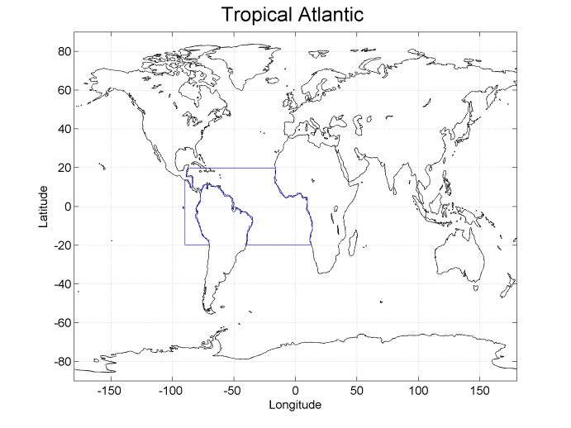
Cal/val In situ vs Satellite
Global versus regional statistics
Match-up database SMOS/In Situ can be derived
Globally
By Oceanographic Regions
How do we define those regions ?
Can we access the results on user-driven
Interfaces with dedicated extraction tools ?

Slide 12
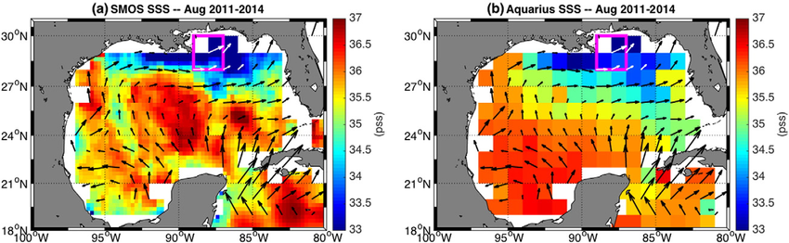
Validating SMOS SSS product using other EO datasets
1) Other L-band satellite SSS data
Aquarius & SMAP products
2) Ocean Circulation Model Data
3) Other EO data:
SST, currents, E-P etc…
What data shall be used ?
What consistency/coherency metrics shall be used ?
What systematic monitoring shall be performed ?
August composite (a) SMOS SSS and (b) Aquarius SSS overlaid with August composite OSCAR currents over 2011–2014. The magenta box denotes the mouth of the Mississippi River. Bottom: time series of SMOS (blue), Aquarius (black) and Hycom model SSS (red) at the mouth of the Mississipi river. Fournier et al., 2015

Slide 13
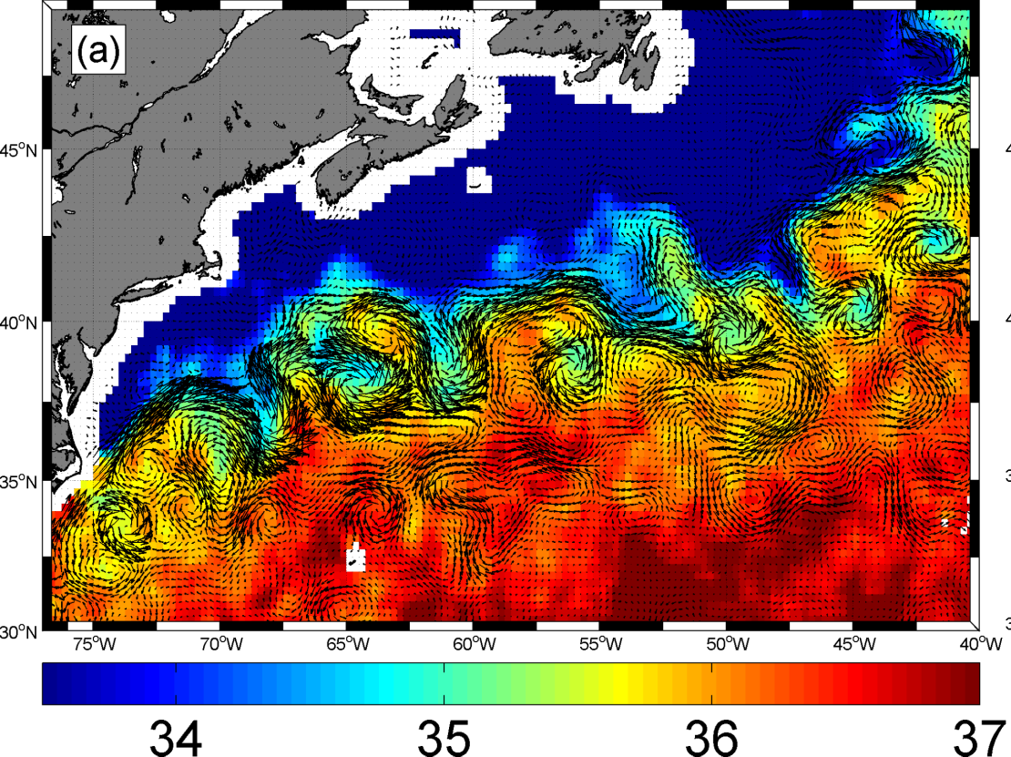
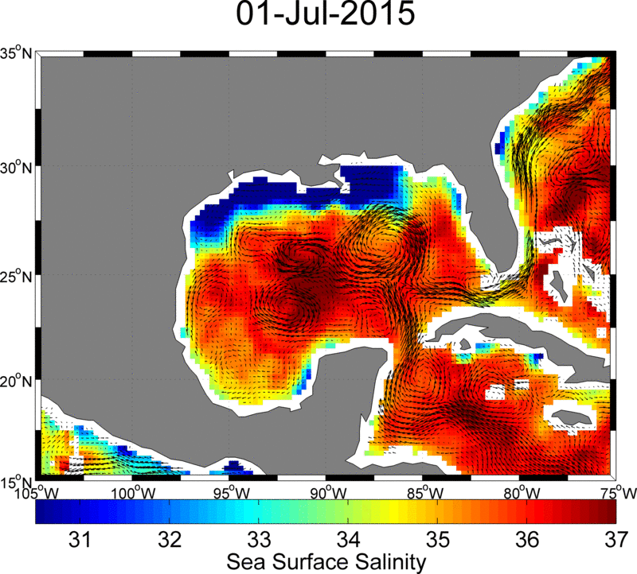
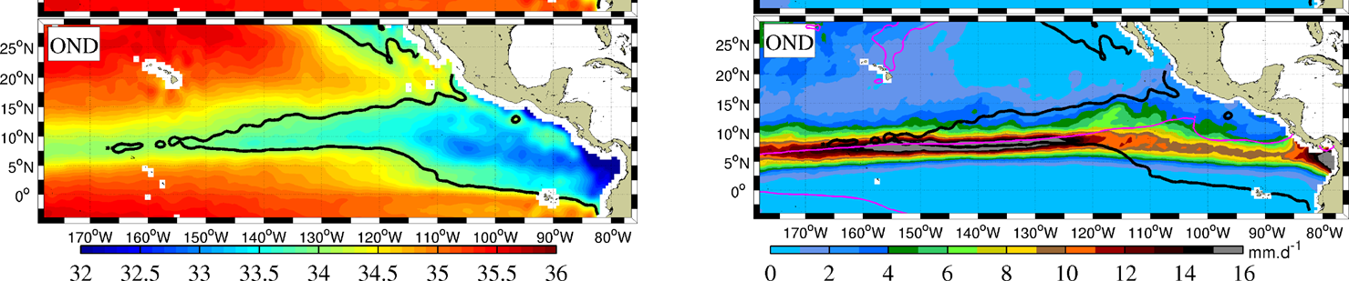
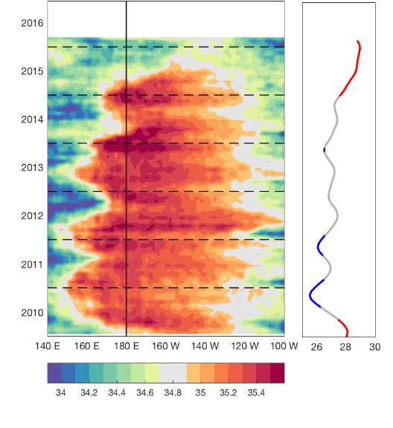
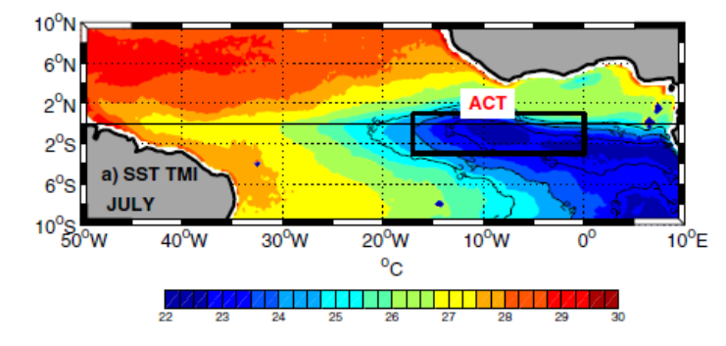
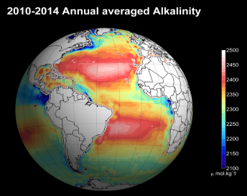
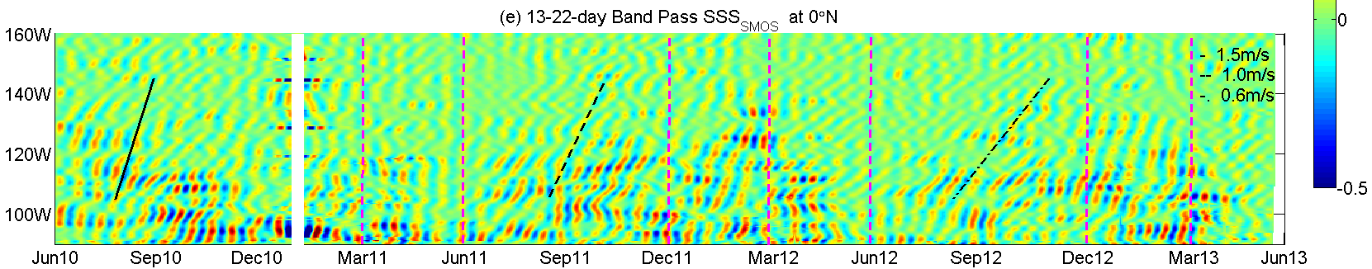
Systematic monitoring of
Specific process studies
Despite lower quality measurements than in situ data, published analyses on SMOS and the two other satellite SSS missions data have demonstrated clear capability of that new information to better help understanding/monitoring an ensemble of key oceanographic processes.
In the Pi-Mep, we will focus on several key of these processes to provide a regular monitoring facility, tools and associated products for these cases.
See dedicated presentation the afternoon by N. Reul

Slide 14
Summary of the SMOS Pilot Mission Exploitation Platform Objectives

Slide 15
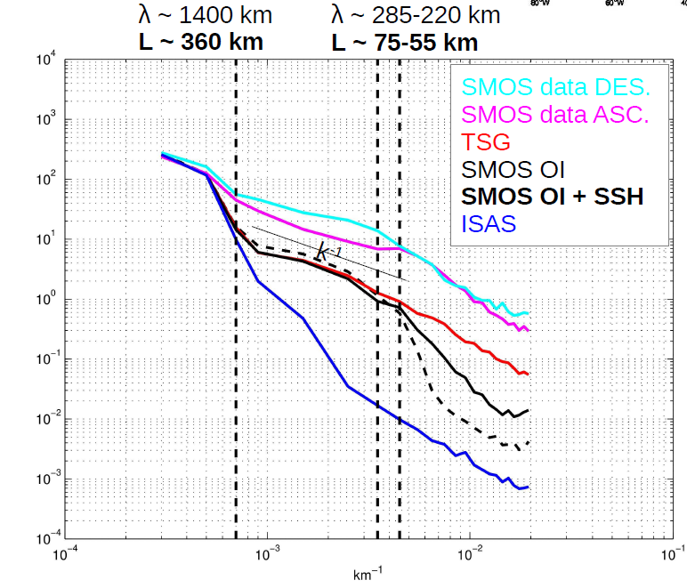
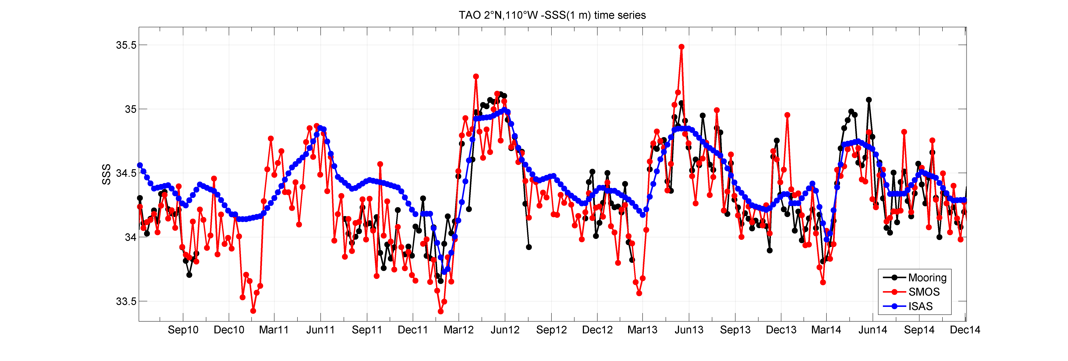
First Aims of Pi-MEP:
To perform a systematic monitoring of SMOS SSS data product quality (L2, L3 & L4)
comparaison of each product with in situ data (ARGO, TSG, moorings, drifters, others,..)
Match-Up Data Base products SMOS/in situ
intercomparsion between products:
-biais, rms diff, more evolved (e.g., spectral analyses, correlation with other variables, pdfs..)
-seasons, interannual, regional, global, …
Re-assess the results & intercomparaison between different reprocessings of the Mission datasets
Give access via a user interface of the match-up databases & statistics per products
Allow visualizations of the results & user-driven extractions
Moored buoy Array

Slide 16
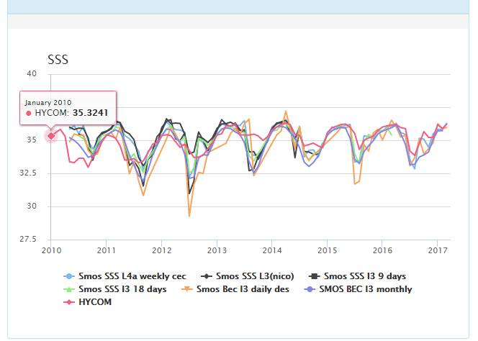
First Aims of Pi-MEP:
To perform a systematic intercomparison
in between SMOS SSS products
In between SMOS and other Satellite
SSS products
To provide enhanced satellite SSS
Validation/verification protocols:
spatial & temporal components (spectral)
Climate indicators (hovmueller, trends)
Correlation with other data sets
(SSS & SST, SSS & SLA, etc…)

Slide 17
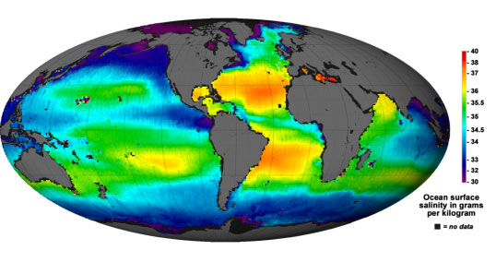
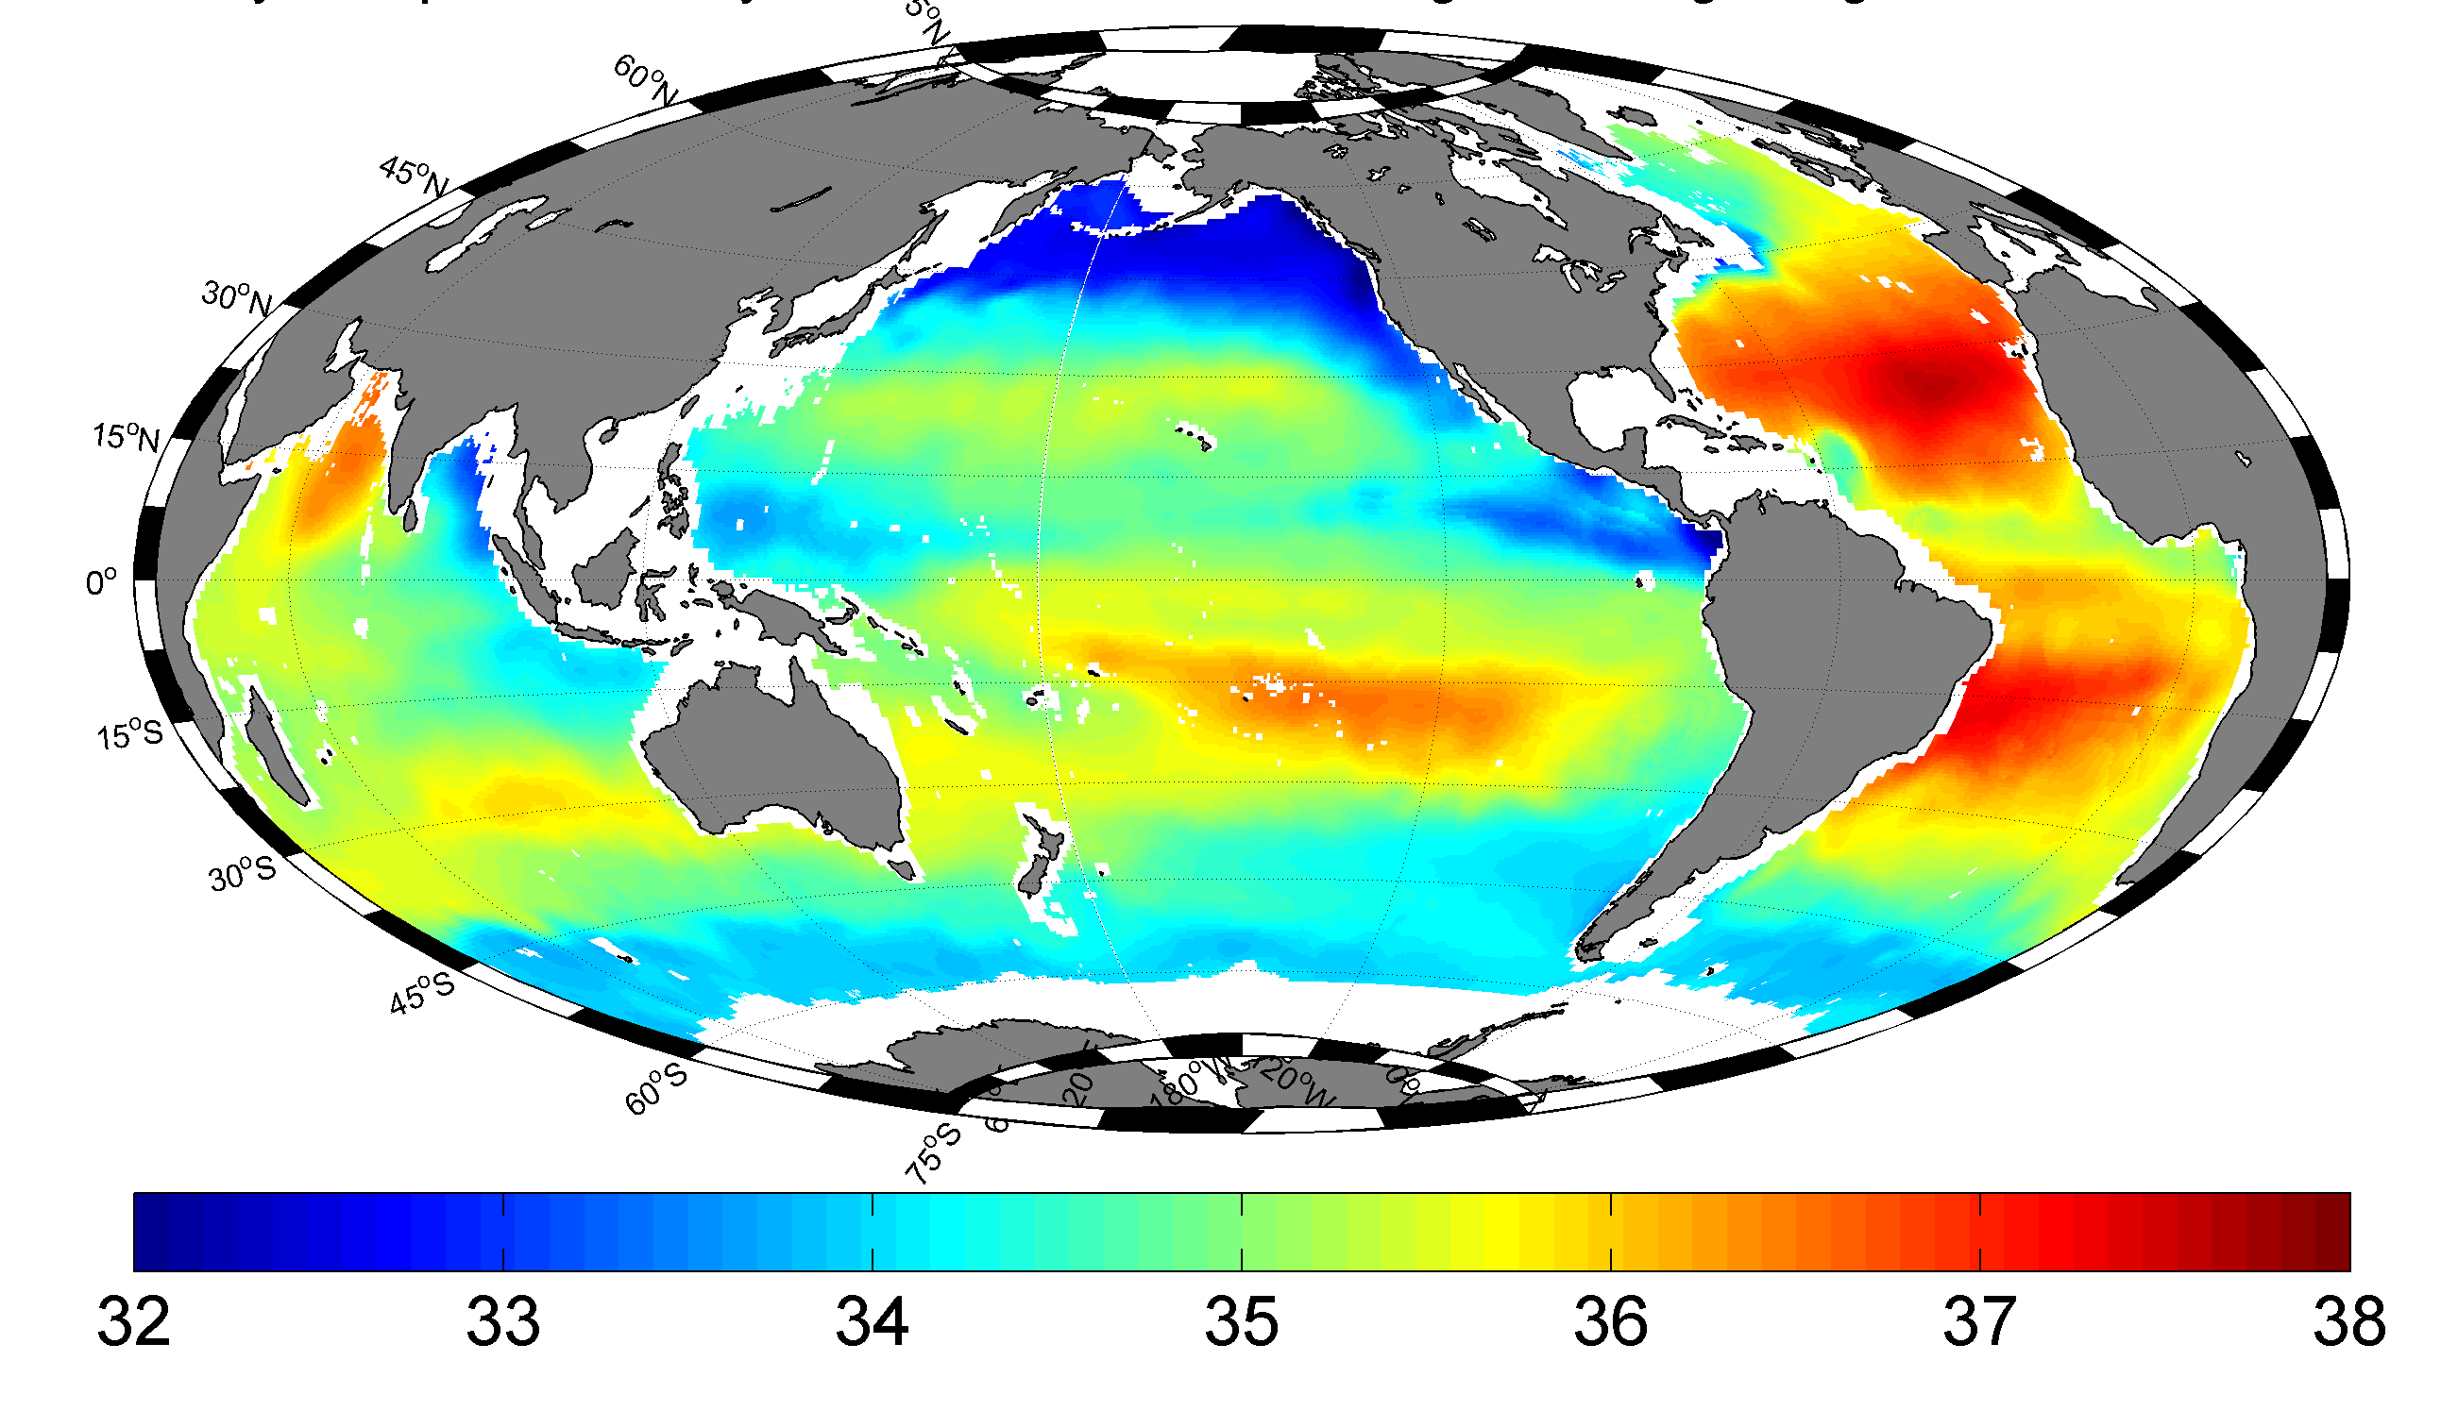
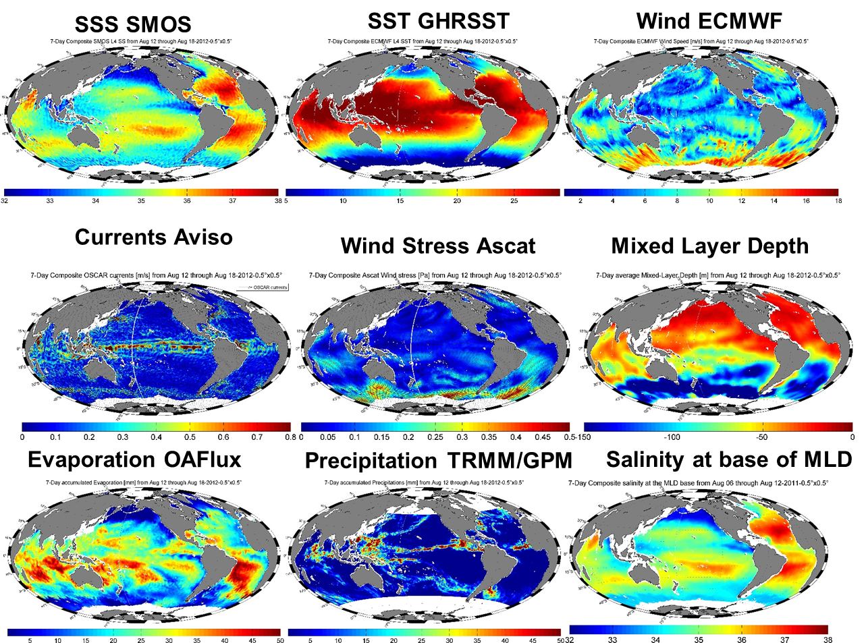
SSS Aquarius, SMAP
SSS In situ
Second Aims of the Pi-MEP
To be a thematic hub for the SMOS (SSS) mission
1) -Assembly & links with other satellite & in situ SSS:
Aquarius, SMAP (L2 à L4)
-In situ OI (ISAS)
2) Assembly & access
(re-gridding, same spatial & temporal resolution) of satellite SSS products with other thematic data:
-Precipitation
-Evaporation
-currents
-sea level anomalies
-sst
Etc etc..

Slide 18
The SMOS Pilot Mission Exploitation Platform
Team & Setup

Slide 19
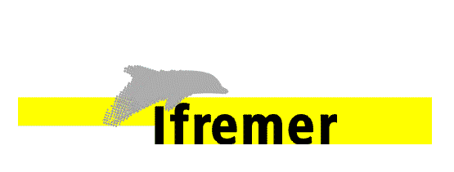

Project Set Up
Science Advisory Group
SAG
N. Reul
F. Paul
JF Piolle
F. Collard
S. Guimbard
S. Herledan
Consortium:

Slide 20
SAG Members Representativness
SMOS Level 2 ESL
SMOS Level 3 Expert Centers:
US Aquarius & SMAP
In Situ SSS
Pole Thematique Océan
Model & Assimilation
Water Cycle Specialists:
Ocean Circulation specialists:
Tropical Oceanography :
High latitude
Bio-geochimist
Meteo
Big Satellite Data Centers

Slide 21
The SMOS Pilot Mission Exploitation Platform
Project Time Table

Slide 22
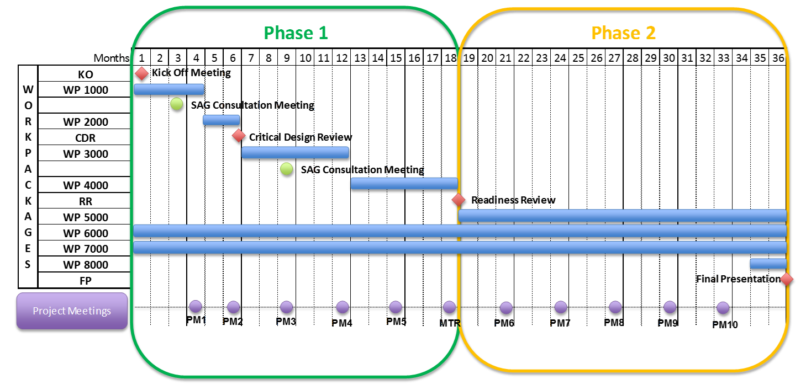
June 2018
Janv 2017
Dec 2019
The duration of the project is 36 months from Kick-Off (1st January 2017) to the Final Report delivery. The project timetable is splitted in two parts :
- Phase 1 : Definition, implementation and pre-operations of Pi-MEP salinity (Tasks 1,.2,.3, 4, 6 and 7).
Duration : 18 months- Jan 2017->June 2018
- Phase 2 : Operations of the PI-MEP salinity (Tasks 5, 6, 7 and 8)
Duration : 18 months: June 2018->Dec 2019
Operations and maintenance activities could be continue after the first 36 months, for a further period length of 24 months upon ESA decision.

Slide 23
Work Package Description | WP 1100
Title: User consultation
Objectives
Select a Science Advisory Group (SAG) for the Pi-MEP Establish a user consultation to help defining the requirements baseline for the Pi-MEP
Inputs • A list of potential SAG members • A first iteration by the project members of the Pi-MEP objectives, content and facilities to be presented and discussed during the SAG workshop
Activities
set-up a Scientific Advisory Group (SAG) Write up a survey document on the Pi-MEP to be submitted to the SAG organize a workshop during which the project will present the Pi-MEP concept to the SAG Define in agreement with the SAG the possible scenari for -The Pi-MEP required data sets - The systematic and user-driven data processings -The tools and expectation of the user community in terms of Pi-MEP outcomes.
WP1000:
Definition of Requirement Baseline for the Pi-MEP
[NRITP091]Cela ne prends en compte que les heures IFR. A rajouter celles d’ODL
SAG meeting #1: May 3rd, 2017, ESA-ESTEC
SAG meeting #2: end 2017

Slide 24
The SMOS Pilot Mission Exploitation Platform
Infra-structure & tools

Slide 25
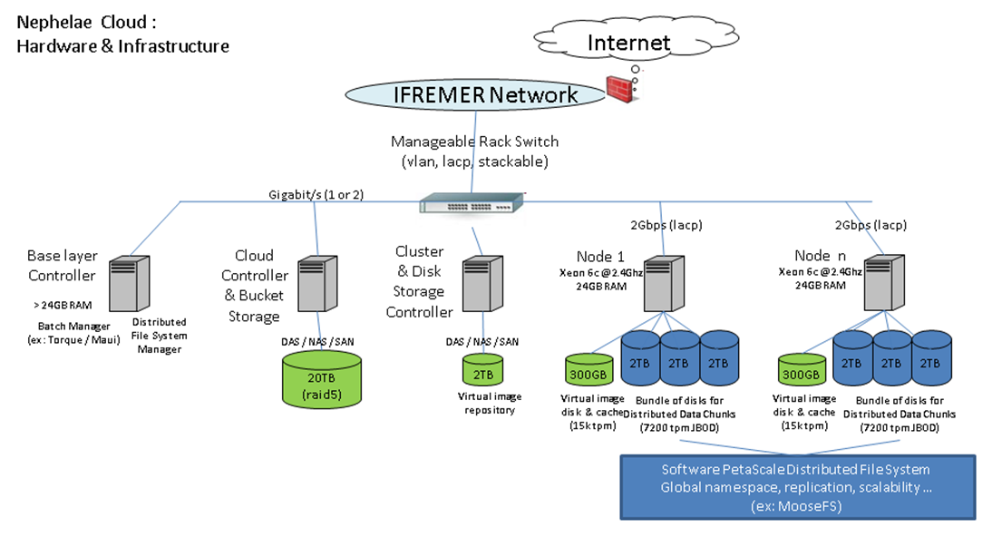
The SMOS Pi-MeP ICT used for Developements
There are 2 ICT Infrastructures that will be used for the Pi-MEP :
1) Pi-MeP Operation on DATARMOR
Developments will be done on the experimental Nephelae platform at IFREMER/CERSAT. An ICT based on "big data“ technologies
storage disks (3 * 2TB) are attached to each processing node (about 20 in total)
+300 GB of fast disk for server image and workspaces.
Dedicated nodes to manage the control and execution of virtual machines, or to host common services (typically job schedulers and management services for the distributed file system).
Physically, the platform is based on a dozen servers, each one having a good processing and large storage capacity with gigabit network connection. More precisely, Dell R510 servers with 2*CPU Intel Xeon 6core (X5650 @2.67GHz) - 24Go RAM - 10*2To disk with raid5 controller and Ubuntu Operating System were used.

Slide 26
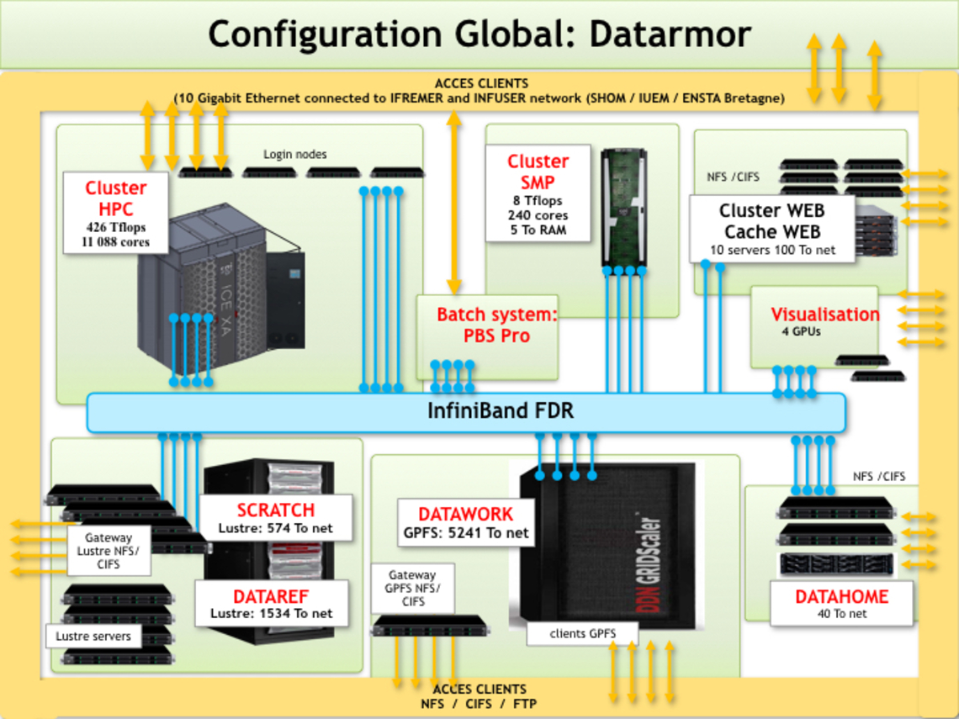
The SMOS Pi-MeP ICT : ICT for operational Implementation
2) Pi-MeP Operation on DATARMOR
Migration of Nephelae toward a mutualized ICT at IFREMER called DATARMOR: will be the ICT where
the PI-MEP will be operated:
Cluster HPC : 11088 cores - 426 Tflops
  O 128 Go of RAM & 28 core per nodes
Cluster SMP : 240 cores, 5 To RAM
Cluster WEB : 10 dédicated servers
Visualisation : 4 GPUs
Data storage
High performance dedicated to HPC : 0,5 Po in Lustre (SCRATCH)
Reference Data : 1,5 Po in Lustre (DATAREF)
Working Datal : 5 Po in GPFS (DATAWORK)
Home directories : 40 To in NFS (DATAHOME)
Web services & others : 100 To

Slide 27
The SMOS Pi-MeP ICT tools
The ICT can run C compiled matlab codes
In addition to its general infrastructure, the ICT hosted platforms are able to run a series of visualization, access, colocation and analysis tools such as :
✓ Naiad tool (http://naiad.ifremer.fr/): satellite data indexing/search/selection tool
✓ Felyx (http://felyx.org): ESA funded analytics tool to analyse and intercompare large collection of EO datasets
✓ Datavore : rapid overview of data and access to precomputed statistics
✓ Datalaps: Data evolution over time
✓ Datacrunch: Compute quickly usual statistics over massive datasets
✓ Merginator: a tool to intercompare multiple datasets
✓ Syntool Web : integrated access and mutlidimensional intercomparison of EO, in-situ and model data.
✓ Jupyter ipython Notebooks : interactive analysis of data on a distant server via a web browser.

Slide 28
Back-Up slides

Slide 29
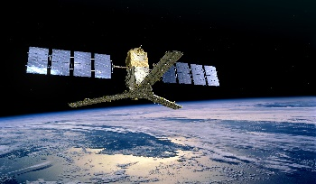
A collection of SMOS SSS data products
Operational Products :
10 d, 1 month, asc/desc/both
25km,50km, 100 km, 200 km
CNES/IFREMER
CATDS
Research Products
CEC-LOCEAN L3 debiased ¼°, 9 d, 18d
CEC-IFREMER L3 ¼°,1/2°,1°, 1d, 10d, monthly
CEC-IFREMER L4, 1/2°, weekly
ESA DPGS
SMOS Level 1 (Tb) +L2 (SSS):
Operational
+ reprocessing SSS products
End USERS
???
SMOS BEC L3 ¼°, 1 d, monthly
SMOS BEC L3 OA, ¼°,9days
SMOS BEC L4 FUSION, 0.05°, 9 days
SMOS BEC OA ARCTIC ¼°,9 days
SMOS BEC OA MED ¼°, 9days
SMOS BEC FUSED MED ¼°, 1d
CDTI
BEC
Hamburg
Univ
SMOS ICDC L3 1°, monthly

Slide 30
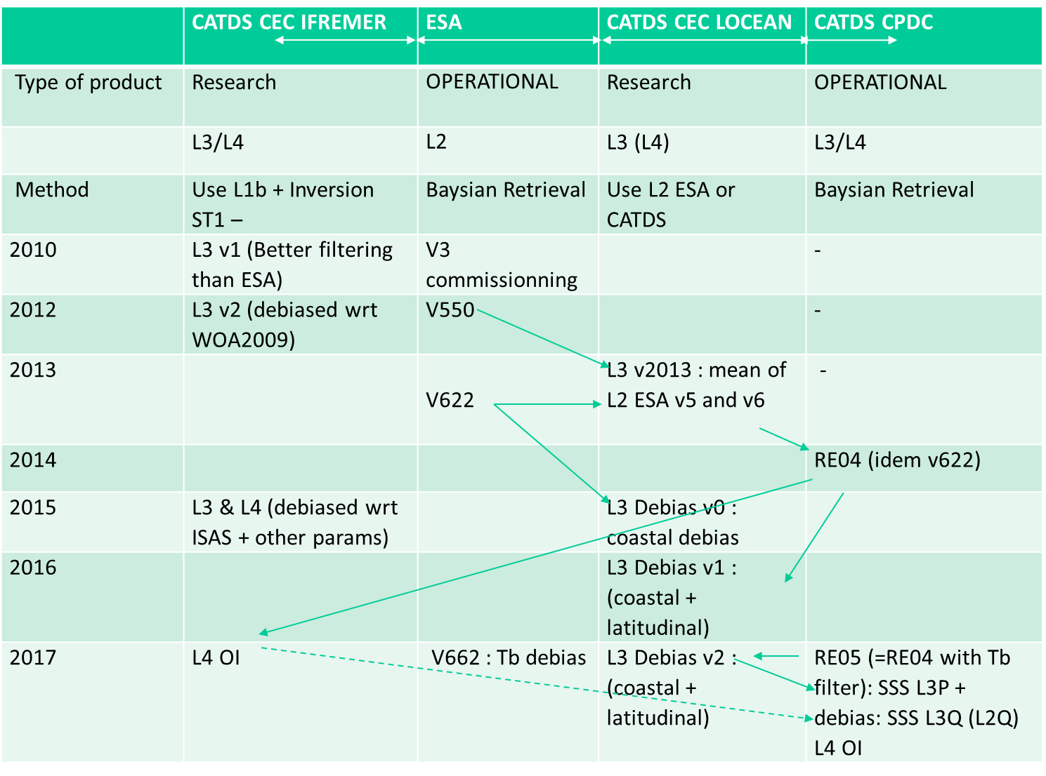
A collection of SMOS SSS data products
=
A collection of successive developments& differing algorithms
Courtesy: J. Boutin/LOCEAN
Here: example for the CATDS products, versions and algorithmic developements: we need systelatic intercomparison metrics !

Slide 31

Pi-Mep & Pôle Océan data portal
The Pôle Océan is one of the four french national portals created for French research institutes for coordinated management and centralised access to data. The other portals are Solid Earth, Continental surfaces and Atmosphere.
Each data portal seeks to facilitate access to satellite, airborne and in situ data acquired and handled by research laboratories or consortiums, by national infrastructures such as the National Observation Services (SNO), SOERE, research vessels, airplanes and space missions.
IFREMER is in charge of the implementation and coordination of the Ocean data portal. The main mission of this data centre is to provide data, software products, tools and/or services intended mainly for the French scientific community to carry out studies on the characterisation and evolution of the ocean as well as understanding its processes.
This data centre will likely include the Pi Mep portal for SMOS SSS

